Slide 1
Click Training
Safety Module
University at Buffalo
Office of the Vice President for Research and Economic Development
Electronic Research Administration (eRA)

Slide 2
HELLO
my name is
Dave Pawlowski
Biosafety Officer
drp@buffalo.edu
Marla Witkowski
PACS Campus Training Program Coordinator
mlw9@buffalo.edu

Slide 3
Safety Module
Background
The Pre-Award and Compliance System (PACS) is a multi-year collaborative project to implement the online Click Portal
The Click Portal is being implemented to assist principal investigators, students, compliance and research administration staff with administering sponsored programs
UB is leading the implementation of the Click Portal, working in collaboration with our vendor partner, Huron, and the PACS Leadership Team.

Slide 4
Safety Module
Training Materials
Click Portal – Safety Module Training Setup
Click Portal - Safety Module Training Agenda
Click Portal - Safety Module Training Exercises
Sample Safety Protocol
Work Instructions:
  Safety Protocol Workflow
  Create and Submit a Safety Protocol
  Clarification Requested and/or Reviewer Notes
  Create and Submit a Follow-On Submission

Slide 5
Safety Module
Course Objectives
Provide principal investigators, study staff, compliance and research administration staff an overview of the Safety module
Demonstrate how to:
  Create a Safety protocol and submit it for review
  Manage the Safety review process
  Create and convene Safety committee meetings
  Communicate the committee’s decision to the study team
Allow the participants to practice with hands-on exercises
Provide training materials and references that will provide assistance while using the Safety module

Slide 6
Roles and Workflow
Click Safety Module
Roles and Workflow

Slide 7
Roles and Workflow
Safety User Roles and Responsibilities
Protocol Team - Individuals responsible for developing and editing the protocol. Includes PIs and their contacts, and other study staff.
Safety Administrators - Individuals who guide submissions through the review process. Includes Safety Specialists and Safety Administrators. Committee Administrators oversee committees and meetings.
Reviewers - Individuals responsible for reviewing protocols. Includes Biosafety Officers, Safety Committee Members, and the Committee Chair. Some protocols may also require an optional review by an Ancillary Reviewer.

Slide 8

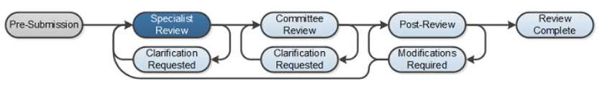
Roles and Workflow
Safety workflow
Pre-Submission: During Pre-Submission, the PI will create the Safety protocol
Specialist Review: In the Specialist Review state, the protocol has been submitted and is reviewed by the Safety Specialist

Slide 9
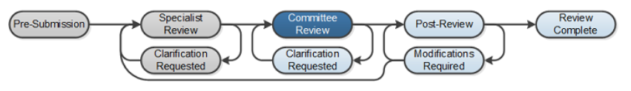
Roles and Workflow
Safety workflow
Committee Review: In Committee Review, the Safety committee members will review the protocol for completeness
Clarification Requested: The Safety Specialist and/or Safety Committee members may send a Request for Clarification during the Specialist and Committee Review states. This will send the protocol into the Clarification Requested state until the PI has responded to the request.

Slide 10
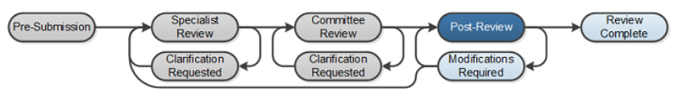
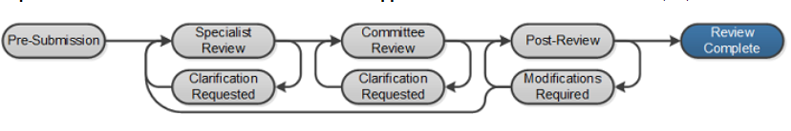
Roles and Workflow
Safety workflow
Post-Review: The Post-Review state gives the Safety staff an opportunity to approve any attached documents, request any modifications, and prepare and send the determination letter
Review Complete: The Safety protocol will reach its final state, Review Complete, after the approval letter is sent

Slide 11
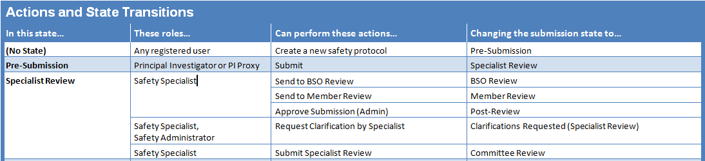
Roles and Workflow
Key Actions by Role
Notes:
Different roles perform different actions when a protocol is in a particular state. Some actions move the submission to another state.
For a listing of actions that cause the protocol to move to a new state, refer to the State Actions and State Transitions table in the Safety Staff Guide.
For example, after a PI submits a Safety Protocol for review, it moves to Specialist Review. In this state, the Safety Specialist can send it for a BSO or member review, approve it administratively, etc.

Slide 12
navigation
Click Safety Module
Navigation

Slide 13
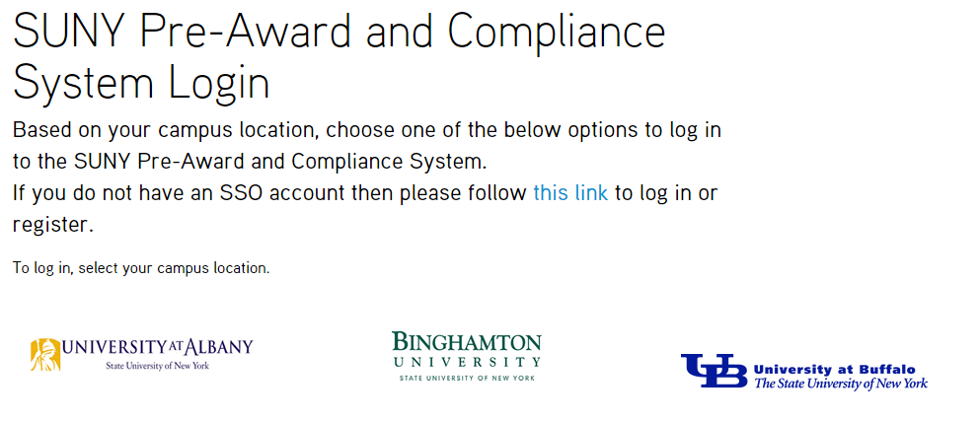
Navigation
Click Safety Module – Training Website
Navigate to http://pacsstg1.rfsuny.org
Locate the heading ‘SUNY Pre-Award and Compliance System Login’
Click on the words ‘this link’
Enter a User Name and Password, and click the Login button.
Click Training Website

Slide 14
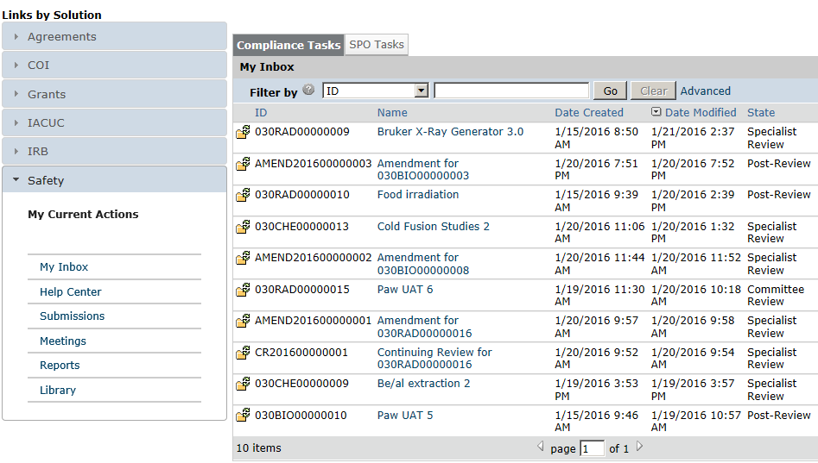
Navigation
My Inbox
1
From My Inbox, you will see:
Submissions that require action
State in the review process
Shortcut to user guides
Shortcut to view all submissions
Shortcut to meetings
Shortcut to procedures, worksheets, checklists, and templates
2
3
4
5
6

Slide 15
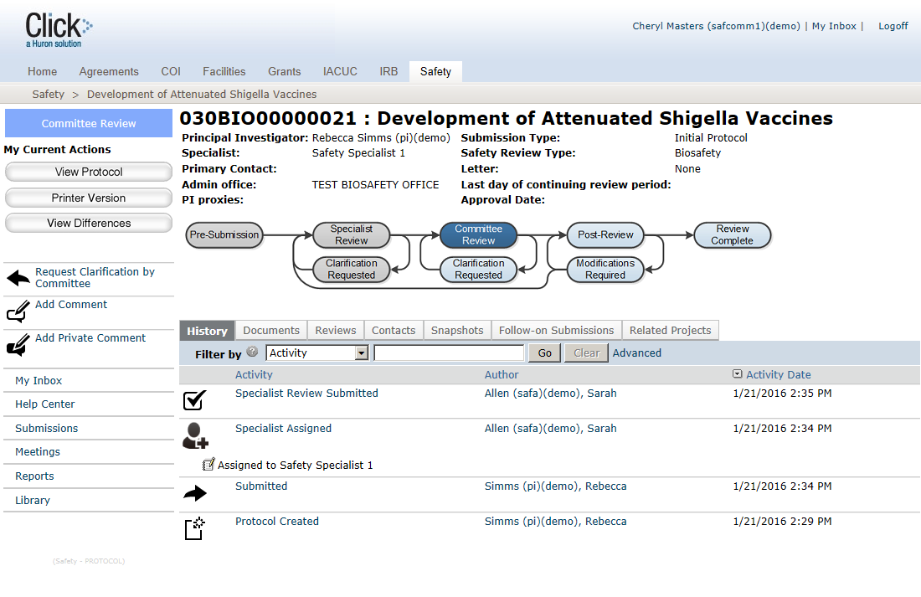
Navigation
Safety Protocol Workspace
From the protocol workspace, you will see:
Protocol details
The state in the review process
Actions you can take in
the protocol’s state
Tabs with information about the protocol and the review process
1
2
3
4

Slide 16
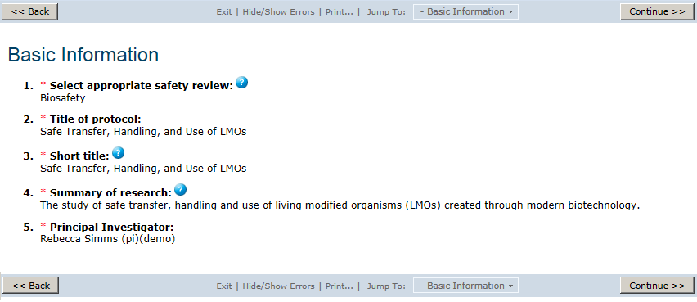
Navigation
Safety Protocol SmartForm Pages
3
1
2
On the protocol pages, you
will see:
Required fields (*)
Field help ( )
Navigation bar
?

Slide 17
Navigation Exercises
Perform the following training exercises:
Exercise 1: Log into the Click Safety Module
Exercise 2: Explore the Inbox
Exercise 3: Explore the Protocol Workspace
Exercise 4: Explore the SmartForm Pages

Slide 18
Pre-Submission
Click Safety Module
Pre-Submission

Slide 19
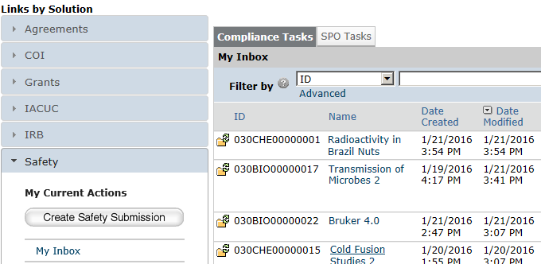
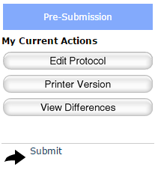
Pre-Submission
Pre-Submission Activities
The PI will :
Create the Safety protocol and complete the protocol SmartForm pages
Submit the protocol for review
1
2

Slide 20
Pre-Submission
What to Expect After Submitting
Submitting your protocol initiates a series of activities that may include:
  Review by Safety Specialist
  Review by a Safety committee
  Optional ancillary review by individuals, departments, and other organizations
  Communication of the committee’s decision to the investigator
Any of these may lead to a request for the study team to take further action, such as providing clarifications regarding the protocol
Whenever the study team needs to act, the PI receives an e-mail notification, and the protocol appears in My Inbox for all study team members when they log in to the Click Portal

Slide 21
Pre-Submission Exercises
Perform the following training exercises:
Exercise 5: Create a Safety Protocol
Exercise 6: Assign Additional Staff to a Protocol
Exercise 7: Submit a Protocol to Specialist Review

Slide 22
Specialist Review
Click Safety Module
Specialist Review

Slide 23
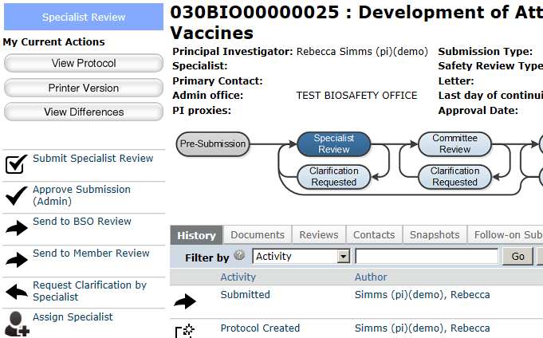
Specialist Review
Specialist Review Activities
The Safety Administrator will:
Assign a Safety Specialist
1

Slide 24
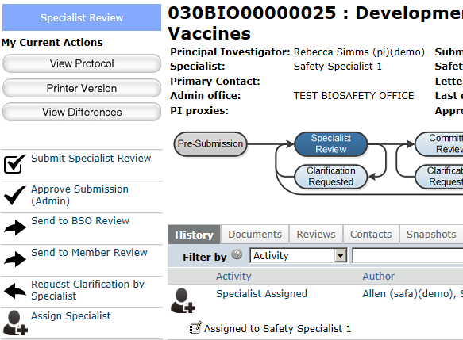
Specialist Review
The assigned Safety Specialist will:
Review the protocol and determine which reviews are needed:
  BSO Review
  Member Review
  Committee Review (via Submit Specialist Review)
Request clarifications from the PI as needed
Administratively approve a protocol, if applicable
Specialist Review Activities
1c
3
1a
1b
2

Slide 25
Specialist Review Exercises
Perform the following training exercises:
Exercise 8: Assign a Specialist
Exercise 9: Add Reviewer Notes and Request Clarifications
Exercise 10: Respond to a Reviewer Request
Exercise 11: Approve a Protocol Administratively

Slide 26
BSO Review
Click Safety Module
BSO Review

Slide 27
BSO Review
BSO Review Activities
The assigned Safety Specialist will:
Send the protocol to BSO Review, if appropriate
1

Slide 28
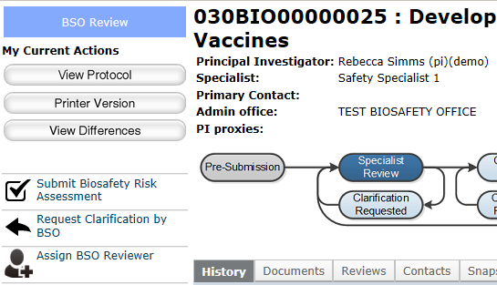
BSO Review
BSO Review Activities
The assigned Biosafety Officer will:
Submit a biosafety risk assessment
1

Slide 29
BSO Review Exercises
Perform the following training exercises:
Exercise 12: Send Protocol to BSO Review
Exercise 13: Submit Biosafety Risk Assessment

Slide 30
Member Review
Click Safety Module
Member Review

Slide 31
Member Review
Member Review Activities
The assigned Safety Specialist will:
Send the protocol to Member Review, if appropriate
1

Slide 32
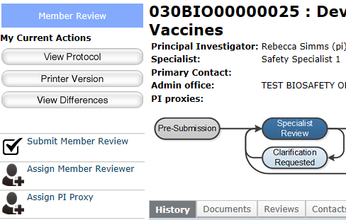
Member Review
Member Review Activities
The assigned Committee Member will:
Submit a member review
1

Slide 33
Member Review Exercises
Perform the following training exercises:
Exercise 14: Send Protocol to Member Review
Exercise 15: Submit Member Review

Slide 34
Ancillary Review
Click Safety Module
Ancillary Review

Slide 35
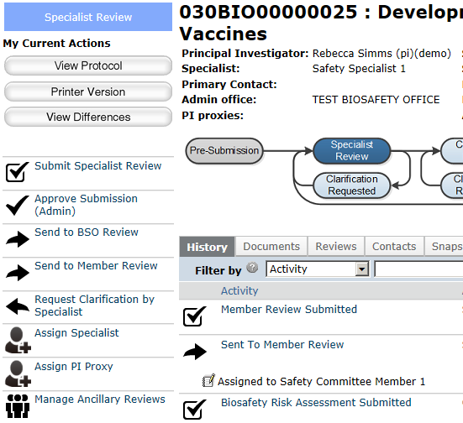
Ancillary Review
Ancillary Review Activities
The assigned Safety Specialist will:
Set up ancillary reviews, if appropriate
1

Slide 36
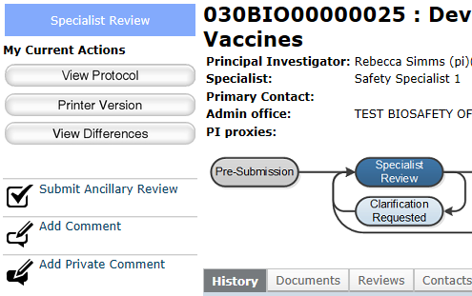
Ancillary Review
Ancillary Review Activities
The assigned Ancillary Reviewers will:
Submit an ancillary review
1

Slide 37
Ancillary Review Exercises
Perform the following training exercises:
Exercise 16: Set Up Ancillary Reviews
Exercise 17: Submit an Ancillary Review

Slide 38
Committee Review
Click Safety Module
Committee Review

Slide 39
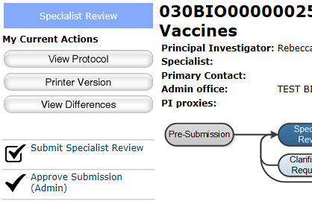
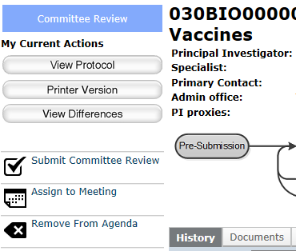
Committee Review
Committee Review Activities
The assigned Safety Specialist will:
Send the protocol to Committee Review, if appropriate (via Submit Specialist Review)
Submit the committee review after the committee has made a determination
1
2

Slide 40
Committee Review Exercises
Perform the following training exercises:
Exercise 18: Send Protocol to Safety Committee Review
Exercise 19: Submit the Committee Review

Slide 41
Post-review
Click Safety Module
Post-Review

Slide 42
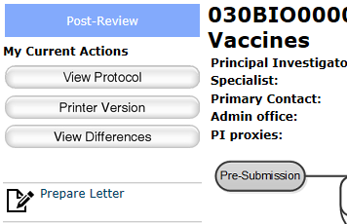
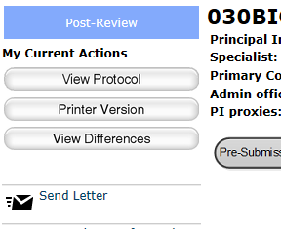
Post-Review
Post-Review Activities
The assigned Safety Specialist will:
Prepare the determination letter
Send the letter
1
2

Slide 43
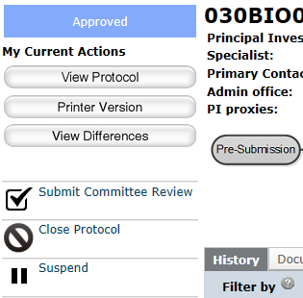
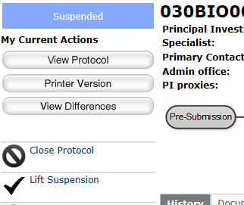
Post-Review
Post-Review Activities
The assigned Safety Specialist can also:
Suspend approved protocols, if appropriate
Lift protocol suspensions
1
2

Slide 44
Post-Review Exercises
Perform the following training exercises:
Exercise 20: Prepare and Send Determination Letter
Exercise 21: Suspend an Approved Protocol
Exercise 22: Lift Suspension of a Protocol

Slide 45
Committee meetings
Click Safety Module
Committee Meetings

Slide 46
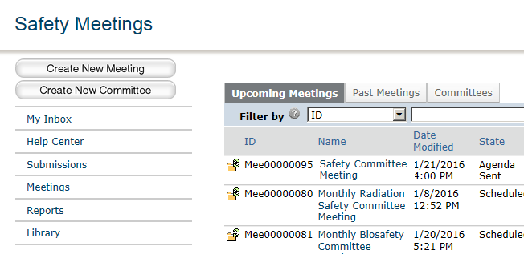
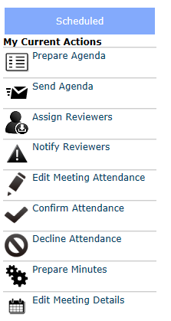
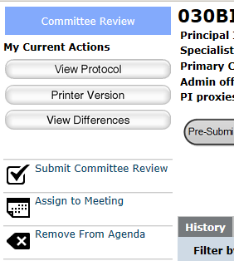
Committee Meeting
Committee Meeting Activities
The Committee Administrator assigned to a committee can perform the following activities for that committee:
Create new meetings
Remove agenda items from protocol workspace
Prepare and send agendas to committee members
Prepare meeting minutes and many other actions from the meeting workspace
1
3
2
2
4

Slide 47
Committee Meeting Exercises
Perform the following training exercises:
Exercise 23: Create a New Meeting
Exercise 24: Run a Meeting

Slide 48
Request clarifications
Click Safety Module

Slide 49
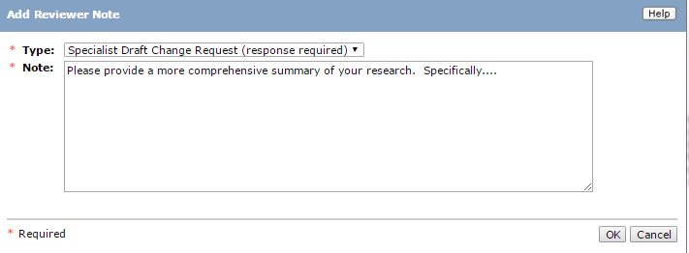
Request Clarifications
Reviewer Notes
The Safety Specialist will:
  Review all of the SmartForm pages for the protocol
  Add Reviewer Notes on specific pages

Slide 50
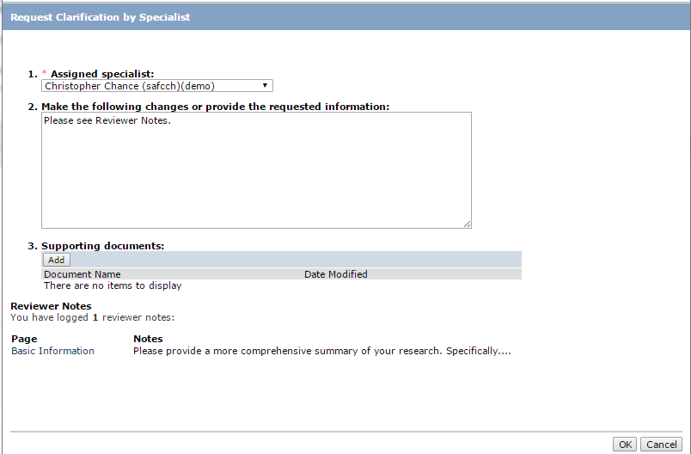
Request Clarifications
Request Clarifications
The Safety Specialist will:
  Send a Request for Clarification message to the Principal Investigator

Slide 51
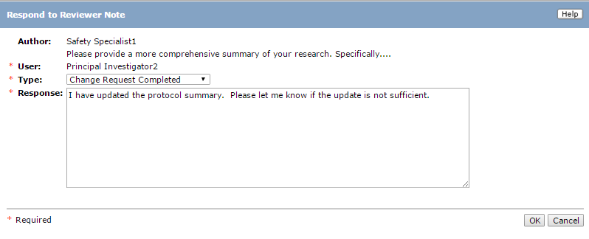
Request Clarifications
Responding to Reviewer Notes
The Principal Investigator will:
  Receive notification that a clarification request was made
  Open the protocol, and click the Edit Protocol button
  Read and respond to any Reviewer Notes

Slide 52
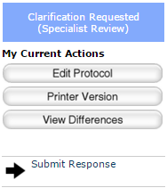
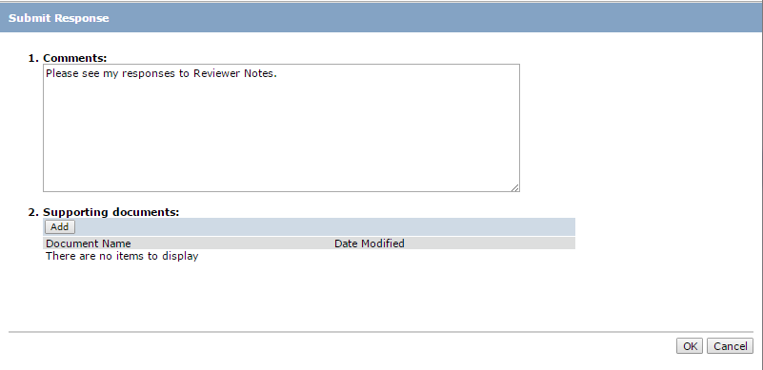
Request Clarifications
Responding to Clarification Requests
The Principal Investigator will:
  Click on Submit Response in the protocol Workspace
  Add any comments, and/or upload supporting documents if needed

Slide 53
Questions?
Click Safety Module

Slide 54
Questions
Contact Information
For policy questions regarding Safety:
  Dave Pawlowski, drp@buffalo.edu
For technical questions regarding Click:
  Marla Witkowski, mlw9@buffalo.edu
For assistance with UBITNames and Passwords:
  Tom Wendt, wendt@buffalo.edu

Slide 55

Navigation
Click Safety Module – Live Website
Navigate to http://www.buffalo.edu/research
Locate the QUICK LINKS section of the page:
Click on the Click IRB Login link
Enter your UBITName and Password, and click the Log In button.

