Slide 1
Click Training
IRB Module
University at Buffalo
Office of the Vice President for Research and Economic Development
Electronic Research Administration (eRA)

Slide 2
Kyle Mann
Office of Research Compliance
klmann@buffalo.edu
HELLO
my name is
Marla Witkowski
PACS Campus Training Program Coordinator
mlw9@buffalo.edu

Slide 3
Background
IRB Module
The Pre-Award and Compliance System (PACS) is a multi-year collaborative project to implement the online Click Portal
The Click Portal is being implemented to assist principal investigators, students, compliance and research administration staff with administering sponsored programs
UB is leading the implementation of the Click Portal, working in collaboration with our vendor partner, Huron, and the PACS Leadership Team.

Slide 4
Training Materials
IRB Module
Click Portal: IRB Module PowerPoint Slides
Click Portal: IRB Module Training Exercises
Sample IRB Document
Work Instructions:
  Create and Submit a New Study
  Create and Submit a Modification or Continuing Review
  Reportable New Information
  Pre-Review Process
  Post Review Process

Slide 5
Objectives
IRB Module
Provide principal investigators, study staff, compliance and research administration staff an overview of the IRB module
Demonstrate how to:
  Create an IRB study and submit it for review
  Manage the IRB review process
  Create and convene IRB committee meetings
  Communicate the committee’s decision to the study team
Allow the participants to practice with hands-on exercises
Provide training materials and references that will provide assistance while using the IRB module

Slide 6
ROles
Click IRB Module

Slide 7
IRB User Roles and Responsibilities
Roles
Protocol Team - Individuals responsible for developing and editing the protocol. Includes PIs and their contacts, and other study staff.
IRB Administrators - Individuals who guide submissions through the review process. Includes IRB Coordinators and the IRB Director. Committee Administrators oversee committees and meetings.
Reviewers - Individuals responsible for reviewing studies. Includes IRB Committee Members, and the Committee Chair. Some studies may also require an optional review by an Ancillary Reviewer.

Slide 8
Workflow – Study/CR/ MOD
Click IRB Module

Slide 9

Workflow – Study/CR/Mod
IRB Module
One workflow is designed for all requests for approval, including:
  New Studies
  Continuing Reviews
  Modifications
  Modification/Continuing Reviews
Activities within each state are controlled by role-based security

Slide 10
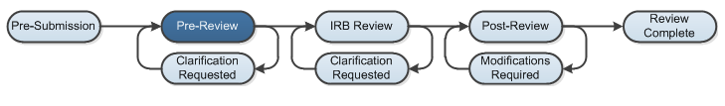
Workflow – Study/CR/Mod
IRB Module
Pre-Submission: During Pre-Submission, the study is created in the system.
Pre-Review: In this state, the study is assigned to an IRB Coordinator who reviews the submission and answers questions about oversight agencies, special populations, etc. that pertain to the study.

Slide 11
Workflow – Study/CR/Mod
IRB Module
Clarification Requested: The IRB Coordinator and/or IRB Committee Members may send a Request for Clarification during the Pre-Review and IRB Review states. This will send the study into the Clarification Requested state until the PI has responded to the request.
IRB Review (Non-Committee Review): During this state, exempt or expedited studies will be reviewed by a designated reviewer.
Notes:
Non-Committee Review: Exempt, Expedited, Not human subjects, Engagement determinations

Slide 12
Workflow – Study/CR/Mod
IRB Module
IRB Review (Committee Review): In Committee Review, the IRB committee members will review the study for completeness
Post-Review: The Post-Review state gives the IRB staff an opportunity to approve any attached documents, request any modifications, and prepare and send the determination letter.

Slide 13
Workflow – Study/CR/Mod
IRB Module
Modifications Requested: The study will enter this state if the IRB decided to require modifications to the study before approving it, providing the study team an opportunity to respond.
Review Complete: The IRB study will reach its final state, Review Complete, after the approval letter is sent.

Slide 14
Workflow - RNI
Click IRB Module

Slide 15
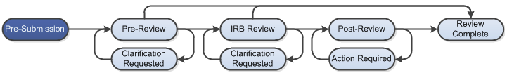
Workflow - RNI
IRB Module
Reportable New Information (RNI) submissions include any submission that is NOT a request for approval, including:
  New/increased risk
  Harm to subjects or other individuals
  Non-compliance
  Audit
  Report
  Research error
  Breach of confidentiality
  Unreviewed change
  Incarceration
  Complaint
  Suspension
  Unanticipated device effect

Slide 16
Workflow – RNI
IRB Module
Pre-Submission: During Pre-Submission, the RNI submission is created in the system.
Pre-Review: In this state, the study is assigned to an IRB Coordinator who reviews the submission and makes a determination on the seriousness of the submission. It will either be transitioned to Acknowledged, or is sent on to IRB Review.
Notes:
* Serious: For an RNI submission to be considered a serious issue, the determinations selected must include an unanticipated problem involving risks, serious or continuing non-compliance, or suspension or termination of IRB approval. If none of these are selected, the workflow routing handles the RNI as less significant.

Slide 17
Workflow – RNI
IRB Module
Clarification Requested: The IRB Coordinator and/or IRB Committee Members may send a Request for Clarification during the Pre-Review and IRB Review states. This will send the submission into the Clarification Requested state until the PI has responded to the request.
IRB Review (Designated Review): During this state, RNI submissions will be reviewed by a designated reviewer. From there it can be transitioned to Acknowledged or sent on to Committee Review.

Slide 18
Workflow – RNI
IRB Module
IRB Review (Committee Review): In Committee Review, the IRB committee members will review the RNI submission. The submission can be transitioned to Acknowledged, or moved to Post-Review.
Post-Review: The Post-Review state gives the IRB coordinator an opportunity to approve any attached documents, request any modifications, and prepare and send the determination letter.

Slide 19
Workflow – RNI
IRB Module
Modifications Requested: The RNI will enter this state if the IRB decided to require modifications to the RNI before approving it, providing the study team an opportunity to respond.
Review Complete: The RNI will reach its final state, Review Complete, after the approval letter is sent.

Slide 20
Navigation
Click IRB Module

Slide 21
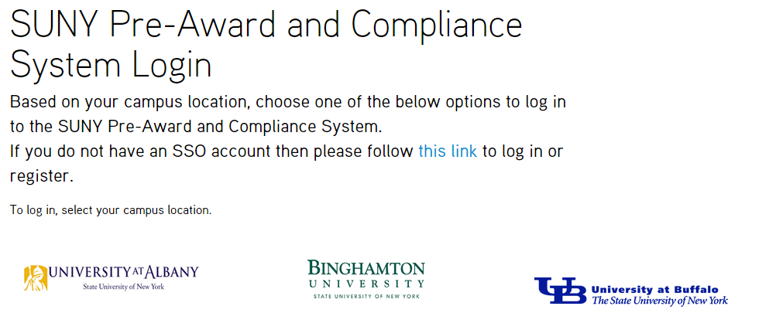
Click Safety Module – Training Website
Navigation
Navigate to http://pacsstg1.rfsuny.org
Locate the heading ‘SUNY Pre-Award and Compliance System Login’
Click on the words ‘this link’
Enter a User Name and Password, and click the Login button.
Click Training Website

Slide 22
My Inbox
Navigation
My Inbox displays items that the user needs to take action on.
  For Principal Investigators:
    Displays items not yet submitted to the IRB for review
    Displays items returned from the IRB that require attention
  For IRB staff:
    Displays items that are assigned to staff that are in a state that requires attention
    For example:
      Items in need of review
      Responses to clarification requests

Slide 23
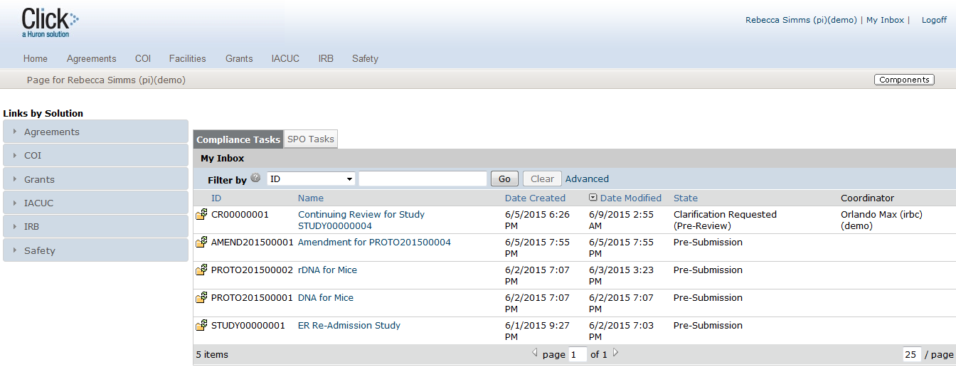
Sample Inbox
Navigation
From My Inbox, you will see:
Submissions that require action
State in the review process
1
2

Slide 24
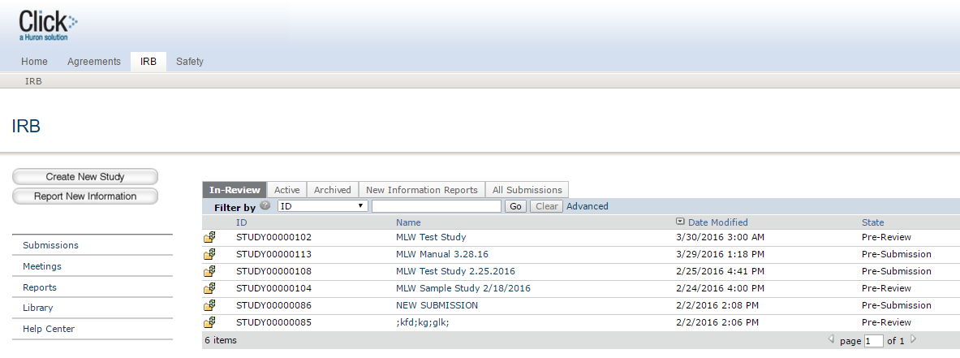
Navigation
From All Submissions, you will see:
All submissions to the IRB module
State in the review process
Shortcut to reporting features
Shortcut to resource documents
Shortcut to user guides
All Submissions
1
2
3
4
5

Slide 25
Study Workspace
Navigation
The Workspace displays key information about a particular study or submission.
This is where anyone with access to the submission can find:
  Details regarding the protocol
  State in the review process
  Actions that can be taken in the protocol’s current state
  Tabs with information regarding:
    Protocol history
    Attached documents
    Important contacts
    Submission information
    Related projects

Slide 26
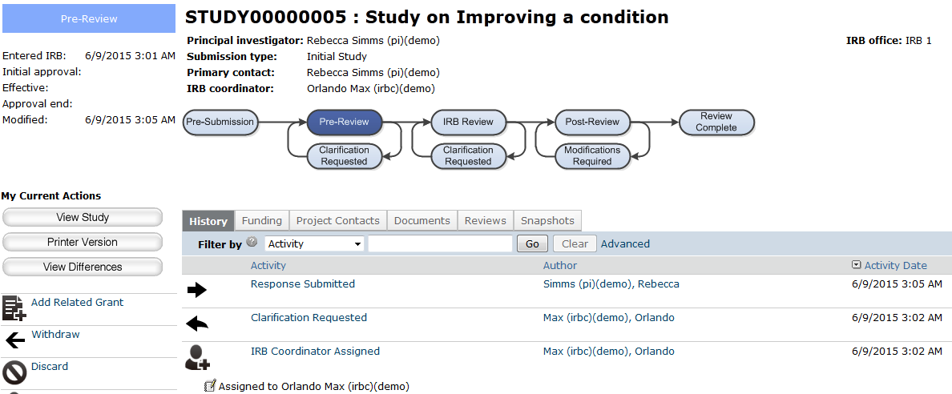
Study Workspace
From the Study Workspace, you will see:
Protocol details
The state in the review process
Actions you can take in the protocol’s state
Tabs with information about the protocol and the review process
Navigation
2
1
1
3
4

Slide 27
Navigation Exercises
Perform the following training exercises:
Exercise 1: Log into the Click IRB Module
Exercise 2: Explore the Inbox
Exercise 3: Explore All Submissions
Exercise 4: Explore the Study Workspace
Exercise 5: Explore the SmartForm Pages

Slide 28
SmartForms
Click IRB Module

Slide 29
Overview
SmartForms
Click IRB SmartForms were designed to be as simple and streamlined as possible, and to capture basic information required for:
  Business Processing/Workflow Routing
  Reporting
Click IRB SmartForms emphasize input by the appropriate individual(s):
  Ask investigators questions related to conduct of their research, not regulatory questions
  Require IRB Administrators and Reviewers to capture regulatory determinations

Slide 30
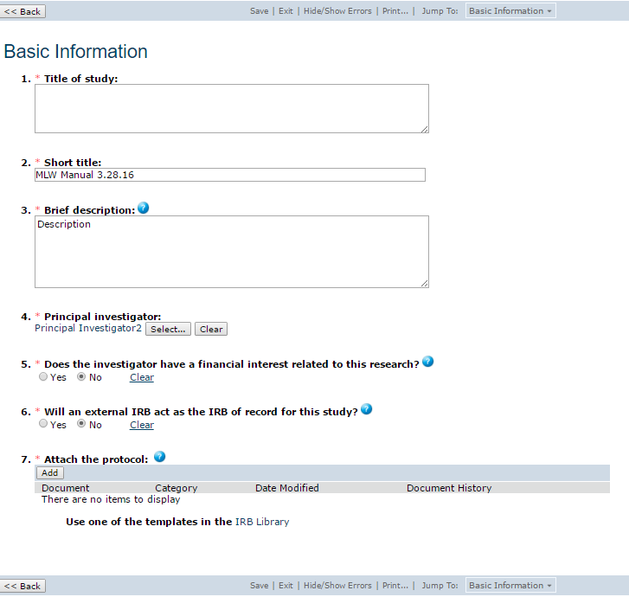
Sample SmartForm
SmartForms
3
1
On the SmartForm pages, you
will see:
Required fields (*)
Field help ( )
Navigation bar
2
?

Slide 31
New Study
SmartForms
Basic Information
Supporting Documents
Consent Form(s) & Recruitment Materials
Funding Sources
Study Scope*
Study Staff
External Sites
Drugs
Devices
CITI Training

Slide 32
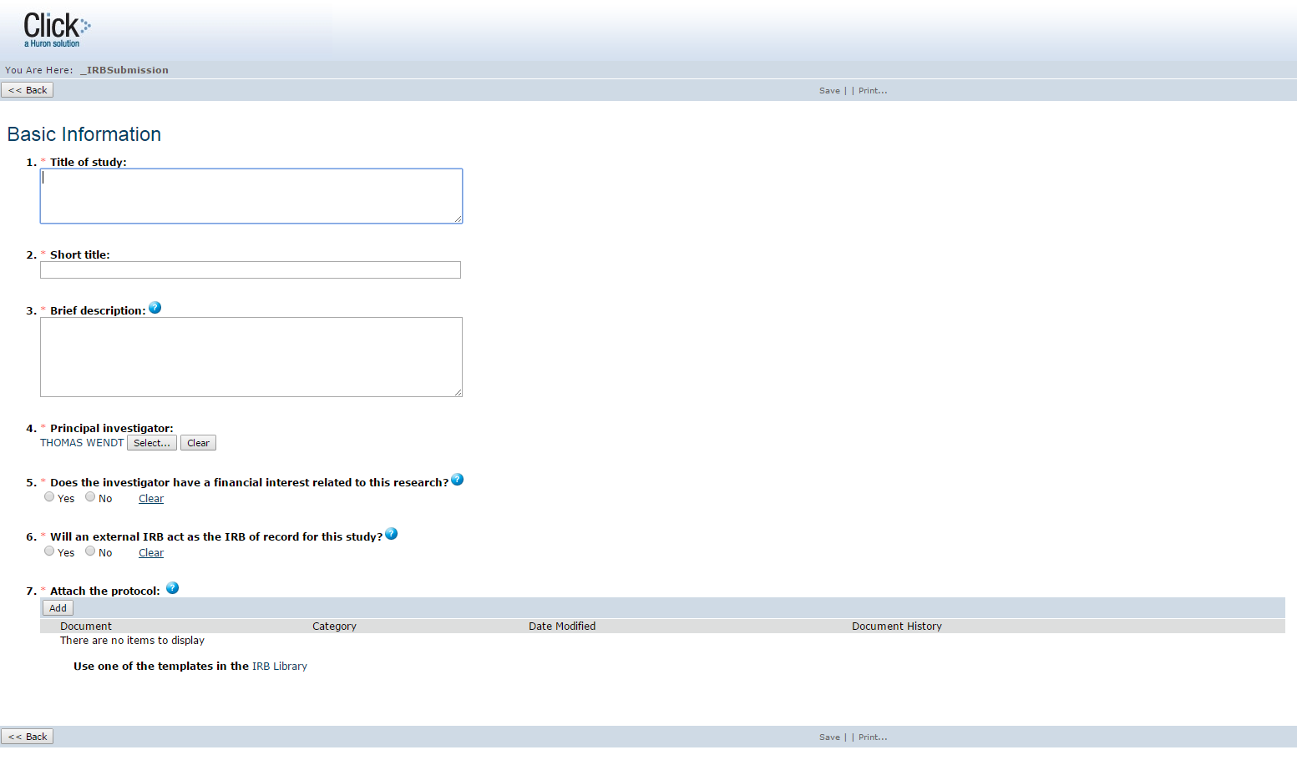
New Study – Basic Information
SmartForms
Basic Information
Notes:
Captures initial information to create the record, including:
PI
Study title
Short title
Branching question for external IRB of record
Leads to a shorter submission form and abbreviated workflow routing if acknowledged by the IRB

Slide 33
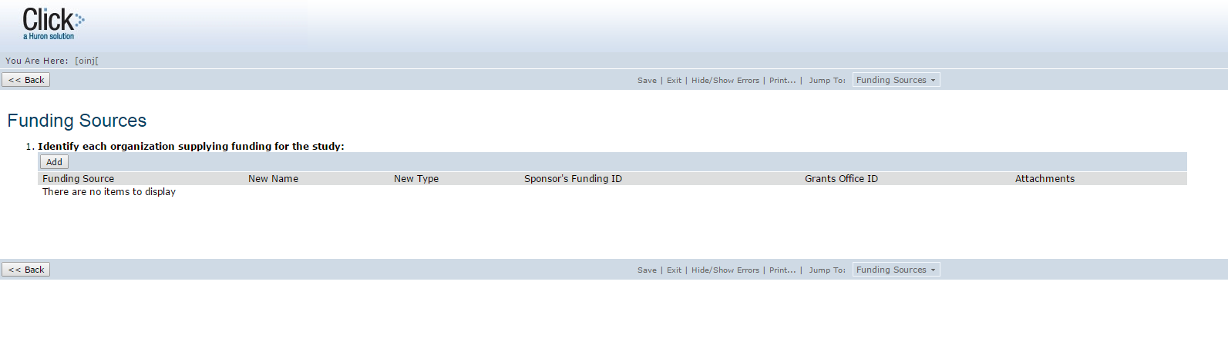
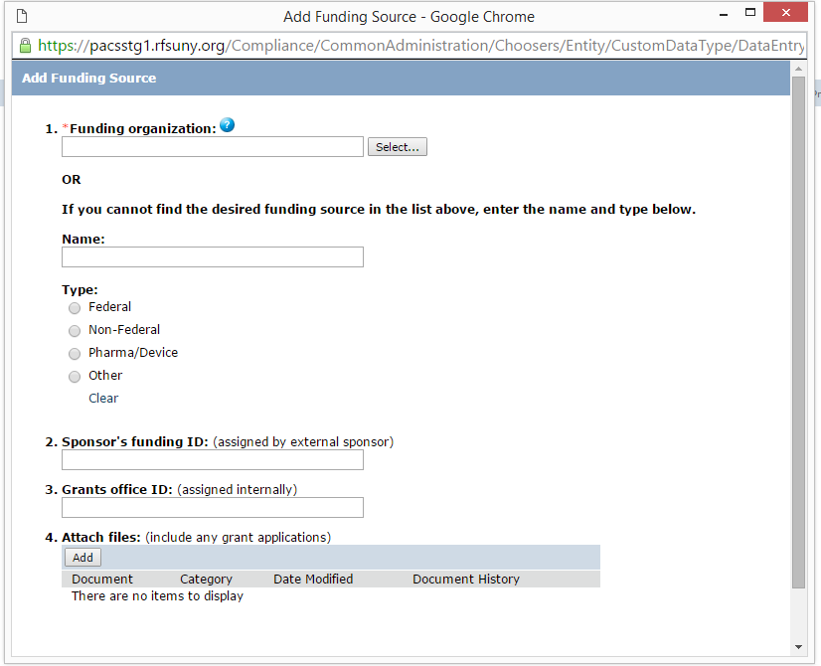
SmartForms
New Study – Funding Sources
Funding Sources
Notes:
Captures all funding sources related to the project
Often customized to integrate with external grants system

Slide 34
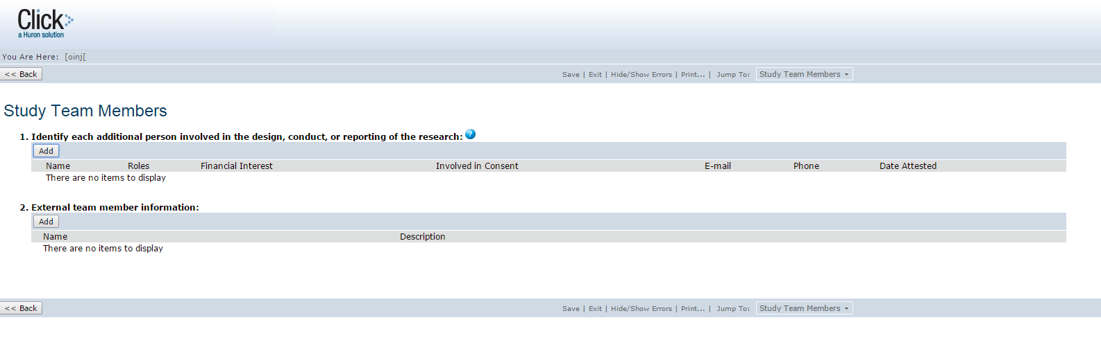
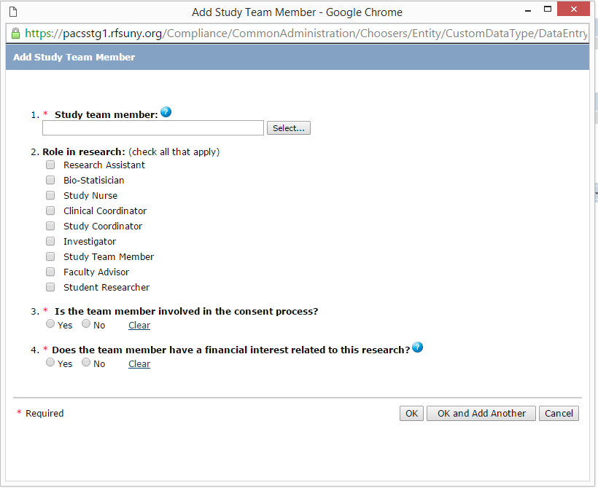
New Study – Study Team Members
SmartForms
Study Team
Members
Notes:
Lists individuals within the system who are participating in the project
Provides access to the project for those listed
Allows document upload for external participants

Slide 35
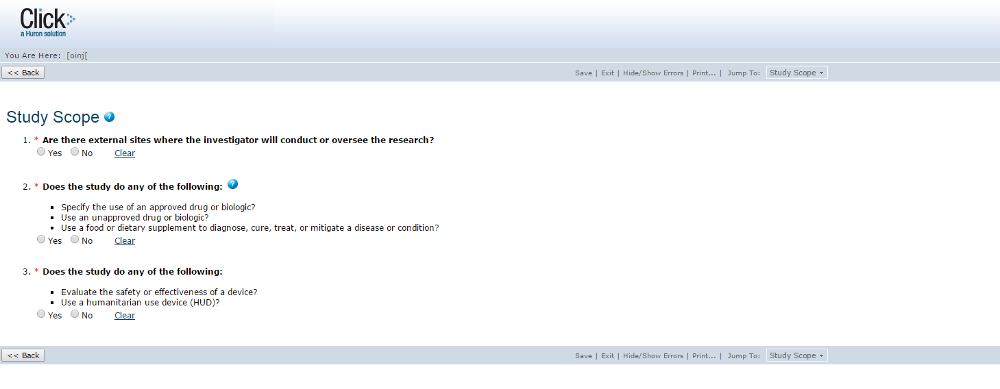
New Study – Study Scope
SMartForms
Study Staff
Study Scope
Notes:
3 yes/no questions to determine branching:
External Sites
Drugs
Devices

Slide 36
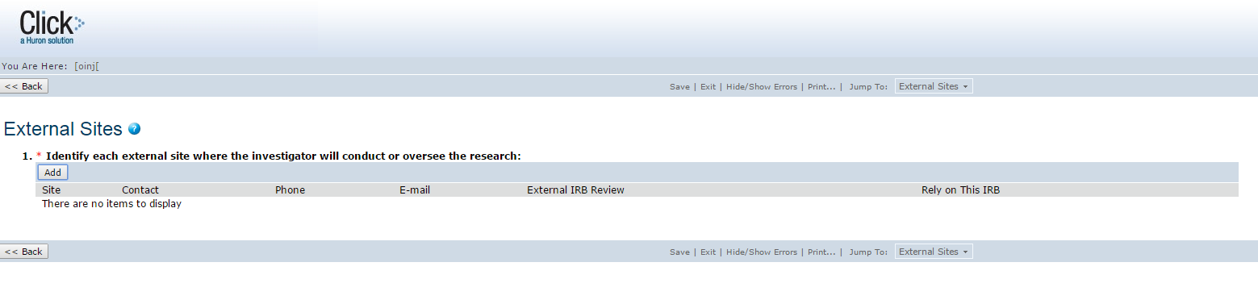
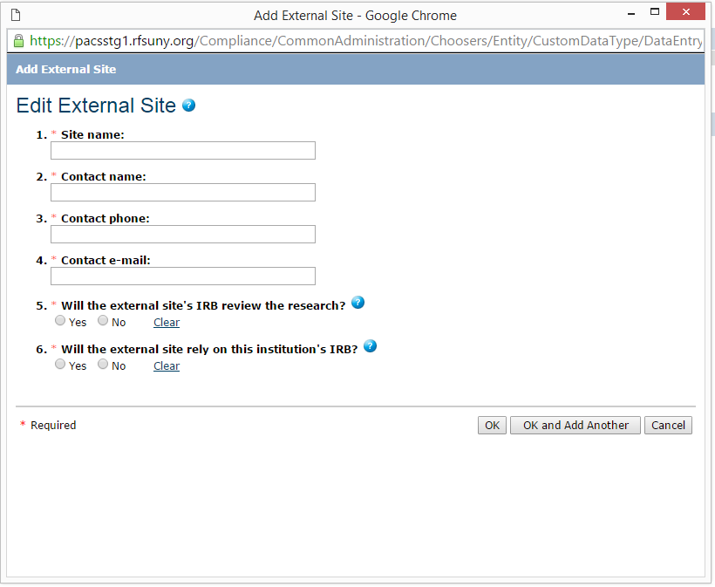
New Study – External Sites
SmartForms
External Sites
Notes:
Identifies external sites where the investigator will conduct or oversee the research

Slide 37
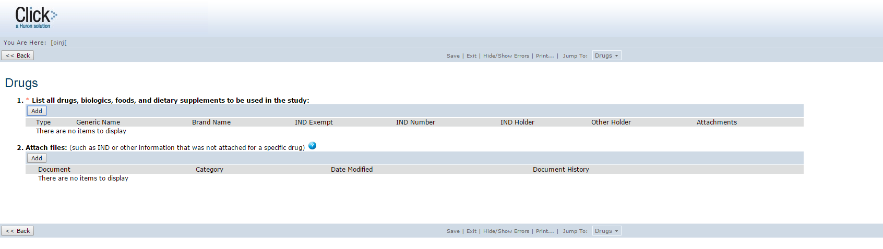
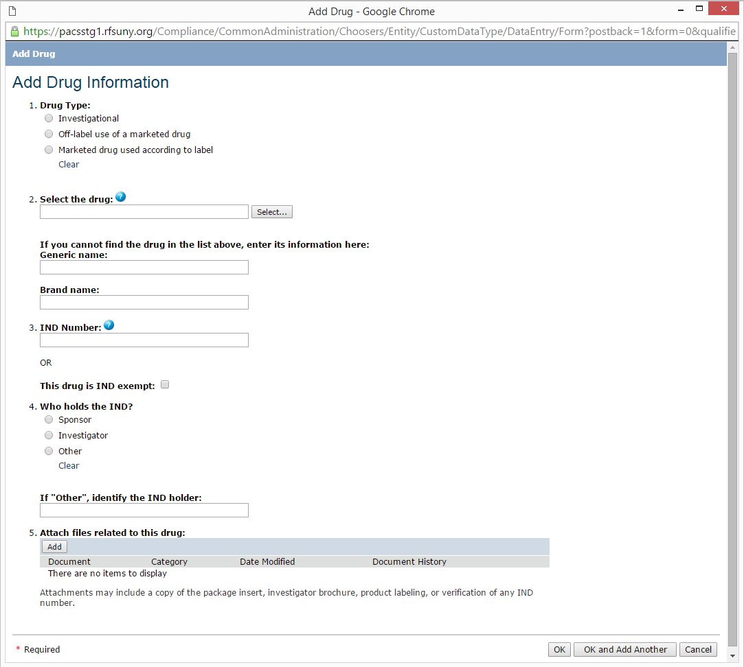
New Study - Drugs
SmartForms
Drugs
Notes:
Lists all drugs, biologics, foods and dietary supplements used in the study, including generic name
Captures IND/Exemption
Provides document upload for supporting materials

Slide 38
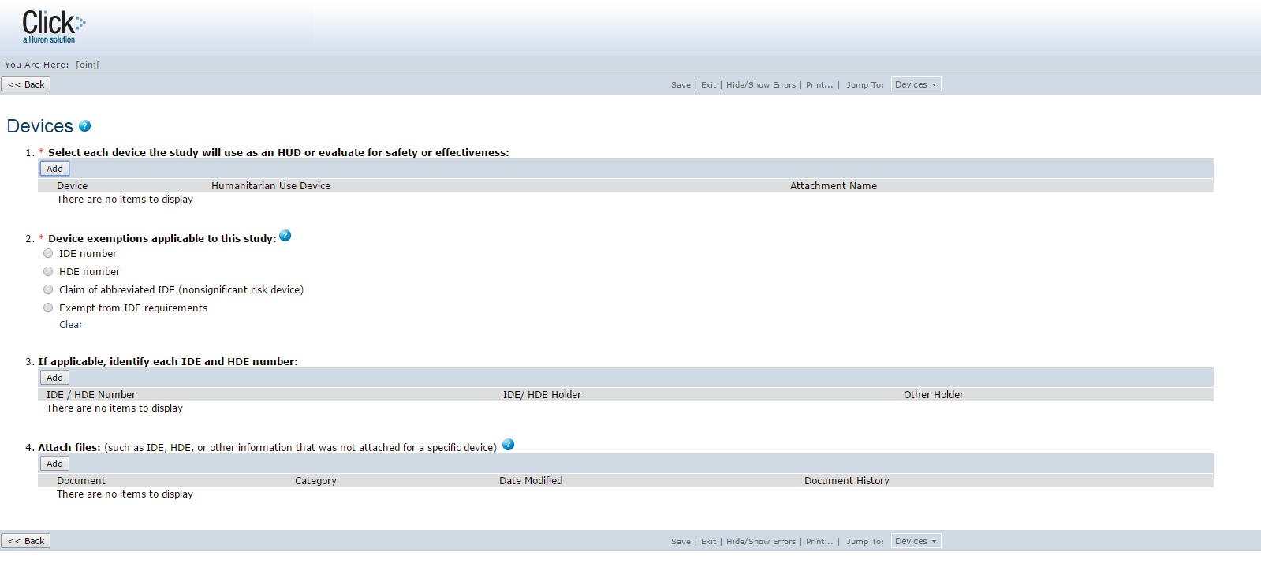
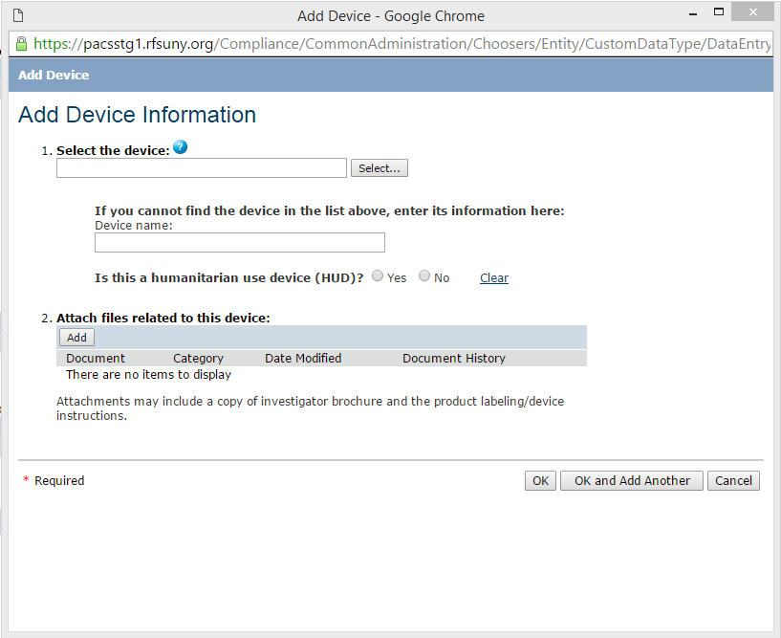
New Study - Devices
SmartForms
Devices
Notes:
Lists all devices/HUDs used in the study, including generic name
Captures IDE/Exemption
Provides document upload for supporting materials

Slide 39
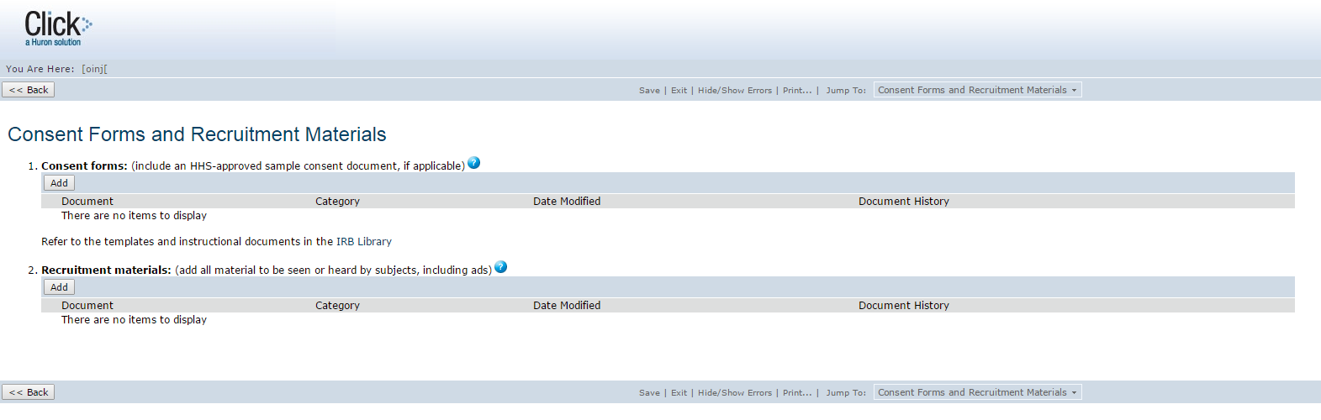
New Study – Consent Forms & Recruitment Materials
SmartForms
Consent Forms & Recruitment Materials
Notes:
Upload documents
Consent forms
Recruitment materials
Provides links for Toolkit templates and instructional documents (including investigator SOPs for documenting consent and the consent process)

Slide 40
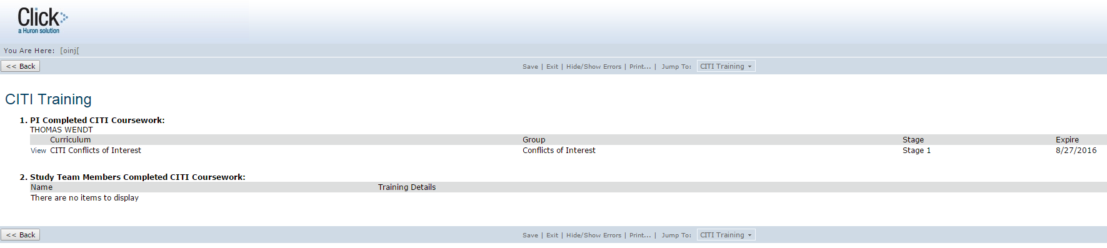
New Study – CITI Training
SmartForms
CITI Training
Notes:
Automatically updates CITI training information for all study team members

Slide 41
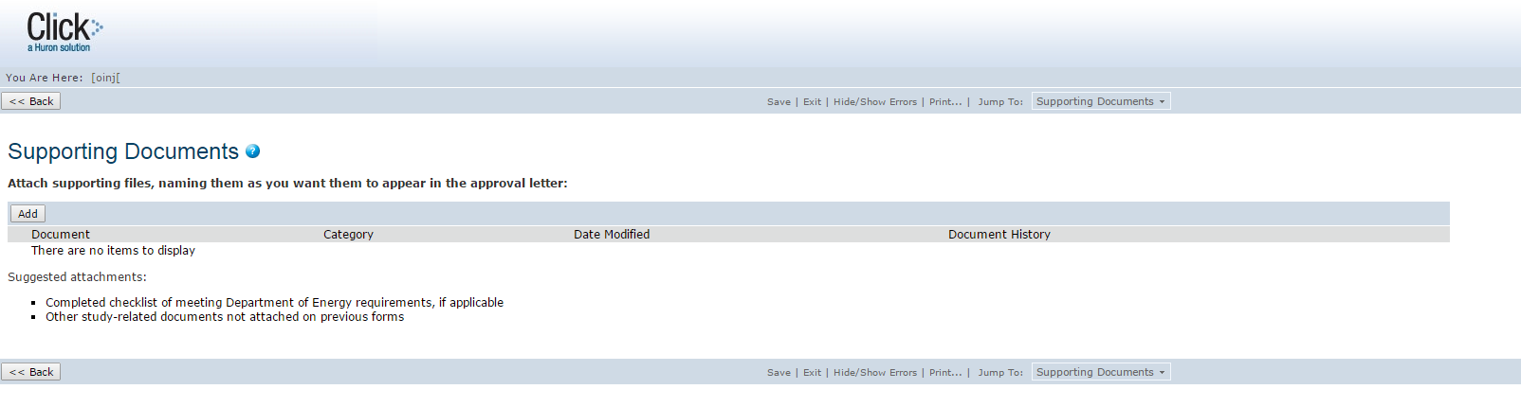
Supporting Documents
SmartForms
Supporting Documents
Notes:
Upload general documents related to the project
Select from a pre-determined list of categories to file documents under
For example:
Surveys
Data collection sheets

Slide 42
Other Submission Types
SmartForms
Continuing Review / MOD
Reportable New Information
Users select CR, MOD, or MOD/CR combo; the SmartForm branches to appropriate questions
  CR SmartForm asks about study progress and number of enrolled subjects.
  MOD SmartForm asks what changes are required, and leads to a copy of the study SmartForm for updating.
All other submissions are sent as Reportable New Information (RNI).
  RNI SmartForm asks the investigator the type of information, date the investigator became aware of the information and if any follow-up is required.

Slide 43
Pre-Submission
Click IRB Module

Slide 44
Documents
Pre-Submission
You will need a protocol and consent form to upload into the system, along with any other documents you want to upload.
If you don’t have documents readily available on your computer:
  Navigate to http://www.buffalo.edu/research
  Click on Office of Research Compliance (ORC)
  Click on Institutional Review Boards (IRB) Toolkit
  Click on Templates
  Download the following files:
    HRP-502-Template Consent Document
    HRP-503-Template Protocol

Slide 45
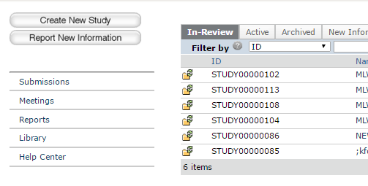
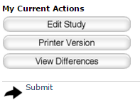
Pre-Submission
Pre-Submission Activities
The PI will :
Create the study protocol and complete the SmartForm pages
Submit the study for review
1
2

Slide 46
Pre-Submission
What to Expect After Submitting
Submitting your protocol initiates a series of activities that may include:
  Review by an IRB Coordinator
  Review by an IRB committee
  Optional ancillary review by individuals, departments, and other organizations
  Communication of the committee’s decision to the investigator
Any of these may lead to a request for the study team to take further action, such as providing clarifications regarding the study
Whenever the study team needs to act, the PI receives an e-mail notification, and the study appears in My Inbox for all study team members when they log in to the Click Portal

Slide 47
Pre-Submission Exercises
Perform the following training exercises:
Exercise 6: Create a New Study
Exercise 7: Assign Additional Staff to a Study
Exercise 8: Submit a Study to Review

Slide 48
Request clarifications
Click IRB Module

Slide 49
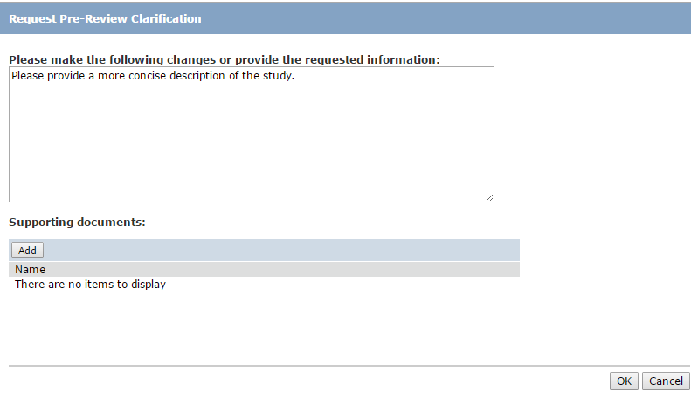
Request Clarifications
Request Clarifications
The IRB Coordinator or IRB Committee Members will:
  Send a Request for Clarification message to the Principal Investigator

Slide 50
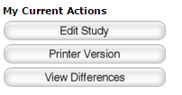
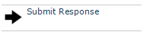
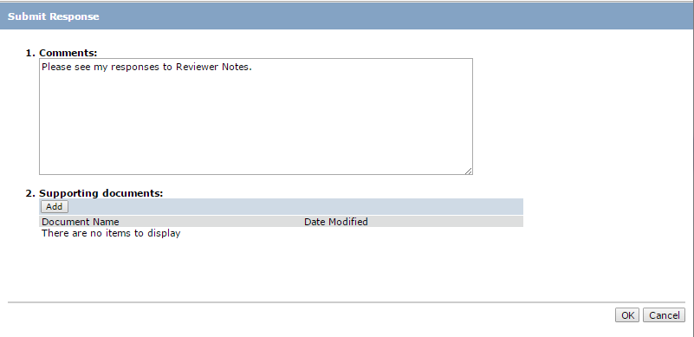
Request Clarifications
Responding to Clarification Requests
The Principal Investigator will:
  Click on Submit Response in the protocol Workspace
  Add any comments, and/or upload supporting documents if needed

Slide 51
Questions?
Click Safety Module

Slide 52
Questions
Contact Information
For policy questions regarding IRB:
  Office of Research Compliance, 716.888.4888
For technical questions regarding Click:
  Marla Witkowski, mlw9@buffalo.edu
For assistance with UBITNames and Passwords:
  Electronic Research Administration, support@research.buffalo.edu

Slide 53
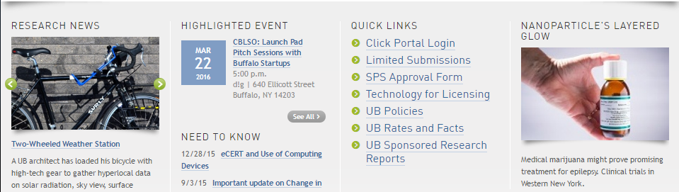
Navigation
Click IRB Module – Live Website
Navigate to http://www.buffalo.edu/research
Locate the QUICK LINKS section of the page:
Click on the Click Portal Login link
Enter your UBITName and Password, and click the Log In button.

Slide 54
Evaluation
Click Safety Module Training Evaluation
http://bit.ly/1VyhQZV

