Slide 1
Click® IACUC
IACUC Administrator Training: Day 2
January 11, 2017

Slide 2
Day 1 Recap
Day 1 we covered the following
Navigating Click IACUC
IACUC Building Blocks
Protocol Workspace
Protocol Workflow

Slide 3
Agenda: Day 2 (January 11th)
Time | Topic | Includes…
8:30 AM | Breakfast
9:00 AM | Complete exercises 22 & 23
9:15 AM | Post Review | Correspondence, Suspensions
9:45 AM | Committee Meeting Workspace | Creating a meeting, administering a meeting
10:30 AM | Day 1 Review
10:45 AM | Submitting Follow-on Submissions | Annual & Triennial Reviews, Amendments, Admin. Approval
12:00 PM | Lunch
12:30 PM | Facilities, Concerns and Inspections | Rooms, Building, Concerns, Inspections
1:30 PM | break
1:45 PM | Training Records | Courses, updating completion records, Display of training data
2:15 PM | Other Key Activities | Managing Departures, Manage Related Safety Records, Update Animal Counts
2:45 PM | Reports | Standard Reports
3:15 PM | IACUC Settings
3:45 PM | Day 2 Review and Q&A

Slide 4
Review Exercises
Perform the following training exercises:
Exercise 22: Assign Protocol to Committee Meeting (use exercise 16 to move a protocol from pre-review to meeting assignment)
Exercise 23:Submit the Committee Review

Slide 5

Post Review
5
© 2016 Huron Consulting Group. All rights reserved. Proprietary and confidential.

Slide 6
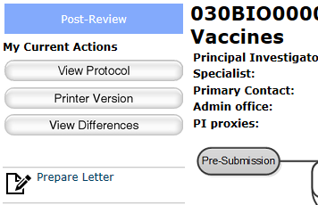
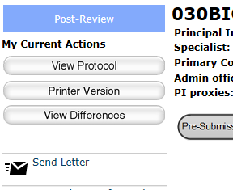
Post-Review Activities
The assigned coordinator will:
Prepare the determination letter
Send the letter
1
2

Slide 7
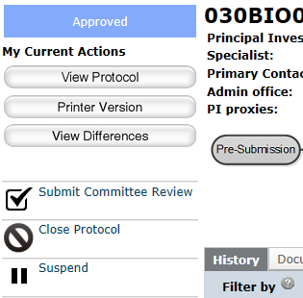
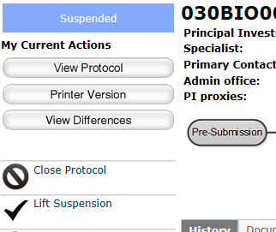
Post-Review Activities
The assigned coordinator
can also:
Suspend approved protocols, if appropriate
Lift protocol suspensions
1
2

Slide 8
Post-Review Exercises
Perform the following training exercises:
Exercise 24: Prepare and Send the Determination Letter
Exercise 25: Suspend an Approved Protocol
Exercise 26: Lift Suspension of a Protocol

Slide 9
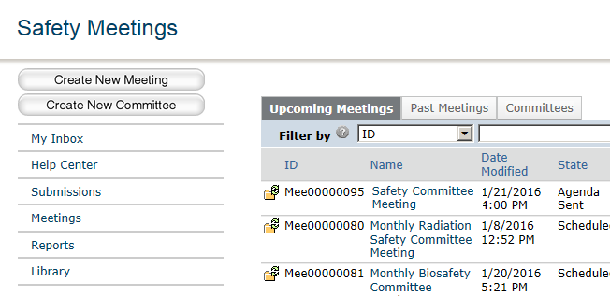
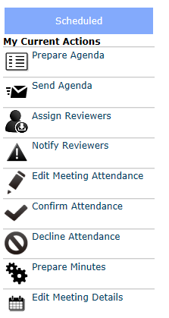
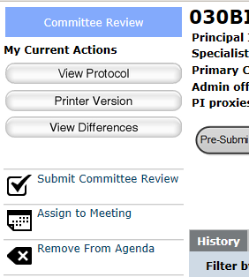
Committee Meeting Activities
The Committee Administrator assigned to a committee can perform the following activities for that committee:
Create new meetings
Remove agenda items from meeting workspace
Prepare and send agendas to committee members
Prepare meeting minutes and many other actions from the meeting workspace
1
3
2
2
4

Slide 10
Committee Meeting Exercises
Perform the following training exercises:
Exercise 33: Create a New Meeting
Exercise 34: Run a Meeting

Slide 11
Day 1 Review
11
© 2016 Huron Consulting Group. All rights reserved. Proprietary and confidential.

Slide 12
Day 1 Review
Describe the steps to build an experiment that includes a standard procedure for euthanasia and a team procedure for administering anesthetics
How do research teams respond to reviewer notes?
How do reviewers see what has been changed on the protocol since the last version?
Can IACUC coordinators edit protocols in review?
When would you add an ancillary review to a protocol?

Slide 13
Follow-on Submissions
13
© 2016 Huron Consulting Group. All rights reserved. Proprietary and confidential.

Slide 14
Workflow for follow-on submissions
Vet Consult
Pre-Submission
Pre-Review
Grace Period
Designated Member Review
Post-Review
Committee Review
Administrative approval (follow-on submissions)
Notes:
How will you cover protocols that can be VVC approved?

Slide 15
Parallel Follow-on Submissions
Submission Type | Parallel Submissions Allowed
Triennial Review | None
Annual Review | Amendment (Type = Sig Change) Amendment (Type = Other)
Amendment (Type = Sig Change) | Annual Review Amendment (Type = Other)
Amendment (Type = Other) | Annual Review Amendment (Type = Sig Change)

Slide 16
Follow-on Submission Exercises
Perform the following training exercises:
Exercise 27: Create and Submit an Annual Review

Slide 17
Follow-on Submission Exercises
Perform the following training exercises:
Exercise 28: Create a Triennial Review

Slide 18
Follow-on Submission Exercises
Perform the following training exercises:
Exercise 29: Create an Amendment for a Significant Change

Slide 19
Facilities: Creating Rooms and Buildings
19
© 2016 Huron Consulting Group. All rights reserved. Proprietary and confidential.

Slide 20
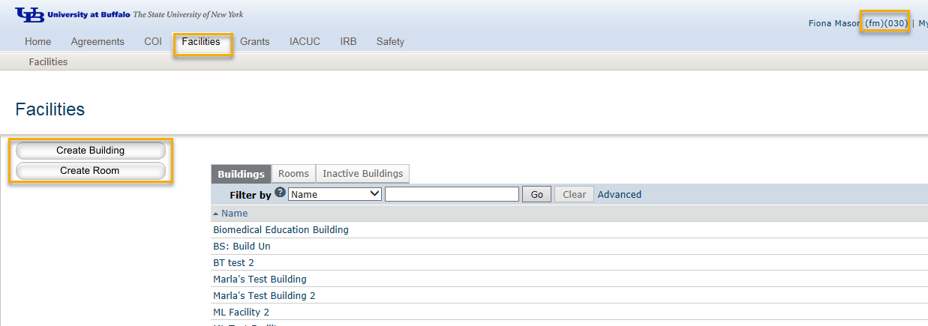
Managing Facilities
1
2
3
Users with the facility manager role can create new facilities (buildings and rooms)
New facilities can be created on the facilities tab
There are separate SmartForms for Buildings and Rooms.

Slide 21
Concerns and Inspections
21
© 2016 Huron Consulting Group. All rights reserved. Proprietary and confidential.

Slide 22
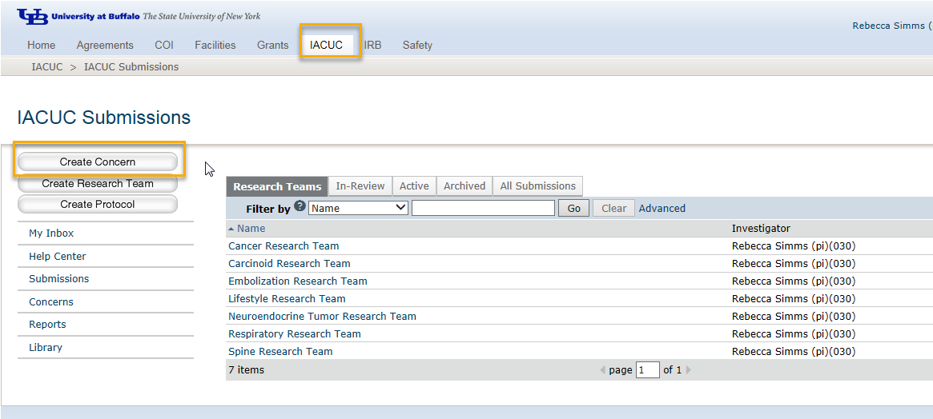
Creating a Concern

Slide 23
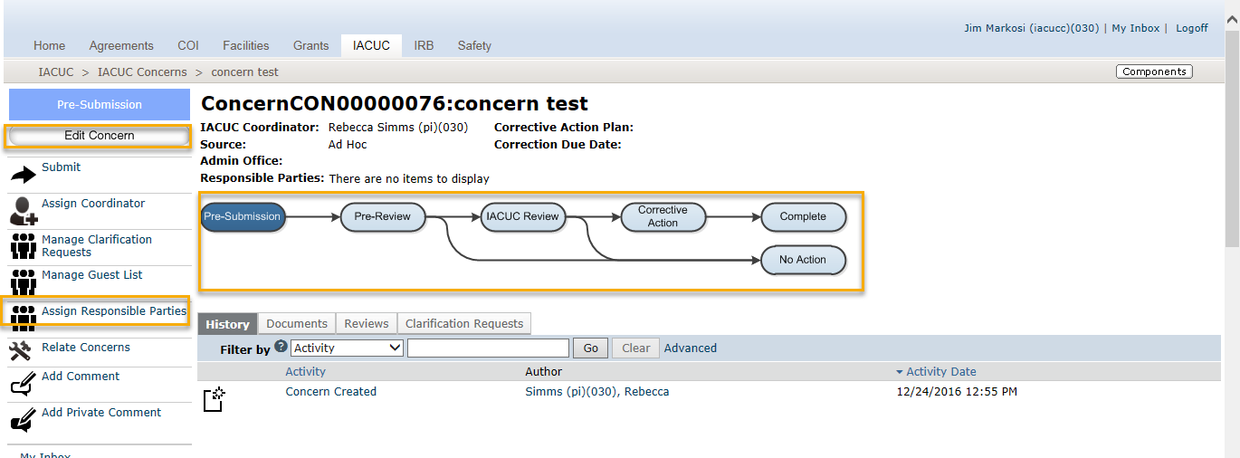
Concerns Workflow

Slide 24
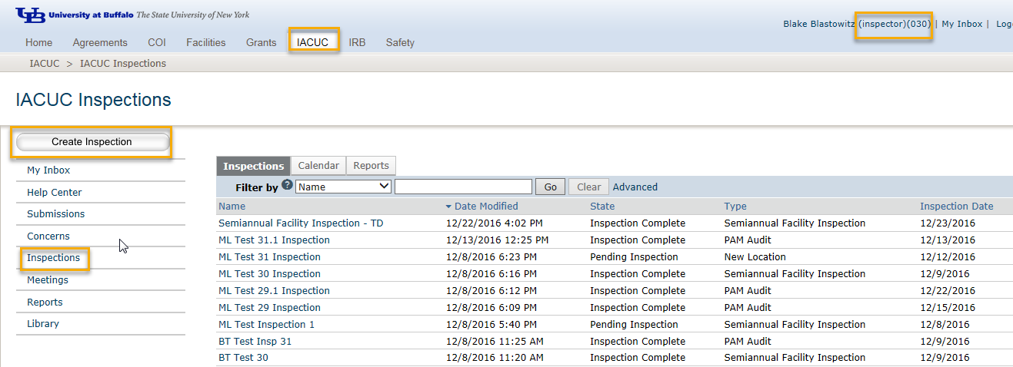
Managing Inspections
1
2
3
Users with the inspector role can create new inspections
New inspections can be created on the IACUC tab, after selecting the inspections link

Slide 25
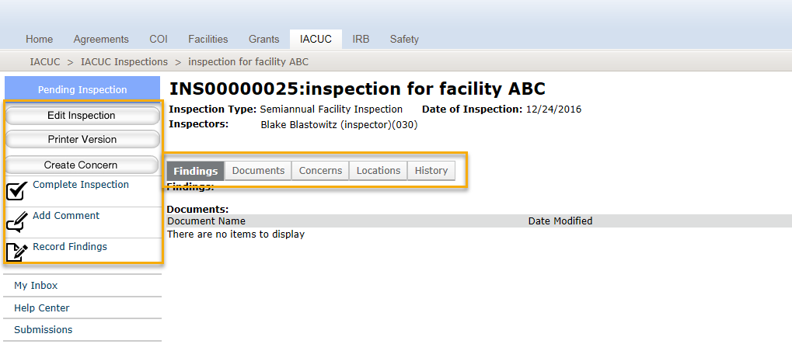
Inspections Workspace
2
1
Once an inspection is created, it can be edited and any related concerns or findings can be documented from the inspection workspace
Use the workspace tabs to see high level information about the inspection
Once an inspection is completed, it is added as an agenda item to a committee meeting

Slide 26
Concerns and Inspections Exercises
Perform the following training exercises:
Exercise 30: Create and Submit a Concern
Exercise 31: Create an Inspection
Exercise 32: Record Findings and Complete an Inspection

Slide 27
Training Records
27
© 2016 Huron Consulting Group. All rights reserved. Proprietary and confidential.

Slide 28
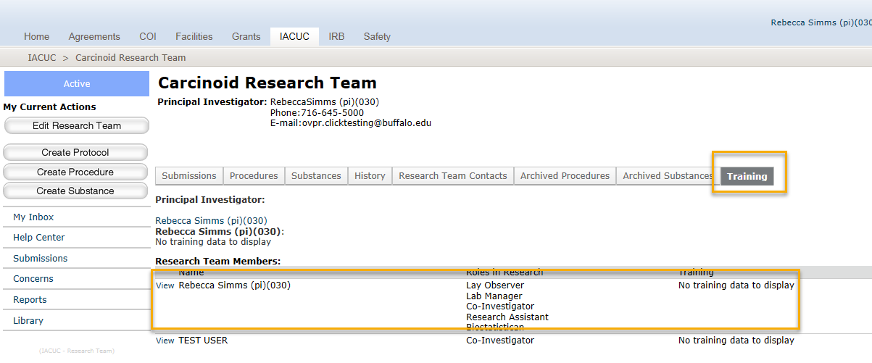
Training on Research Team Workspace

Slide 29
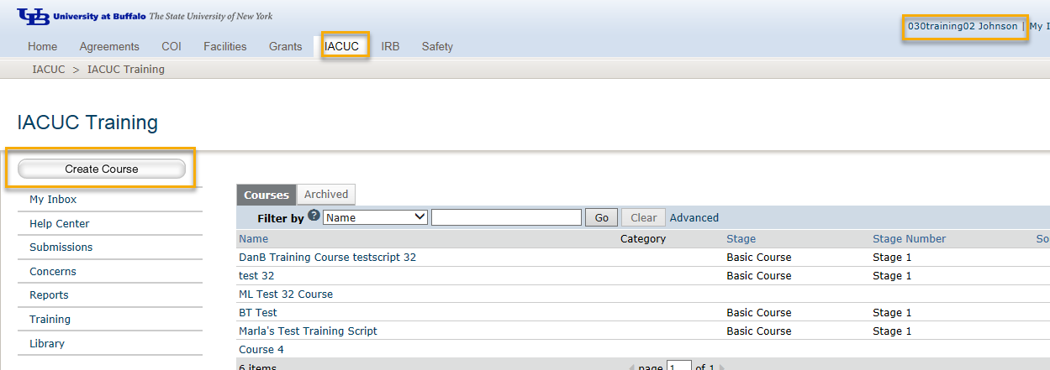
Creating New Training Courses
*CITI Training, updates courses with training completion records.

Slide 30
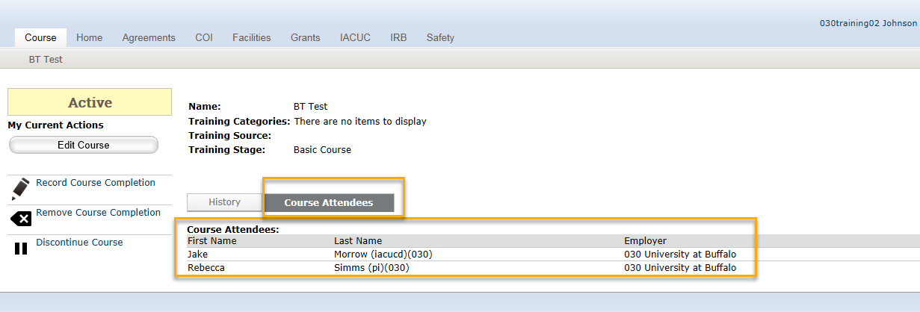
Recording Course Completion

Slide 31
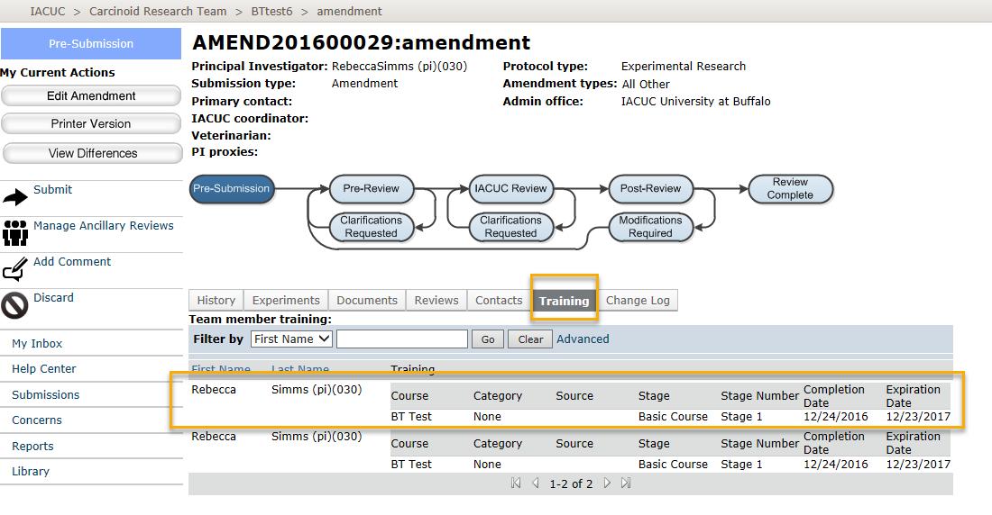
Training on the Submission Workspaces

Slide 32
Training Exercises
Perform the following training exercises:
IACUC13 Manage Training Courses and Tracking (Admin) Work Instructions.docx

Slide 33
Other Key Activities
33
© 2016 Huron Consulting Group. All rights reserved. Proprietary and confidential.

Slide 34
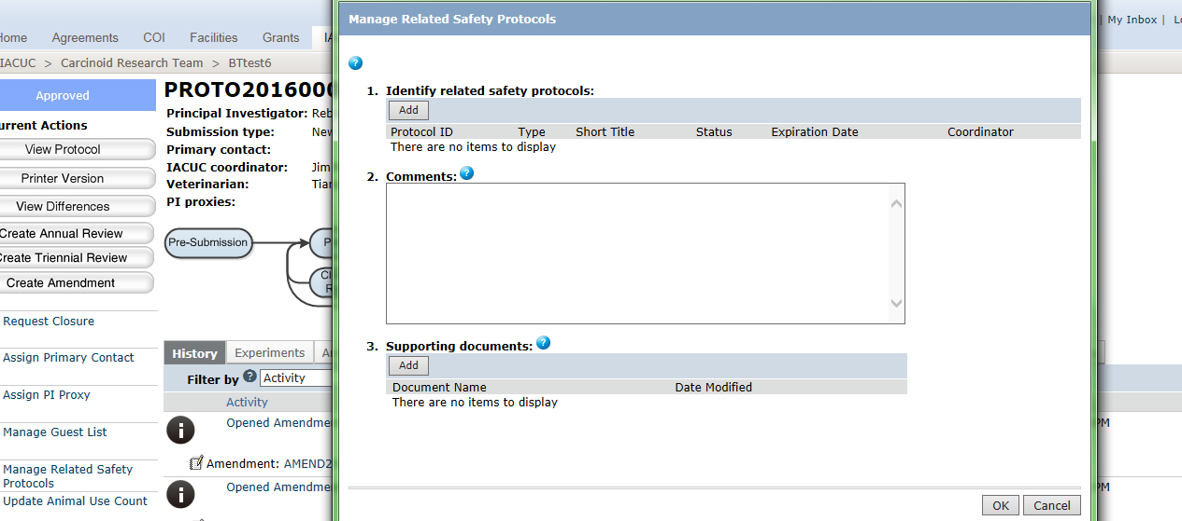
Managing Related Safety Protocols

Slide 35
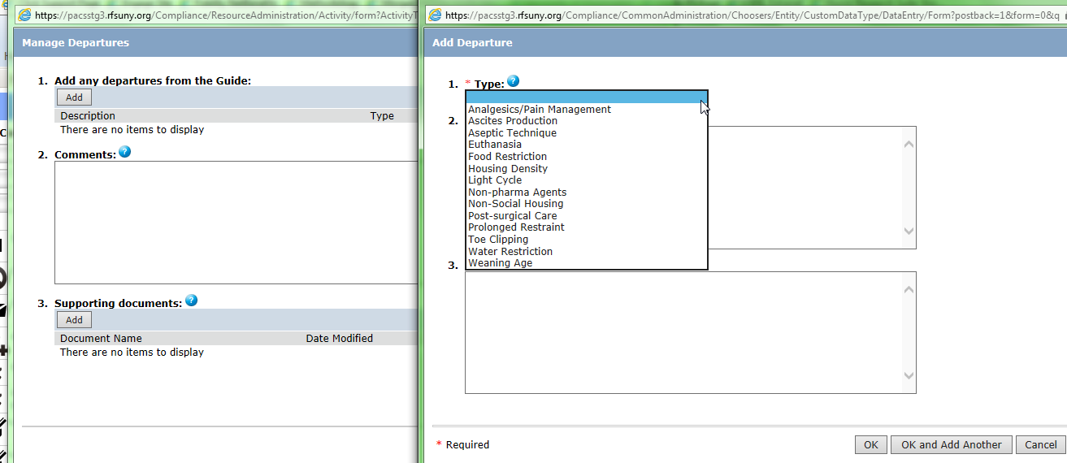
Managing Departures

Slide 36
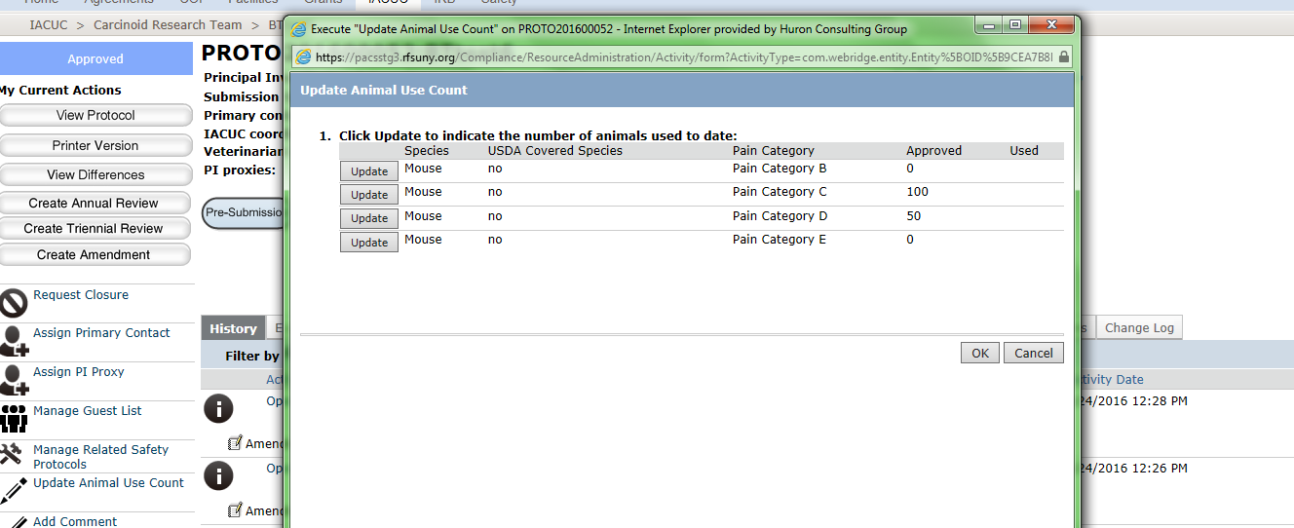
Animal Counts

Slide 37
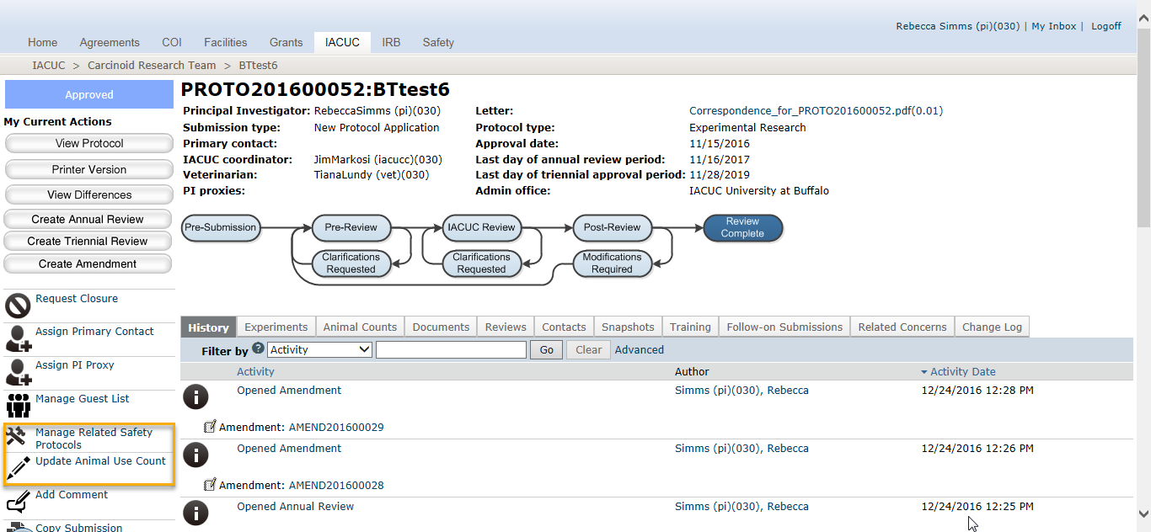
Research Team can execute…

Slide 38
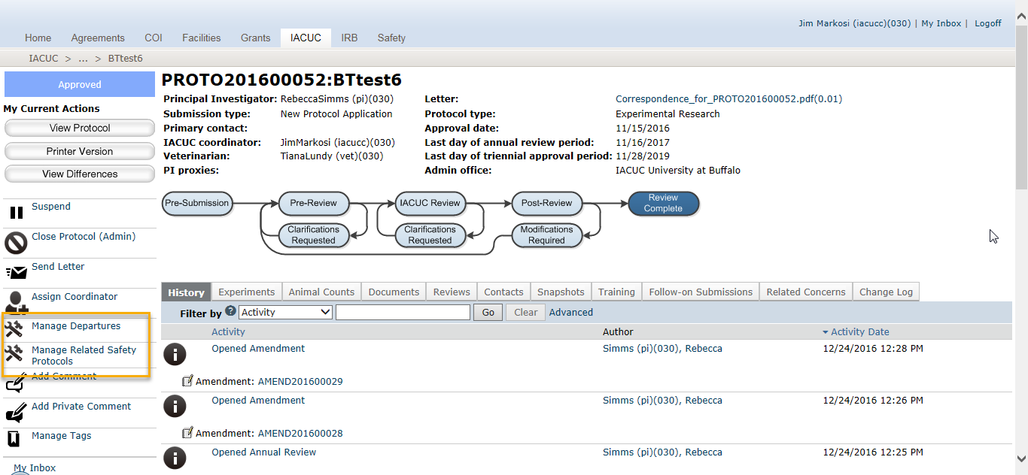
IACUC Coordinator can execute…

Slide 39
Final Exercises
Perform the following training exercises:
IACUC9di Administrative Review (Admin)_Manage Departures Work Instructions.docx
IACUC9dii Administrative Review (Admin)_Manage Related Safety Protocols Work Instructions.docx
Exercise 35: Update Animal Counts

Slide 40
Day 2 Review
40
© 2016 Huron Consulting Group. All rights reserved. Proprietary and confidential.

Slide 41
Day 2 Review
In Click IACUC, what are the differences between the review workflow for a protocol and a follow-on submission?
Which of the following is true:
  A) A TR can be in review at the same time as an amendment.
  B) An amendment can be in review at the same time as an AR.
  C) Both are true.
Name the two types of facilities I can configure in Click IACUC.
Name the types of inspections and the user roles who can create them.
Who can create a concern?
A concern has to be reviewed by the IACUC. True or false?

Slide 42
IACUC Settings
42
© 2016 Huron Consulting Group. All rights reserved. Proprietary and confidential.

Slide 43
Site-wide IACUC Settings
Number of days in grace period: | 0
Allow IACUC Staff to edit protocols in any state up to approved: | Checked
Grace period ends at the next IACUC meeting if this meeting occurs before the grace period lapses: | Unchecked
Require annual review for all protocols, even those that do not include USDA-covered species: | Checked
Enable PI proxies: | Checked
Number of days in clarifications requested, modifications required, or approval withheld state before reminder is sent: | 5
Require Chair Letter Review: | Unchecked
The PI can select the admin office in Pre-Submission: | Checked
IACUC staff can reassign admin office during Pre-Review without involving the PI: | Checked
Number of days before concern correction due date when reminder is sent: | 5
Batch protocols for grace period review: | Unchecked
Grace period batch e-mail day (on a weekly schedule): | Monday
Number of days before inspection due date when reminder is sent: | 5
Restrict IACUC system changes to supported extensions only without allowing customizations: | Unchecked

