Slide 1
Click® IACUC
IACUC Administrator Training: Day 1
January 10, 2017

Slide 2
Monika Vishnubhakat
mvishnubhakat@huronconsultinggroup.com

Slide 3
Course Objectives
By the end of this course, you should be able to:
Train end user PI’s how the building blocks are used to create protocols and follow-on submissions
Ability to administer the multiple workflow paths of the determination process of a protocol as well as for its follow-on submissions
Understand the system IACUC settings
Understand the inspections functionality so administrative staff can complete inspections.
Understand the concerns functionality to
  train campus staff on how to create concerns
  So administrative staff can administer concerns.
Understand how to add facilities
Understand how training data is loaded and displayed
Locate and run reports

Slide 4
Agenda: Day 1 (January 10th)
Time | Topic | Includes…
8:30 AM | Breakfast
9:00 AM | Click IACUC Overview | Major components of Click IACUC, Roles, Research Team, Submissions, Meetings, Concerns, Inspections, Training
9:30 AM | Navigating Click IACUC | Inbox, IACUC tabs, links
10:15 AM | Break
10:45 AM | IACUC Building Blocks | Research Team Workspace, Standard and Team Substances, Standard and Team Procedures, Protocols
12:00 PM | Building Block Workspaces | Summary Section, Tabs, Activities
12:30 PM | Lunch
1:00 PM | Protocol Submission: Designated Member Review | Pre review, vet consult, reviewer notes, clarifications, reviewer assignment, designated member review
2:15 PM | Break
2:30 PM | Protocol Submission: Full Committee Review | Ancillary Review, Committee meetings, meeting agenda, committee feedback, determination, post review
4:30 PM | Q&A
Notes:
For each topic, I will provide an overview of that section, and then you will get a chance to get onto the system and go through some exercises.
Since we have a lot of material to go through, please hold questions to the end of each section. During the exercises, Dan and I will walk around to make sure you are progressing ok.

Slide 5
Agenda: Day 2 (January 11th)
Time | Topic | Includes…
8:30 AM | Breakfast
9:00 AM | Day 1 Review
9:15 AM | Submitting Follow-on Submissions | Annual Reviews, Triennial Reviews, Amendments, Administrative Approval
10:45 AM | Break
11:00 AM | Facilities, Concerns and Inspections | Rooms, Building, Concerns, Inspections
12:30 PM | Lunch
1:00 PM | Training Records | Courses, updating completion records, Display of training data
1:30 PM | Other Key Activities | Managing Departures, Manage Related Safety Records, Update Animal Counts
2:15 PM | Reports | Standard Reports
2:45 PM | IACUC Settings
3:30 PM | Day 2 Review and Q&A

Slide 6

Click Overview
6
© 2016 Huron Consulting Group. All rights reserved. Proprietary and confidential.

Slide 7
Huron IACUC Overview
Built on the Huron Click® Portal platform
  Enables adaptation of forms and workflow processes to customer's needs
Incorporates design elements from industry experts
  Designed in conjunction with a Customer Advisory Board and internal Product Advisory Committee
Provides infrastructure for a reusable library of substances and procedures
  Streamlines protocol construction; eliminates data inconsistency
  Using the standard library, creating and sharing the research team library
Tracks regulatory compliance such as approved departures from the Guide, training requirements, concerns and deficiencies tracking, semiannual evaluations, and regulatory reporting requirements
  Helps your organization reduce risk of noncompliance

Slide 8
Submissions and Review Types
Pre-review, Designated Member Review, and Full Committee Review
New Protocol
Amendment
Pre-review, Administrative Review, Designated Member Review, Full Committee Review
Pre-review, Administrative Review, Designated Member Review, and Full Committee Review
*Institution determines whether Annual Reviews are required for all protocols or just for protocols that include USDA-covered species (DoD sponsored research requires Annual Reviews)
Annual Review
Triennial Review
Pre-review, Administrative Review, Designated Member Review, and Full Committee Review

Slide 9
Regulatory compliance tracking
Approved Departures from the Guide for the Care and Use of Laboratory Animals
  Ensures compliance with federal regulations
Training requirements for researchers, IACUC staff, and IACUC members
  Ability to match research personnel to specific procedures on the protocol
  Integration Toolkit for AALAS and CITI
Concerns & Deficiencies Management
  Ensures compliance with federal regulations
Semi-Annual Evaluations & Post-Approval Monitoring
  Ensures compliance with federal regulations
Reports
  Assists with regulatory reporting requirements
Notes:
Click IACUC includes compliance tracking beyond the approval of an IACUC submission that the system can be a one stop shop for IACUC tracking.

Slide 10
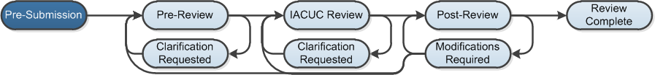
IACUC Submission Workflow
Notes:
At a high level, the system follows this workflow. This training covers the key reviews that IACUC protocols can go through: Pre Review (which includes the admin review, Vet Review, and Ancillary Reviews) and then IACUC Review (which includes either DMR or FCR) followed by Post Review (for preparing correspondence).

Slide 11
Navigation
11
© 2016 Huron Consulting Group. All rights reserved. Proprietary and confidential.
Notes:
In this section we will cover 3 main areas:
The Inbox
The Research Team Workspace
The Protocol Workspace

Slide 12
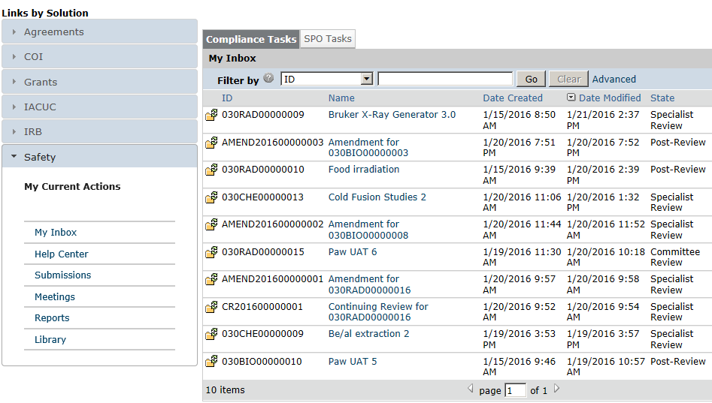
My Inbox
1
From My Inbox, you will see:
Submissions that require action
State in the review process
Shortcut to user guides
Shortcut to view all submissions
Shortcut to meetings
Shortcut to procedures, worksheets, checklists, and templates
2
3
4
5
6

Slide 13
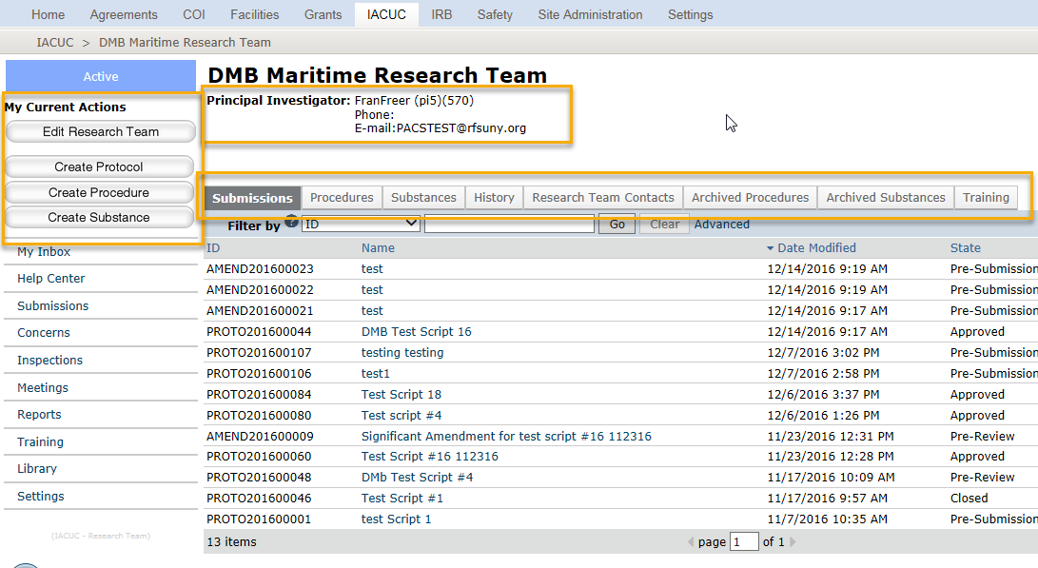
Research Team Workspace
1
From the research team workspace, you will see:
Team PI
Actions you can take in
the research team
Tabs with information about the protocol and the
review process
2
3
Notes:
Research team workspace is first place researchers will go to.
For researchers, everything starts from this workspace. Protocols are created from a specific research team.
IACUC administrators and and committee members do not have access to the research team workspaces. Only team members added to a research team can get to this workspace.
This workspace is setup in typical click fasion. Actions you can take on the left, summary information at the top, and tabs across the middle that extract data relevant to the workspace in an organized way.

Slide 14
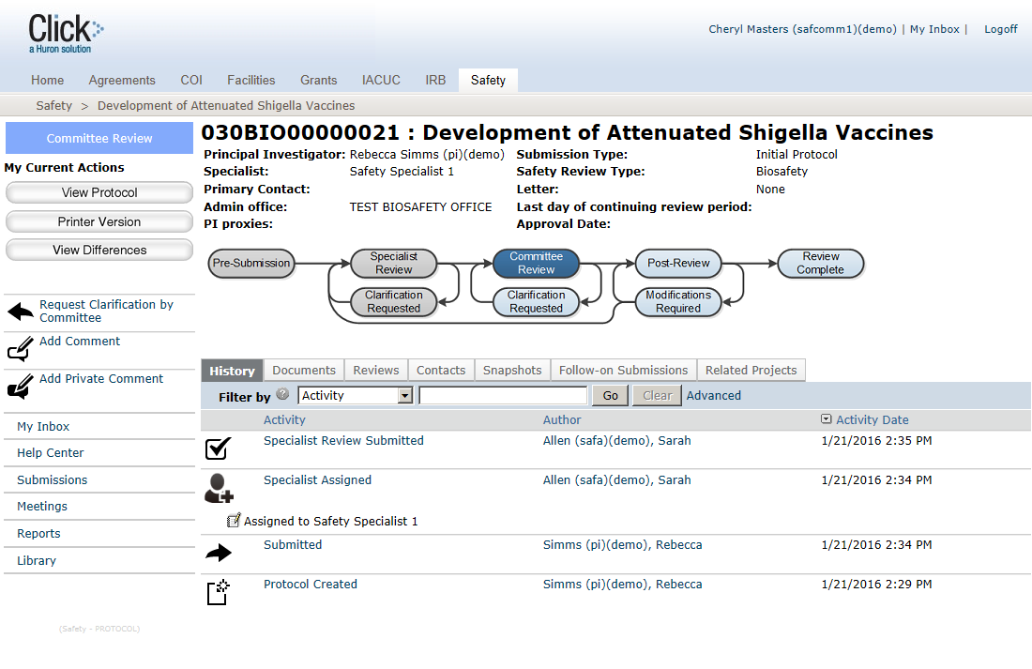
IACUC Protocol Workspace
From the protocol workspace, you will see:
Protocol details
The state in the review process
Actions you can take in
the protocol’s state
Tabs with information about the protocol and the
review process
1
2
3
4
Notes:
This is the protocol workspace. Like the research team workspace you have the summary at the top, actions you can take on the left and tabs with pertinent information across the middle.
In addition, the top left displays the state of the protocol. Which gives you further detail about where you are in the workflow.
From the protocol workspace, depending on your permissions, you will have different actions you can take on the protocol. For example the PI or PI Proxy can submit the protocol, where as a team member can edit the protocol, but not submit. Vets, and committee members can see the protocol in read only, but can make comments and ask for clarification. We will go into that more during the exercises.
No matter who you are logged in as, the layout of the workspace is always the same.

Slide 15
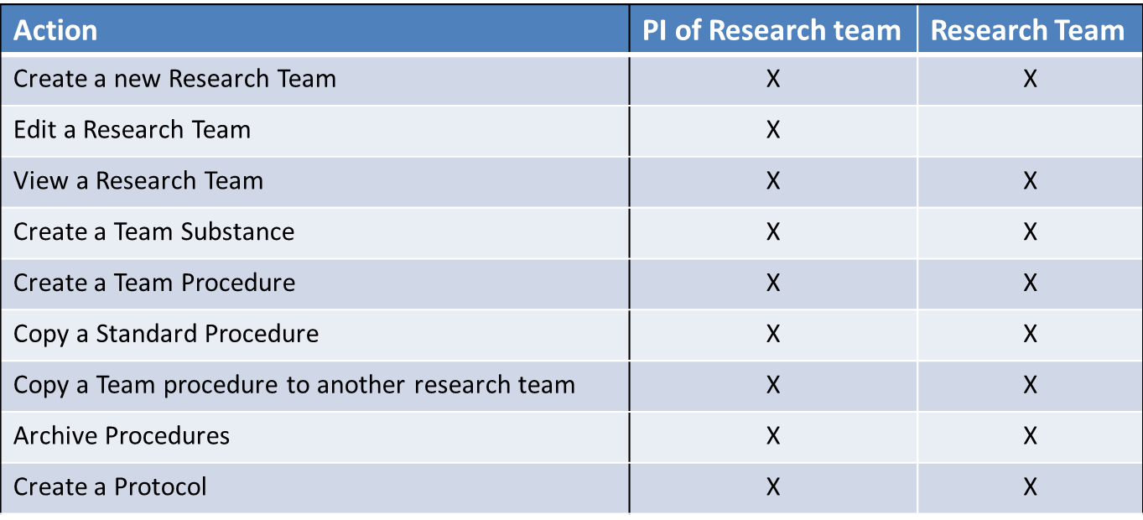
Research Team Capabilities
Notes:
These next two slides summarize a research teams capabilities on the research team workspace vs the protocol workspace.

Slide 16
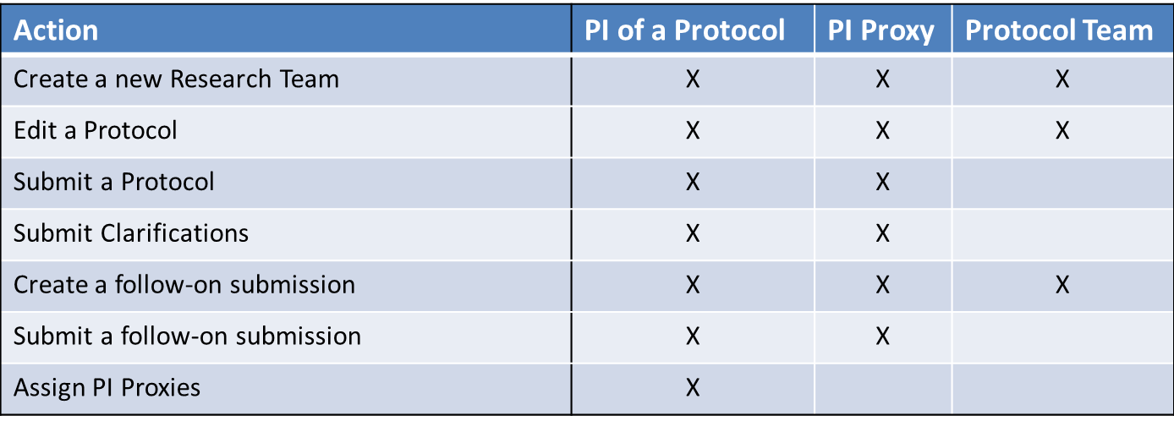
Protocol Team Capabilities

Slide 17
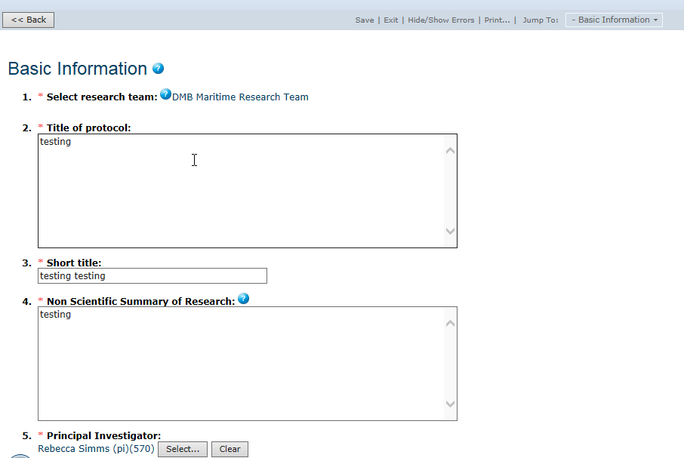
IACUC Protocol SmartForm Pages
3
On the protocol pages, you
will see:
Required fields (red asterisk)
Field help (blue circle)
Navigation bar
1
2

Slide 18
Navigation Exercises
Perform the following training exercises:
Exercise 1: Log into Click® IACUC
Exercise 2: Explore the Inbox
Exercise 3: Explore the Protocol Workspace
Exercise 4: Explore the SmartForm Pages

Slide 19
The Building Blocks
19
© 2016 Huron Consulting Group. All rights reserved. Proprietary and confidential.

Slide 20
IACUC Building Blocks
Standard Substances & Procedures Library
Research Team
Substances
Procedures
Substances
Procedures
Protocols
Create Team Substances
Create Team Procedures*
*Team procedures can have one or more team or standard substances
Create Protocols with Experiments*
*Experiments can have one or more team or standard procedures
Substance
Procedure
Protocol Experiment
Substance
Substance
Substance
Procedure
Substance
Substance
Substance
Procedure
Substance
Substance
Procedure
Substance

Slide 21
Navigation Exercises
Perform the following training exercises:
Exercise 5: Create a Research Team
Exercise 6: Create a Team Substance
Exercise 7: Create a Team Procedure
Exercise 8: Copy a Procedure
Exercise 9: Create and Submit a Protocol for Review

Slide 22
Building Block Workspaces
22
© 2016 Huron Consulting Group. All rights reserved. Proprietary and confidential.

Slide 23
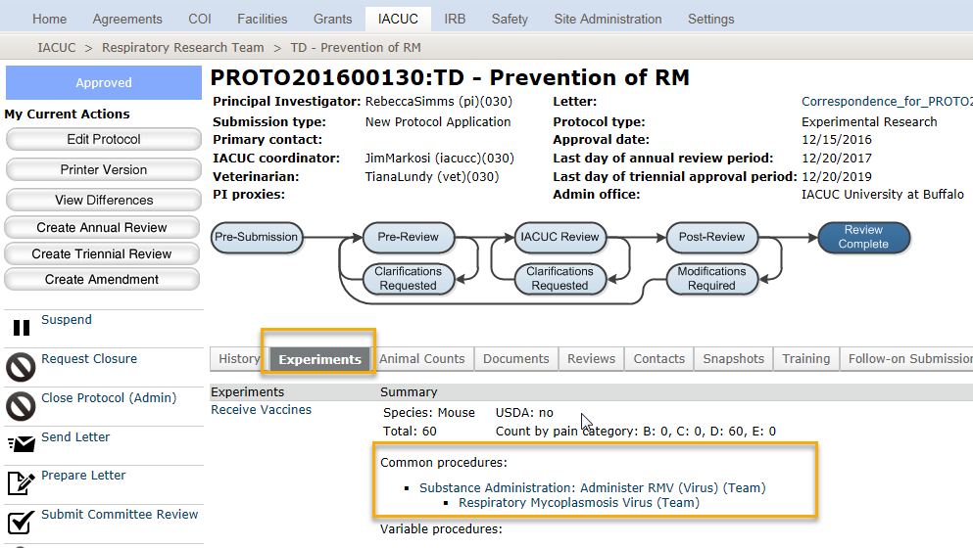
Protocol Workspace
Notes:
From the protocol workspace, the experiments tab shows the building blocks.
For each experiment, you will see the procedures included on the experiment and if they are standard and team procedures. This can be helpful for the reviewer who may need to spend more time on reviewing the team procedures, but only look at the standard procedure in context with the experiment.

Slide 24
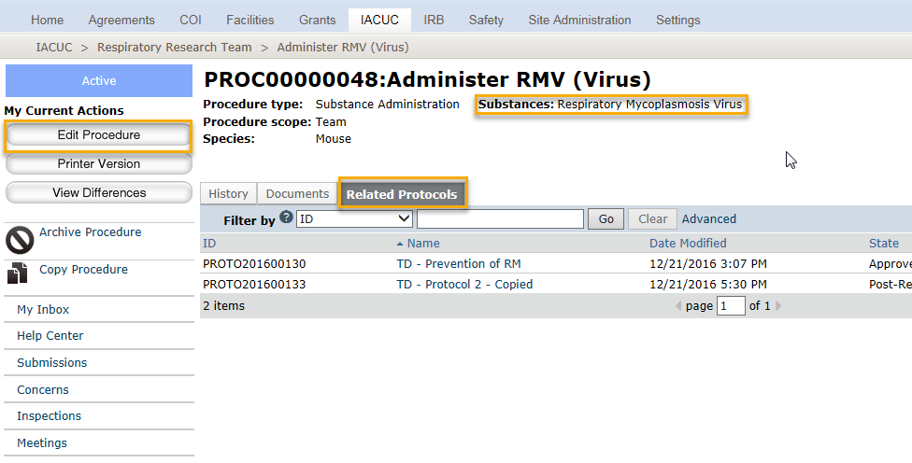
Procedure Workspace
Notes:
This is the procedure workspace. By now you might be recognizing the structure. Actions on the left, summary information at the top, and tabs across the middle.
From the procedure workspace you can see all protocols the procedure has been added to. This is important, for a few reasons.
If the procedure is on many protocols, it could be a candidate for a standard procedure if not already. Secondly, if it’s a team procedure that’s already on an approved protocol, it will not be editable. If edits are required, then a copy of the procedure should be made, and that copy can be added to the new protocol or followon submission.

Slide 25
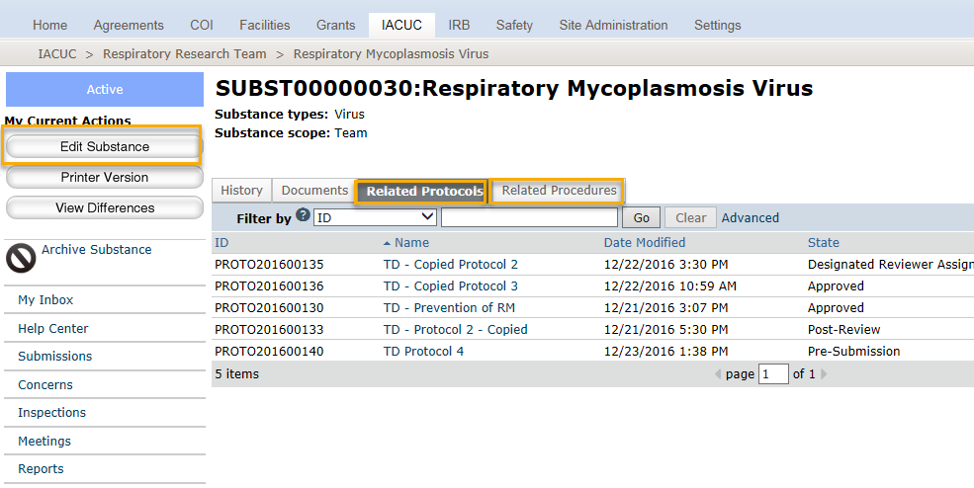
Substance Workspace
Notes:
Lastly are substances. Substances are utilized through the substance administration procedure type. That’s why you see related procedures and related protocols on the substance workspace. If a team substance is on a team procedure, it is editable when the procedure is editable.
Substances cannot be copied, but there are only 3 questions on the substance form.

Slide 26
When are the building blocks editable?
When the protocol is… | The related procedures and substances are…
In Pre-submission | Editable
In Pre-Review | Editable
In past pre-review | Not Editable by Protocol Team, only by IACUC Coordinator
Clarifications Requested | Editable
Approved | Not editable, including when follow-on submissions are editable. For follow-on submissions, create a new procedure/substance, and swap it in on the experiment. (Requires redoing the personnel procedure assignments)

Slide 27
Protocol Submission Workflow
27
© 2016 Huron Consulting Group. All rights reserved. Proprietary and confidential.

Slide 28
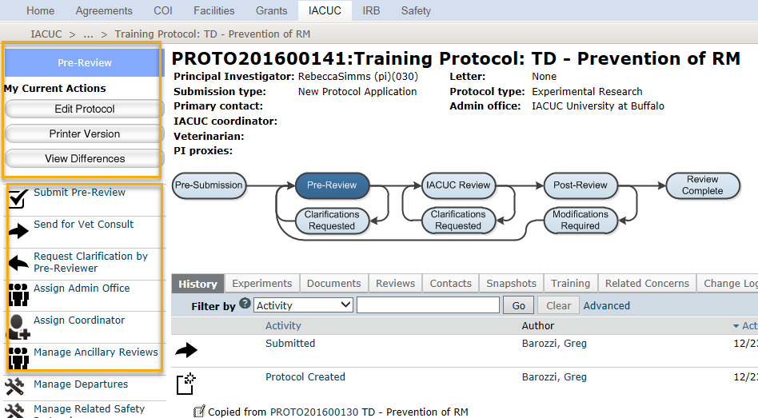
Pre-Review
The IACUC Coordinator can view the SmartForms and use view differences to compare versions of the protocol.
The IACUC Coordinator can take action on the protocol
  Submit Pre Review
  Send for Vet Consult
  Request Clarifications
  Assign Admin Office
  Assign Coordinator
  Manage Ancillary Review
1
1
2

Slide 29
Match the action with its activity!
This activity assigns the protocol to a user with the vet role to review the protocol
Submit Pre-Review
The activity sends a notification to the PI, PI Proxy and Primary Contact that they need to submit changes for the approval process to continue.
Request Clarifications
This activity moves the protocol to a specific coordinator, so that they receive notifications and their inbox is updated when a coordinator is required to take action.
Assign Admin Office
The activity allows for a parallel review process for a protocol that needs to be reviewed by someone other than a vet, coordinator, or committee member
Assign Coordinator
This activity moves to protocol from pre review to either the grace period or meeting assignment.
Manage Ancillary Review
The activity allows the coordinator to assign the protocol to a specific administrative office, so that only certain set of coordinators can take action on the protocol. This is useful when one IACUC site is managing multiple IACUC Committees.
Send for Vet Consult

Slide 30
Pre-Review Exercises
Perform the following training exercises:
Exercise 10: Assign a Coordinator
Exercise 11: Review the Protocol
Exercise 12: Request Clarifications
Exercise 13: Respond to a Reviewer Request
Exercise 14: Send Protocol for Vet Consult
Exercise 15: Submit Vet Consult
Exercise 16: Respond to Vet Reviewer Notes

Slide 31
Protocol Submission: Designated Member Review
31
© 2016 Huron Consulting Group. All rights reserved. Proprietary and confidential.

Slide 32
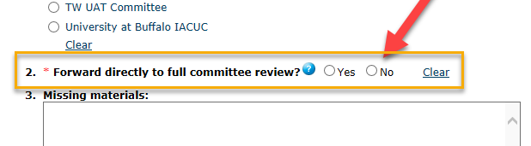
Grace Period
Reviewer Assignment
Designated Review
Pre Review
Post Review
Designated Member Review (DMR)

Slide 33
Grace Period
Reviewer Assignment
Designated Review
Pre Review
Post Review
Designated Member Review (DMR)
The number of days in the grace period is set for the IACUC site, and is calculated based on calendar days.
When set to zero, the protocol will still go to the grace period state for the remainder of the day.
Committee Members can see the protocol in this state, but reviewers cannot be assigned, and reviewer notes are not available.

Slide 34
Grace Period
Reviewer Assignment
Member Review
Pre Review
Post Review
Designated Member Review (DMR)
The assigned coordinator or the IACUC Chair assigns one of the committee members as the designated reviewer.

Slide 35
Grace Period
Reviewer Assignment
Member Review
Pre Review
Post Review
Designated Member Review (DMR)
The DMR can add reviewer notes, and request clarifications from the protocol team
In this state, the Coordinator can reassign the designated reviewer to another committee member.
The DMR can move the protocol to Full Committee Review, or complete their review determining it is approved, or requires modifications
Once the DMR Review is complete, the protocol moves to post review where correspondence letter to the protocol team is prepared by the coordinator

Slide 36
Ancillary Review
36
© 2016 Huron Consulting Group. All rights reserved. Proprietary and confidential.

Slide 37
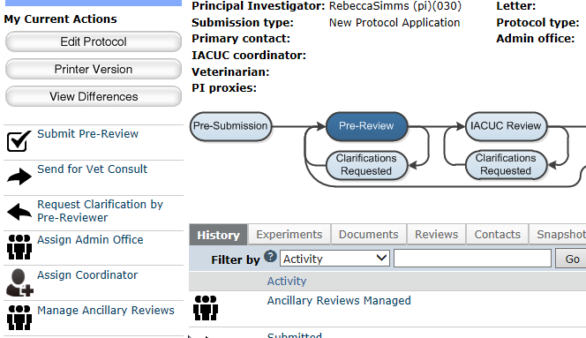
Ancillary Review Activities
The IACUC Coordinator will:
Set up ancillary reviews, if appropriate
1

Slide 38
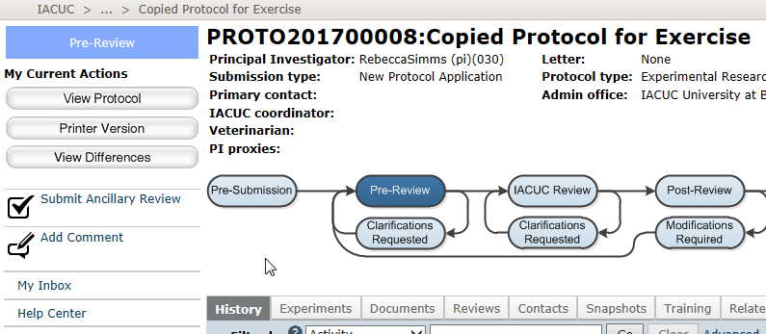
Ancillary Review Activities
The assigned Ancillary Reviewers will:
Submit an ancillary review
1

Slide 39
Protocol Submission: Full Committee Review
39
© 2016 Huron Consulting Group. All rights reserved. Proprietary and confidential.

Slide 40
Committee Review
Meeting Assignment
Assign to Meeting
Assign Reviewers (Still available to all committee members, but assigned reviewers will see the protocol in their inbox and receive a notification
Committee Review
Add Reviewer Notes
Request Clarifications
Submit Committee Determination
Add Private Comments
1

Slide 41
Review Exercises
Perform the following training exercises:
Exercise 17: Submit a Pre-Review Decision
Exercise 18: Assign a Designated Reviewer
Exercise 19: Submit a Member Review
Exercise 20: Set Up Ancillary Reviews
Exercise 21: Submit an Ancillary Review

