Slide 1
Click Training
IACUC Module
University at Buffalo
Office of the Vice President for Research and Economic Development
Electronic Research Administration (eRA)

Slide 2
Alyssa Astran
HRPP Administrator
amsmith8@buffalo.edu
HELLO
my name is
Meghan Laski
IACUC Coordinator
meghanla@buffalo.edu
Marla Witkowski
PACS Campus Training Program Coordinator
mlw9@buffalo.edu

Slide 3
Background
IACUC Module
The Pre-Award and Compliance System (PACS) is a multi-year collaborative project to implement the online Click Portal
The Click Portal is being implemented to assist principal investigators, students, compliance and research administration staff with administering sponsored programs
UB is leading the implementation of the Click Portal, working in collaboration with our vendor partner, Huron, and the PACS Leadership Team.

Slide 4
Objectives
IACUC Module
Provide principal investigators, study staff, compliance and research administration staff an overview of the IACUC module
Demonstrate how to:
  Use building blocks to create an IACUC study and submit it for review
  Manage the IACUC review process
  Create and convene IACUC committee meetings
  Communicate the committee’s decision to the study team
  Submit concerns regarding animal welfare and research practices
  Complete inspections of research facilities
Allow the participants to practice with hands-on exercises
Provide training materials and references that will provide assistance while using the IACUC module

Slide 5
Training Materials
IACUC Module
Click Portal: IACUC Module PowerPoint Slides
Click Portal: IACUC Module Training Exercises
Sample IACUC Study Document
Work Instructions:
  Create a Research Team
  Create a Protocol – Substances
  Create a Protocol - Procedures
  Create and Submit a Protocol
  Respond to Clarification Requests
  Create a Concern

Slide 6
ROles
Click IACUC Module

Slide 7
IACUC User Roles and Responsibilities
Roles
Protocol Team - Individuals responsible for developing and editing the protocol. Includes PIs and their contacts, and other study staff.
IACUC Administrators - Individuals who guide submissions through the review process. Includes IACUC Coordinators and the IACUC Director. Committee Administrators oversee committees and meetings.
Reviewers - Individuals responsible for reviewing studies. Includes IACUC Committee Members, and Veterinarians. Some studies may also require an optional review by an Ancillary Reviewer.
Inspectors – Individuals who conduct semiannual facility inspections and Post-Approval Monitoring (PAM) Audits of investigators, protocols, and procedures. Includes the Inspection Officer and PAM Coordinator roles, along with selected IACUC Committee Members.

Slide 8
Workflow
Click IACUC Module

Slide 9
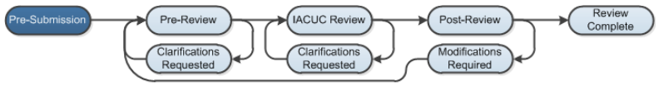
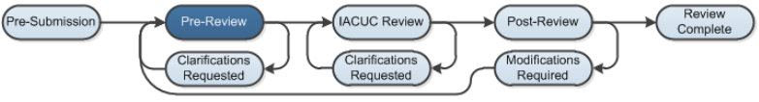
Workflow
IACUC Module
Pre-Submission: During Pre-Submission, the building blocks (e.g., research team, substances, procedures) and the study are created in the system.
Pre-Review: In this state, the study is assigned to an IACUC Coordinator who reviews the submission; the study will also be forwarded to a veterinarian for review.

Slide 10
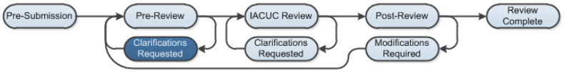
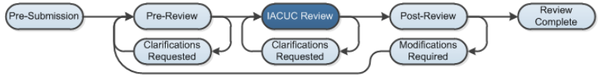
Workflow
IACUC Module
Clarification Requested: The IACUC Coordinator and/or IACUC Committee Members may send a Request for Clarification during the Pre-Review and IACUC Review states. This will send the study into the Clarification Requested state until the PI has responded to the request.
IACUC Review (Designated Review): During this state, exempt or expedited studies will be reviewed by a designated reviewer.
Notes:
Non-Committee Review: Exempt, Expedited

Slide 11
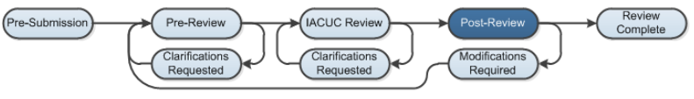
Workflow
IACUC Module
IACUC Review (Committee Review): In Committee Review, the IACUC Committee Members will review the study for completeness
Post-Review: The Post-Review state gives the IACUC staff an opportunity to approve any attached documents, request any modifications, and prepare and send the determination letter.

Slide 12
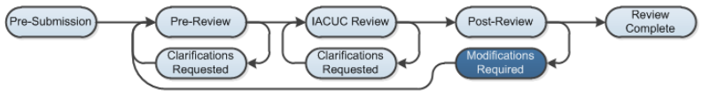
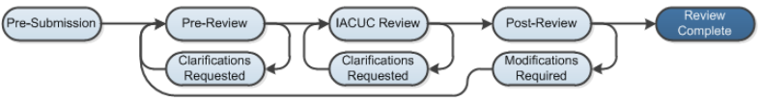
Workflow
IACUC Module
Modifications Required: The study will enter this state if the IACUC decided to require modifications to the study before approving it, providing the study team an opportunity to respond.
Review Complete: The IACUC study will reach its final state, Review Complete, after the approval letter is sent.

Slide 13
Submission and Review Stages
IACUC Module
New Protocol
Pre-Review, Designated Member Review/Full Committee Review, and Post-Review
Amendment
Pre-Review, Administrative Review, Designated Member Review/Full Committee Review, and Post-Review
Annual Review
Pre-Review, Administrative Review, Designated Member Review/Full Committee Review, and Post-Review
Triennial Review
Pre-Review, Administrative Review, Designated Member Review/Full Committee Review, and Post-Review
Activities within each state are controlled by role-based security
Notes:
*Institution determines whether Annual Reviews are required for all protocols or just for protocols that include USDA-covered species (DoD sponsored research requires Annual Reviews)

Slide 14
Navigation
Click IACUC Module

Slide 15
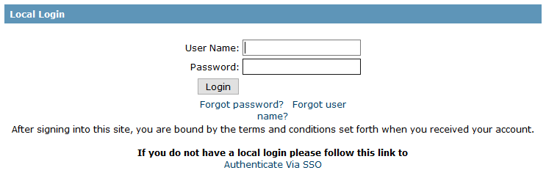
Click IACUC Module – Training Website
Navigation
Navigate to https://pacsstg1.rfsuny.org/SponsoredPrograms/login
Enter a User Name and Password, and click the Login button.

Slide 16
My Inbox
Navigation
My Inbox displays items that the user needs to take action on.
  For Principal Investigators:
    Displays items not yet submitted to the IACUC for review
    Displays items returned from the IACUC that require attention
  For IACUC staff:
    Displays items that are assigned to staff that are in a state that requires attention
    For example:
      Items in need of review
      Responses to clarification requests

Slide 17
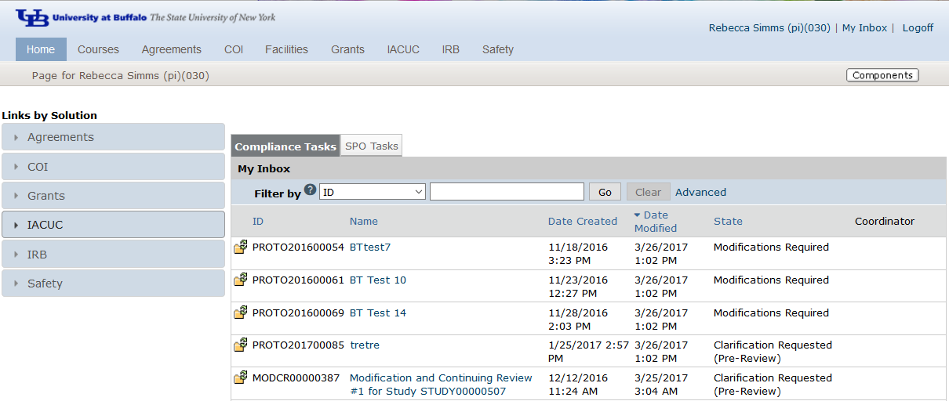
Sample Inbox
Navigation
From My Inbox, you will see:
Submissions that require action
State in the review process
1
2

Slide 18
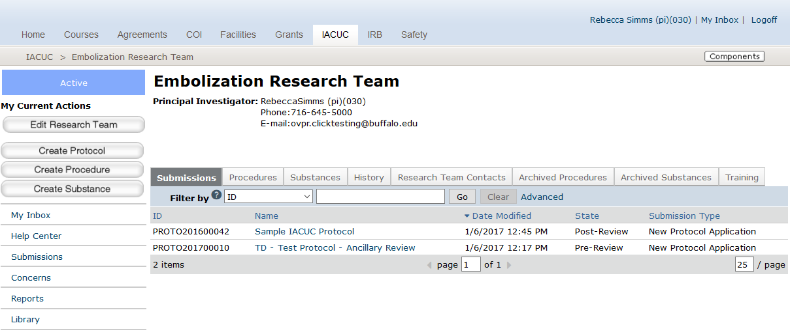
Navigation
From the Research Team workspace, you will see:
All submissions to the IACUC module
State in the review process
Team PI
Actions that can be performed by the research team
Research Team Workspace
3
4
1
2

Slide 19
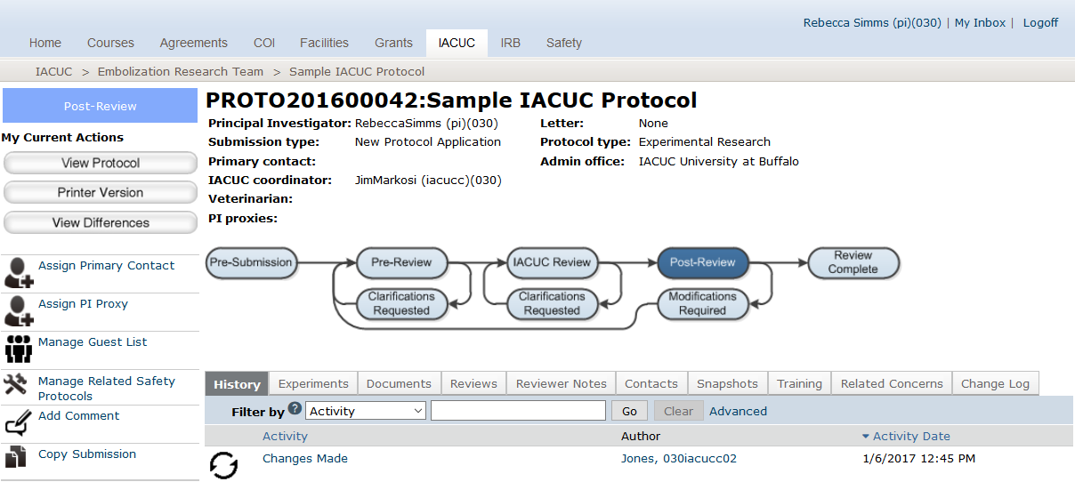
Protocol Workspace
From the Protocol workspace, you will see:
Protocol details
The state in the review process
Actions you can take in the protocol’s state
Tabs with information about the protocol and the review process
Navigation
2
1
3
1
4

Slide 20
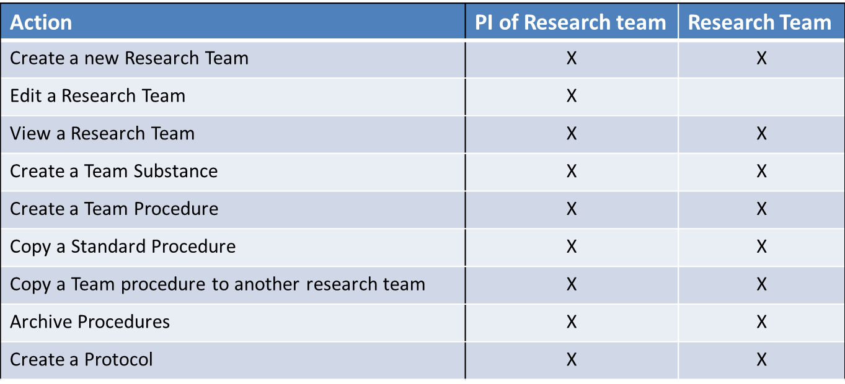
Research Team Actions
Navigation

Slide 21
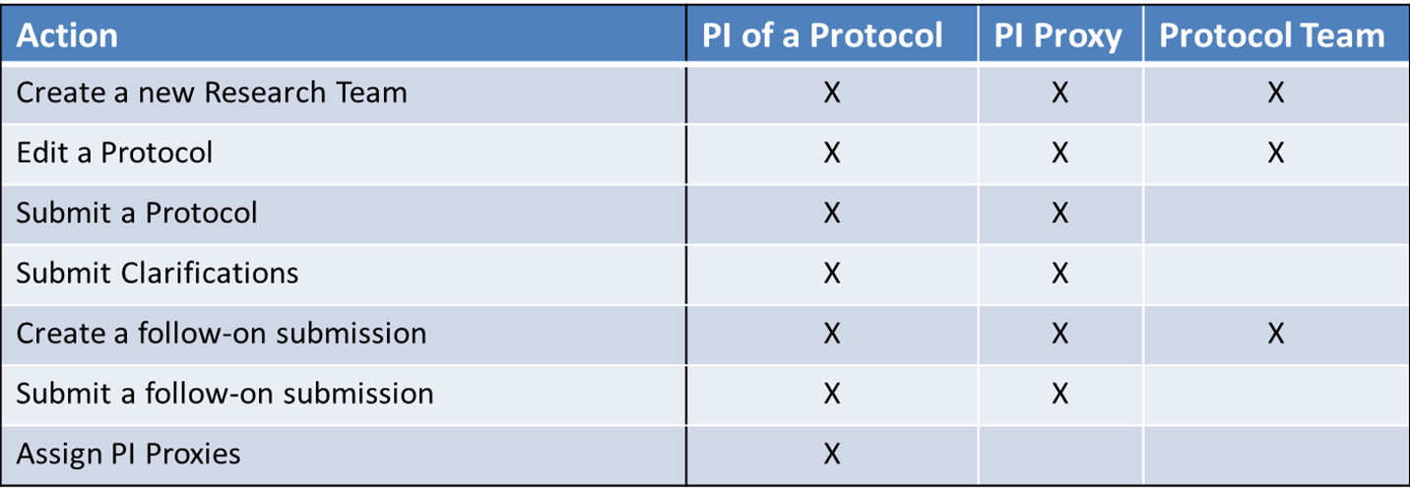
Research Team Actions
Navigation

Slide 22
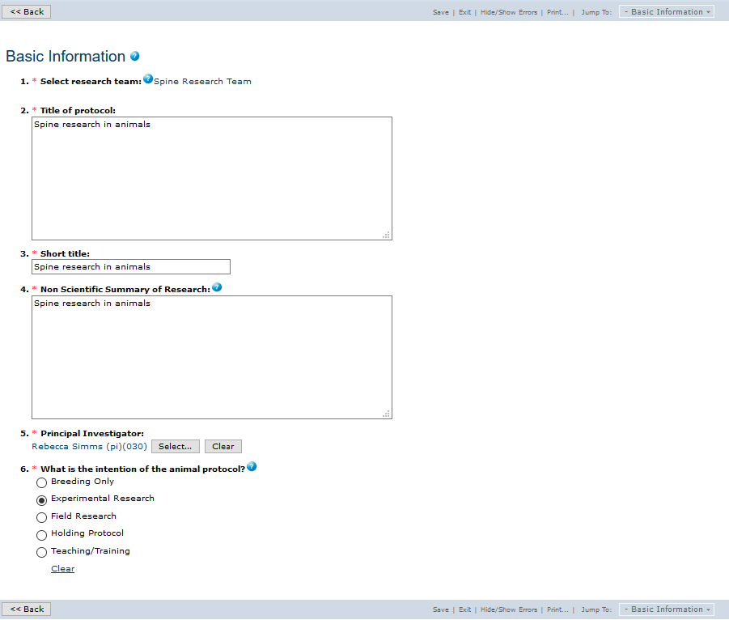
Sample SmartForm
Navigation
3
1
On the SmartForm pages, you
will see:
Required fields (*)
Field help ( )
Navigation bar
2
?

Slide 23
Navigation Exercises
Perform the following training exercises:
Exercise 1: Log into the Click IACUC Module
Exercise 2: Explore the Inbox
Exercise 3: Explore Submissions
Exercise 4: Explore the Protocol Workspace
Exercise 5: Explore the SmartForm Pages

Slide 24
Pre-Submission
(Building Blocks)
Click IACUC Module

Slide 25
Building Blocks
Pre-Submission
Standard Substances & Procedures Library
Research Team
Substances
Procedures
Substances
Procedures
Protocols
Create Team Substances
Create Team Procedures*
*Team Procedures can have one or more Team or Standard Substances
Create Protocols with Experiments*
*Experiments can have one or more Team or Standard Procedures
Substance
Procedure
Protocol Experiment
Substance
Substance
Substance
Procedure
Substance
Substance
Substance
Procedure
Substance
Substance
Procedure
Substance

Slide 26
Editing Building Blocks
Pre-Submission Activities
When the protocol is… | The related procedures and substances are…
In Pre-Submission | Editable
In Pre-Review | Editable
Past the Pre-Review stage | Not editable by Research Team, only by the assigned IACUC Coordinator
Clarifications Requested | Editable
Approved | Not editable, including when Follow-On submissions are editable. For Follow-On submissions, create a new Procedure/Substance, and swap it in on the experiment. (Requires redoing the personnel procedure assignments)
The related procedures and substances are…

Slide 27
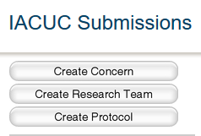
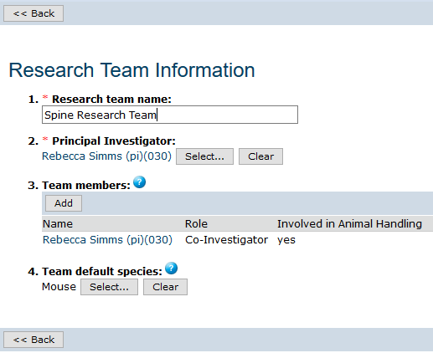
Create a Research Team
Pre-Submission Activities
The PI will :
Create the Research Team
Complete the SmartForm pages
1
2

Slide 28
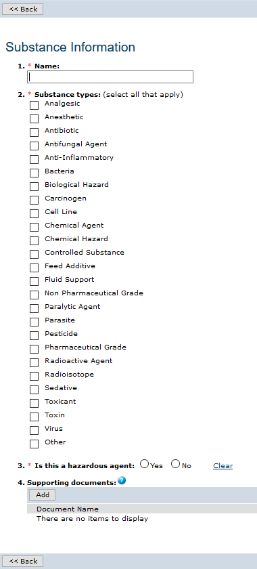
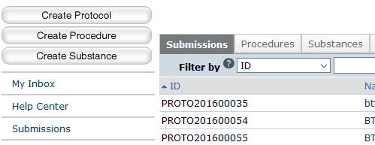
Create a Team Substance
2
Pre-Submission Activities
1
The PI will :
Create the Substance
Complete the SmartForm pages

Slide 29
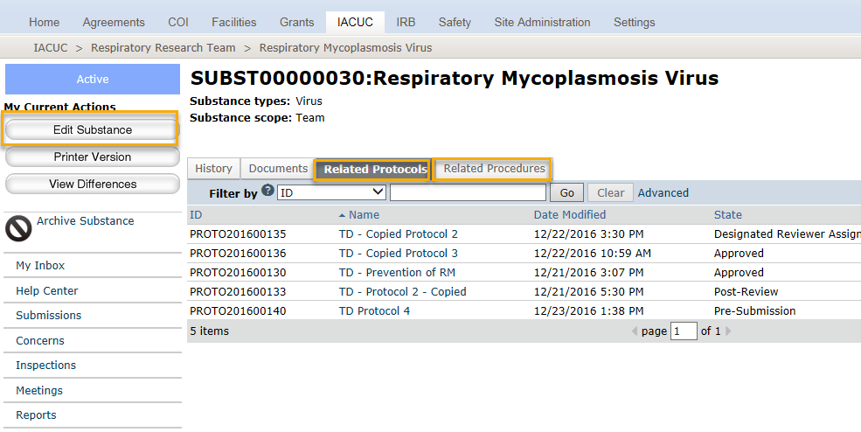
Substance Workspace
Pre-Submission Activities
Notes:
Substances are utilized through the substance administration procedure type. That’s why you see related procedures and related protocols on the substance workspace.
If a team substance is on a team procedure, it is editable when the procedure is editable.
Substances cannot be copied, but there are only 3 questions on the substance form.

Slide 30
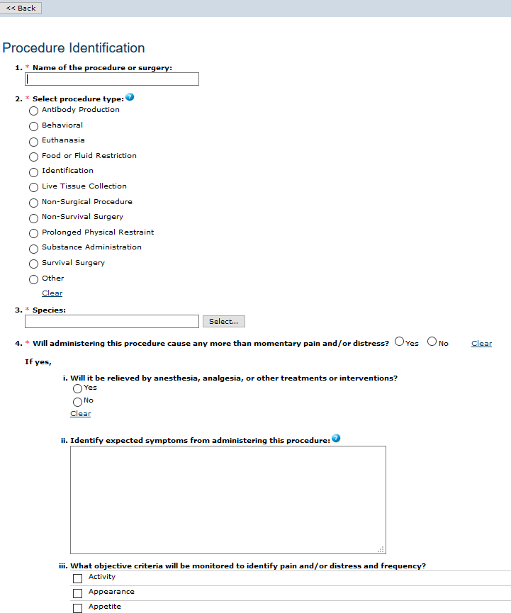
Create a Team Procedure
Pre-Submission Activities
2
1
The PI will :
Create the Procedure
Complete the SmartForm pages

Slide 31
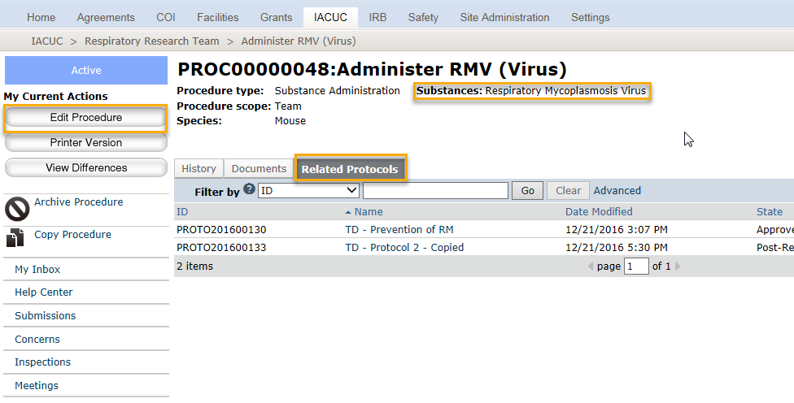
Procedure Workspace
Pre-Submission Activities
Notes:
From the procedure workspace you can see all protocols the procedure has been added to. This is important, for a few reasons.
If the procedure is on many protocols, it could be a candidate for a standard procedure if not already.
Secondly, if it’s a team procedure that’s already on an approved protocol, it will not be editable. If edits are required, then a copy of the procedure should be made, and that copy can be added to the new protocol or follow-on submission.

Slide 32
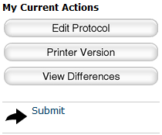
Create a Protocol
Pre-Submission Activities
The PI will :
Create the protocol and complete the SmartForm pages
Submit the protocol for review
1
2

Slide 33
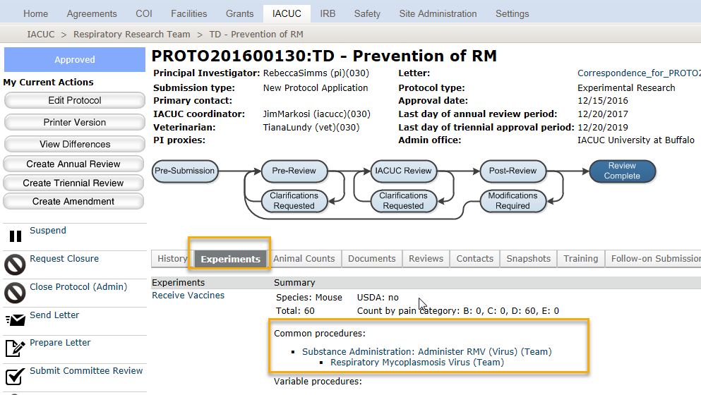
Protocol Workspace
Pre-Submission Activities
Notes:
From the Protocol workspace, the Experiments tab shows the Building Blocks.
For each Experiment, you will see the Procedures included on the Experiment and if they are Standard or Team procedures. This can be helpful for the reviewer who may need to spend more time on reviewing the Team Procedures, but only look at the Standard Procedures in context with the experiment.

Slide 34
Pre-Submission
What to Expect After Submitting
Submitting your protocol initiates a series of activities that may include:
  Review by an IACUC Coordinator
  Review by an IACUC committee
  Optional ancillary review by individuals, departments, and other organizations
  Communication of the committee’s decision to the investigator
Any of these may lead to a request for the research team to take further action, such as providing clarifications regarding the protocol
Whenever the research team needs to act, the PI receives an e-mail notification and the study appears in My Inbox for all research team members when they log in to the Click Portal

Slide 35
Pre-Submission Exercises
Perform the following training exercises:
Exercise 6: Create a Research Team
Exercise 7: Create a Team Substance
Exercise 8: Create a Team Procedure
Exercise 9: Copy a Procedure
Exercise 10: Create a Protocol
Exercise 11: Submit a Protocol for Review

Slide 36
Pre-Review
Click IACUC Module

Slide 37
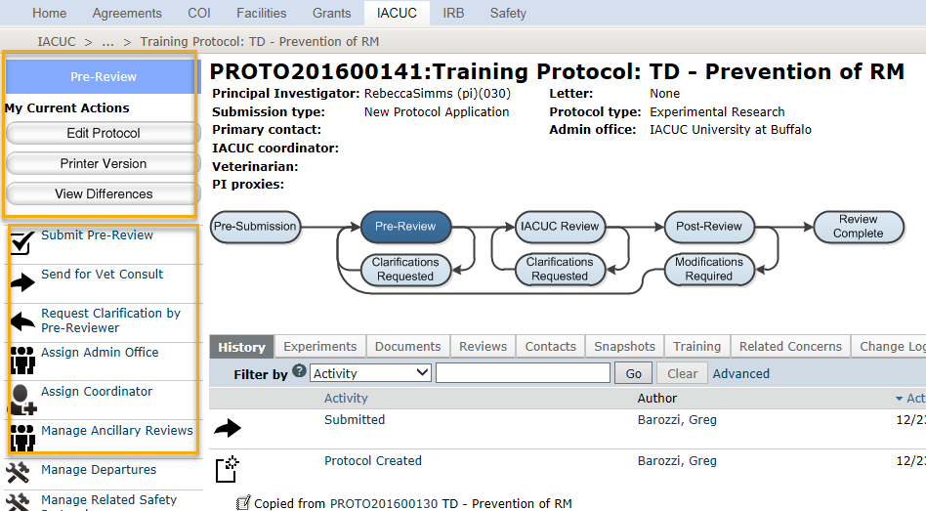
Pre-Review
Pre-Review Activities
The IACUC Coordinator can:
Review the SmartForms, print the SmartForm pages, and compare different versions of the protocol
Take action on the protocol:
  Submit a Pre-Review
  Send for a Vet Consult
  Request Clarifications
  Assign an Admin Office
  Assign an IACUC Coordinator
  Manage Ancillary Reviews
1
2

Slide 38
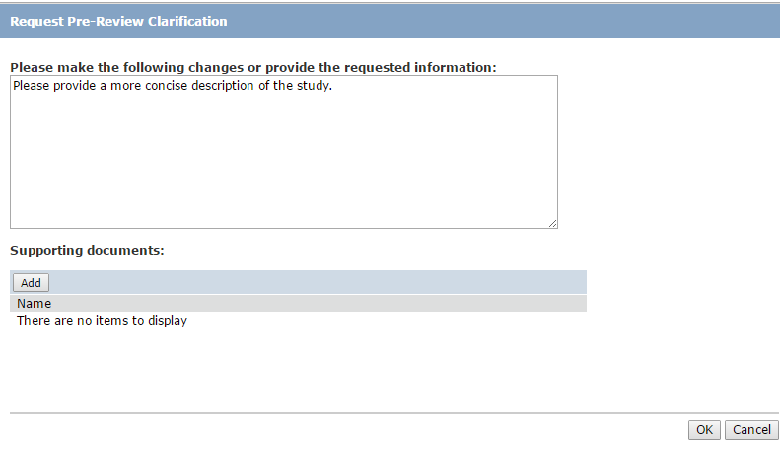
Request Clarifications
Pre-Review Activities
The IACUC Coordinator or IACUC Committee Members will send a Request for Clarification message to the Principal Investigator
Clarifications can be requested in the Pre-Review and IACUC Review stages.

Slide 39
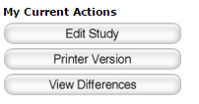
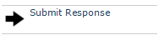
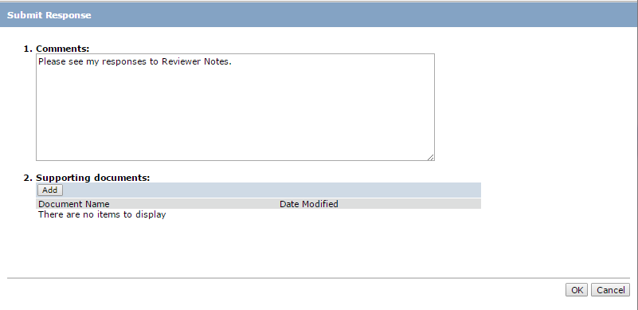
Responding to Clarification Requests
Pre-Review Activities
The Principal Investigator will:
  Click on Submit Response in the Protocol workspace
  Add any comments, and/or upload supporting documents as needed

Slide 40
Pre-Review Exercises
Perform the following training exercises:
Exercise 12: Assign a Coordinator
Exercise 13: Review the Protocol
Exercise 14: Add Reviewer Notes/Request Clarification
Exercise 15: Respond to a Reviewer Request
Exercise 16: Send Protocol for Vet Consult
Exercise 17: Submit Vet Consult (with Reviewer Notes
Exercise 18: Respond to Vet Reviewer Notes
Exercise 19: Submit a Pre-Review Decision

Slide 41
Ancillary Review
Click IACUC Module

Slide 42
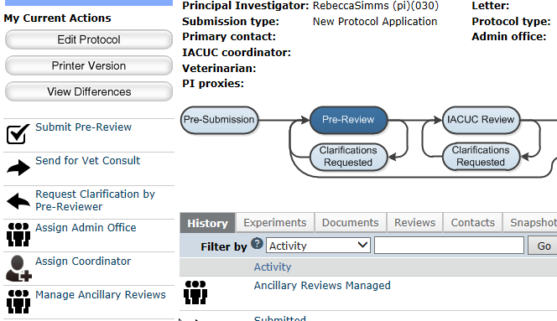
Request an Ancillary Review
Ancillary Review Activities
The IACUC Coordinator will:
Set up Ancillary Reviews, if appropriate
1

Slide 43
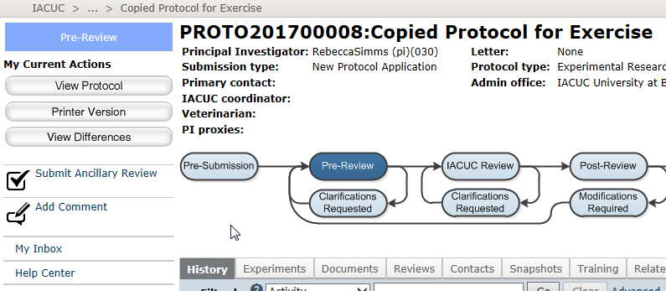
Submit an Ancillary Review
Ancillary Review Activities
The assigned Ancillary Reviewer(s) will:
Submit an Ancillary Review
1

Slide 44
Ancillary Review Exercises
Perform the following training exercises:
Exercise 20: Set Up Ancillary Reviews
Exercise 21: Submit an Ancillary Review

Slide 45
IACUC Review:
Designated Review
Click IACUC Module

Slide 46
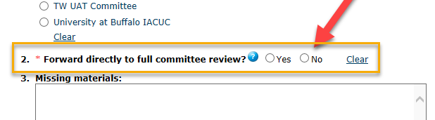
Pre-Review
Grace Period
Reviewer Assignment
Designated Review
Pre-Review
Post Review
IACUC Review: Designated Review

Slide 47
Grace Period
Grace Period
Reviewer Assignment
Designated Review
Pre-Review
Post Review
IACUC Review: Designated Review
The number of days in the Grace Period is set for the IACUC module and is calculated based on calendar days.
When set to zero, the protocol will still go to the Grace Period state for the remainder of the day.
IACUC Committee Members can see the protocol in this state, but reviewers cannot be assigned, and Reviewer Notes are not available.

Slide 48
Reviewer Assignment
Grace Period
Reviewer Assignment
Member Review
Pre-Review
Post Review
IACUC Review: Designated REview
Either the assigned IACUC Coordinator or the IACUC Chair assigns one of the IACUC Committee Members as the Designated Reviewer.

Slide 49
Member Review and Post-Review
Grace Period
Reviewer Assignment
Member Review
Pre-Review
Post Review
IACUC Review: Designated Review
The Designated Reviewer can add Reviewer Notes and Request Clarifications from the protocol team.
The IACUC Coordinator can reassign the Designated Reviewer role to another IACUC Committee Member, if necessary.
The Designated Reviewer can complete their review determining it is Approved, or Requires Modifications. They can also move the protocol to Full Committee Review, if a full review is warranted
Once the Designated Review is complete, the protocol moves to Post-Review where a correspondence letter is prepared by the IACUC Coordinator and is sent to the protocol team.

Slide 50
IACUC Review: Designated Reviewer Exercises
Perform the following training exercises:
Exercise 22: Assign a Designated Reviewer
Exercise 23: Add Reviewer Notes/Request Clarification
Exercise 24: Submit a Designated Review

Slide 51
IACUC Review:
Committee Review
Click IACUC Module

Slide 52
Full Committee Review
IACUC Review: Committee Review
Meeting Assignment
The IACUC Coordinator assigns the protocol to an IACUC Committee Meeting.
The IACUC Coordinator may assign specific IACUC Committee Members to serve as Primary/Secondary Reviewers; these reviewers will receive an email notification from the system.
Committee Review
At the IACUC Committee Meeting the IACUC Committee Members will review the protocol as a group, adding Reviewer Notes and Comments as warranted. They may also request clarifications from the protocol team.
Once the IACUC Committee Members have made a determination, the IACUC Director will submit the committee’s determination within the system.
Notes:
The protocol is available to all Committee Members, but assigned Primary/Seconday Reviewers will see the protocol in their Inbox and will receive an email notification from the system.

Slide 53
IACUC Review: Committee Review Exercises
Perform the following training exercises:
Exercise 25: Assign Protocol to a Committee Meeting
Exercise 26: Add Reviewer Notes
Exercise 27: Submit the Committee Review

Slide 54
Post- Review
Click IACUC Module

Slide 55
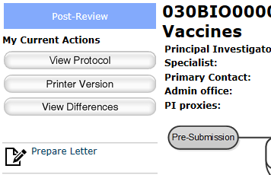
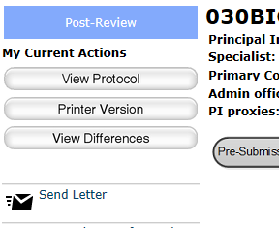
Prepare and Send the Determination Letter
Post-Review Activities
The assigned IACUC Coordinator will:
Prepare the determination letter
Send the letter
1
2

Slide 56
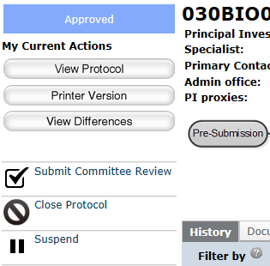
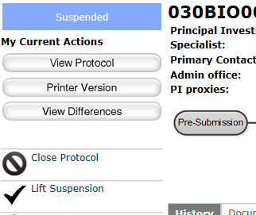
Suspend a Protocol
The assigned IACUC Coordinator can also:
Suspend approved protocols, when appropriate
Lift protocol suspensions
Post-Review Activities
1
2

Slide 57
Post-Review Exercises
Perform the following training exercises:
Exercise 28: Prepare and Send the Determination Letter
Exercise 29: Suspend an Approved Protocol
Exercise 30: Lift Suspension of a Protocol

Slide 58
Follow-On Submissions
Click IACUC Module

Slide 59
Follow-On Submission Workflow
Follow-On Submissions Activities
Vet Consult
Pre-Submission
Pre-Review
Grace Period
Designated Member Review
Post-Review
Committee Review
Administrative approval (follow-on submissions)

Slide 60
Parallel Submission
Follow-On Submission Activities
Submission Type | Parallel Submissions Allowed
Triennial Review | None
Annual Review | Amendment (Type = Sig Change) Amendment (Type = Other)
Amendment (Type = Sig Change) | Annual Review Amendment (Type = Other)
Amendment (Type = Other) | Annual Review Amendment (Type = Sig Change)

Slide 61
Follow-On Submission Exercises
Perform the following training exercises:
Exercise 31: Create and Submit and Annual Review
Exercise 32: Create a Triennial Review
Exercise 33: Create an Amendment for Significant Change

Slide 62
Concerns and Inspections
Click IACUC Module

Slide 63

Concerns Workflow
Concerns and Inspections Activities
Pre-Submission
  An IACUC user with any role may create and submit a Concern.
  An IACUC Coordinator reviews the concern and adds any missing information to it. Then the coordinator submits it for Pre-Review.

Slide 64
Concerns Workflow
Concerns and Inspections Activities
Pre-Review
  The IACUC Coordinator may request clarification and may determine that no further action is required based on their review; they can also assign it to an IACUC Committee Meeting for further review.
  Concerns that don't require a Committee Review will still appear on the committee's next meeting agenda to inform Committee Members of the Coordinator's determination.

Slide 65
Concerns Workflow
Concerns and Inspections Activities
IACUC Review
  The IACUC Committee determines whether the concern is a deficiency.
  The IACUC Coordinator enters the Committee's determination, and if applicable, the corrective action instructions or plan, corrective action due date, and those responsible for performing the corrective action.
  Upon submitting the determination, the system sends a notification to the responsible parties. If the concern is an administrative issue, the system will also send a notification to the IACUC Chair and institutional official.

Slide 66
Concerns Workflow
Concerns and Inspections Activities
Corrective Action
  The responsible parties perform the corrective action and when completed, notify the IACUC that the action was completed.
  During this state, IACUC staff or the Committee Chair can update the corrective action plan and the system will notify the responsible parties of the updated plan.
  Once the responsible parties have completed the corrective action, the IACUC staff or chair can confirm the action plan was indeed completed.

Slide 67
Concerns Workflow
Concerns and Inspections Activities
Complete
  The corrective action plan for the concern or deficiency has been completed.
  The completed concern is added to the IACUC Committee's next meeting agenda for acknowledgment.
No Action
  No action is taken on the concern.
  The IACUC Coordinator, Director, or Chair can, at any time, assign it to a meeting to be reviewed by the IACUC Committee.

Slide 68
Inspections
Concerns and Inspections Activities
Provides the ability to schedule and track different types of inspections
  Semiannual facility inspections
  Post-Approval Monitoring (PAM) audits
All inspection types follow the same workflow involving two states —Pending Inspection and Inspection Complete.
Upon creation, an inspection is in the Pending Inspection state and remains in that state until the inspection is completed.
  The system sends email notifications to the inspectors informing them of their assignments.
  If a due date was entered for the inspection, the inspection is also added to the inspection calendar.
Notes:
For facility inspections, the inspection officer selects committee members to do the inspection; for PAM audits the inspector is the PAM Coordinator, which appears by default on the form.

Slide 69
Concerns and Inspections Exercises
Perform the following training exercises:
Exercise 34: Create and Submit a Concern
Exercise 35: Create an Inspection
Exercise 36: Record Findings and Complete an Inspection

Slide 70
Committee
Meeting Management
Click IACUC Module

Slide 71
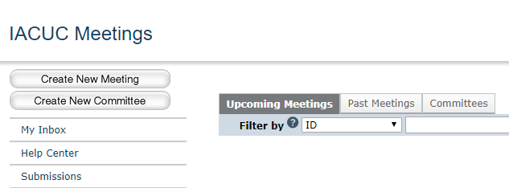
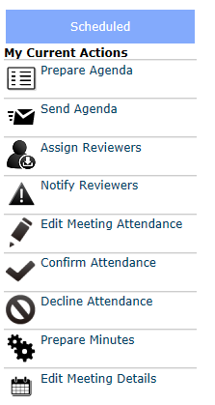
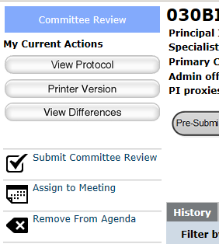
Committee Meeting Management
Committee Meeting Management Activities
The Committee Administrator assigned to a committee can perform the following activities for that committee:
Create new Meetings
Remove agenda items from Meeting workspace
Prepare and send agendas to Committee Members
Prepare meeting minutes and many other actions from the Meeting workspace
1
3
2
2
4

Slide 72
Committee Meeting Management Exercises
Perform the following training exercises:
Exercise 37: Create a New Meeting
Exercise 38: Run a Meeting

Slide 73
Update Animal Count
Click IACUC Module

Slide 74
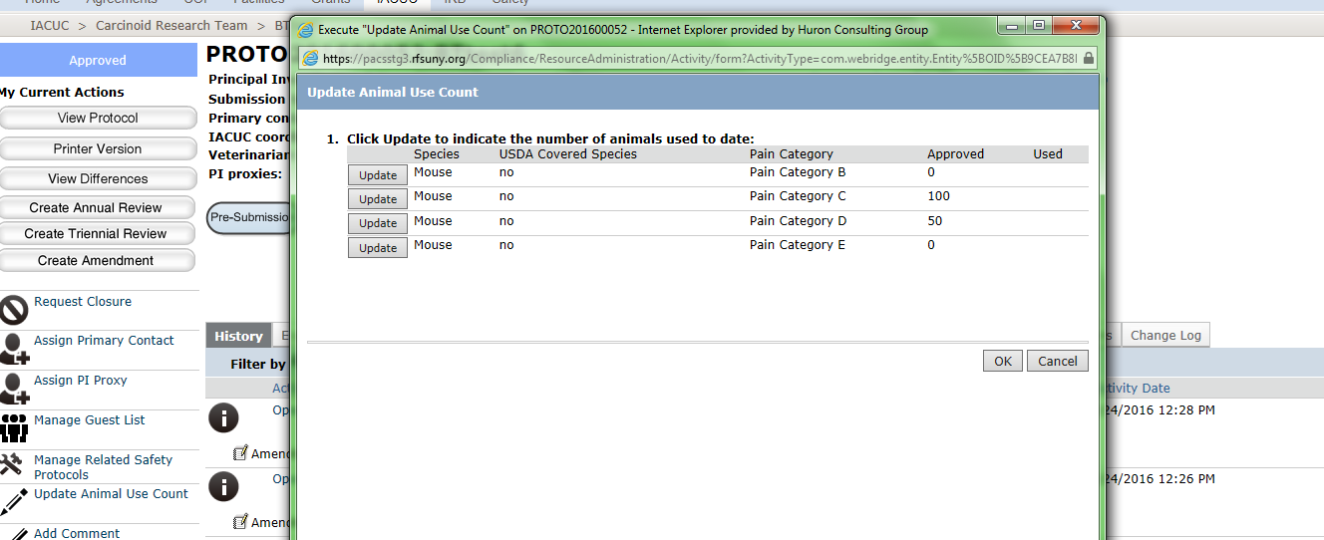
Update Animal Use Count
Update Animal Count Activities
The Principal Investigator can:
Update the Animal Use Count
Edit the Animal Count to verify the numbers of animals used
2
1

Slide 75
Update Animal Count Exercises
Perform the following training exercises:
Exercise 39: Manage Departures
Exercise 40: Update Animal Count
Exercise 41: Manage Associated Projects

Slide 76
Questions?
Click Safety Module

Slide 77
Questions
Contact Information
For policy questions regarding IACUC:
  Elizabeth Trumpower, eatrumpo@buffalo.edu
For technical questions regarding Click:
  Marla Witkowski, mlw9@buffalo.edu
For assistance with UBIT Names and Passwords:
  Electronic Research Administration, support@research.buffalo.edu

Slide 78

Navigation
Click IACUC Module – Live Website
Navigate to http://www.buffalo.edu/research
Locate the QUICK LINKS section of the page:
Click on the Click Portal Login link
Enter your UBITName and Password, and click the Log In button.

Slide 79
Evaluation
Click IACUC Module Training Evaluation
http://bit.ly/2nLQGDo

