Slide 1
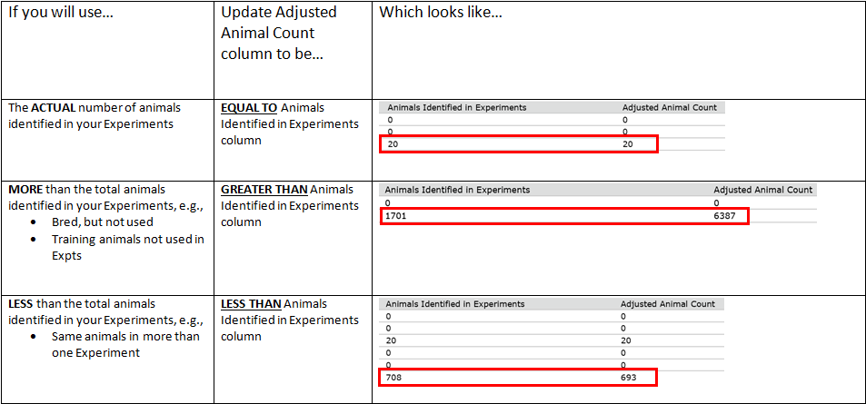
Making Sense of Animal # Adjustments

