Slide 1
Click Training
Conflict of Interest (COI) Module
University at Buffalo
Office of the Vice President for Research and Economic Development
Electronic Research Administration (eRA)

Slide 2
HELLO
my name is
Ed Zablocki
Conflict of Interest Officer
zablocki@buffalo.edu
Marla Witkowski
PACS Campus Training Program Coordinator
mlw9@buffalo.edu

Slide 3
COI Module
Background
The Pre-Award and Compliance System (PACS) is a multi-year collaborative project to implement the online Click Portal
The Click Portal is being implemented to assist principal investigators, students, compliance and research administration staff with administering sponsored programs
UB is leading the implementation of the Click Portal, working in collaboration with our vendor partner, Huron, and the PACS Leadership Team.

Slide 4
COI Module
Training Materials
Click Portal: COI Module PowerPoint Slides
Click Portal: COI Module Training Exercises
Sample Disclosure Document
Work Instructions:
  Agreements Module Workflow
  Create and Submit an Agreement
  Respond to Clarifications Requested
  Track and Manage Reviews
  Manage Ancillary Reviews
  Activate an Agreement
  Create and Submit an Amendment

Slide 5
COI Module
Course Objectives
Provide principal investigators, study staff, compliance and research administration staff an overview of the COI module
Demonstrate how to:
  Access and update an Annual Disclosure Certification
  Create an Agreement and submit it for review
  Manage the Agreement review process
  Obtain necessary signatures and activate an Agreement
Allow the participants to practice with hands-on exercises
Provide training materials and references that will provide assistance while using the COI module

Slide 6
Roles and Workflow
Click COI Module
Roles and Workflow

Slide 7
Roles and Workflow
COI User Roles and Responsibilities
COI Discloser - Individuals who are developing and entering a research protocol. This individual is more commonly known as the Principal Investigator.
COI Administrators - Individuals who guide submissions through the review process. They are responsible for reviewing a disclosure, administratively approving the disclosure or assigning it to the Conflict of Interest Committee (CIRC) for review.
COI Reviewers - Committee Members who are responsible for reviewing disclosures. Some disclosures may also require an optional review by an Ancillary Reviewer.
COI Monitors – Committee Members that are assigned to monitor whether or not a management/mitigation plan to address any issues with a disclosure is being followed or completed.

Slide 8
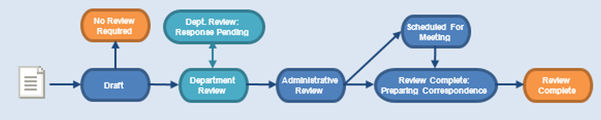
Roles and Workflow
COI workflow – No Issues
Notes:
At a high level, the system follows this workflow. This training covers the key reviews that Safety protocols can go through: Specialist Review (which includes the Safety Specialist, Biosafety Officer, Member Reviews, and Ancillary Reviews) and Committee Review.

Slide 9
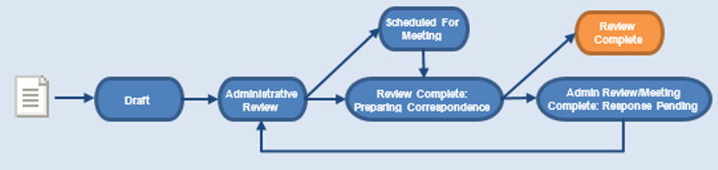
Roles and Workflow
COI workflow – Changes Required
Notes:
At a high level, the system follows this workflow. This training covers the key reviews that Safety protocols can go through: Specialist Review (which includes the Safety Specialist, Biosafety Officer, Member Reviews, and Ancillary Reviews) and Committee Review.

Slide 10
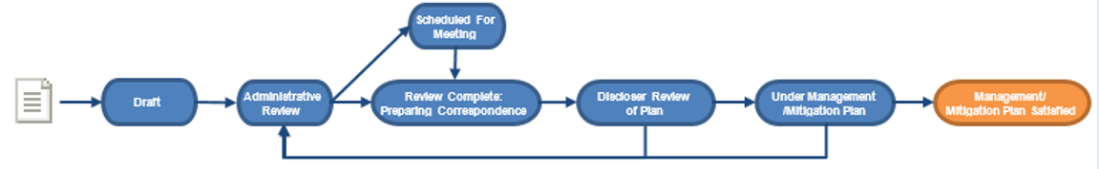
Roles and Workflow
COI workflow – Management or Mitigation Plan Required
Notes:
At a high level, the system follows this workflow. This training covers the key reviews that Safety protocols can go through: Specialist Review (which includes the Safety Specialist, Biosafety Officer, Member Reviews, and Ancillary Reviews) and Committee Review.

Slide 11
navigation
Click COI Module
Navigation

Slide 12
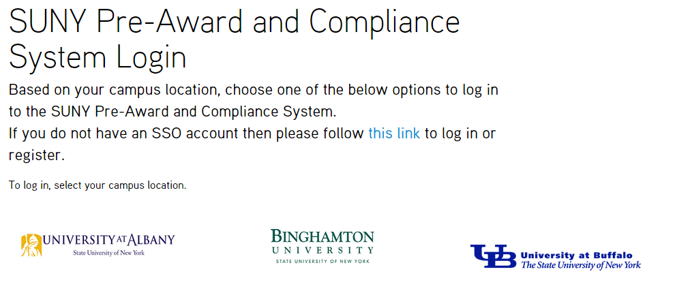
Navigation
Training Website
Navigate to http://pacsstg1.rfsuny.org
Locate the heading ‘SUNY Pre-Award and Compliance System Login’
Click on the words ‘this link’
Enter a User Name and Password, and click the Login button.
Click Training Website

Slide 13
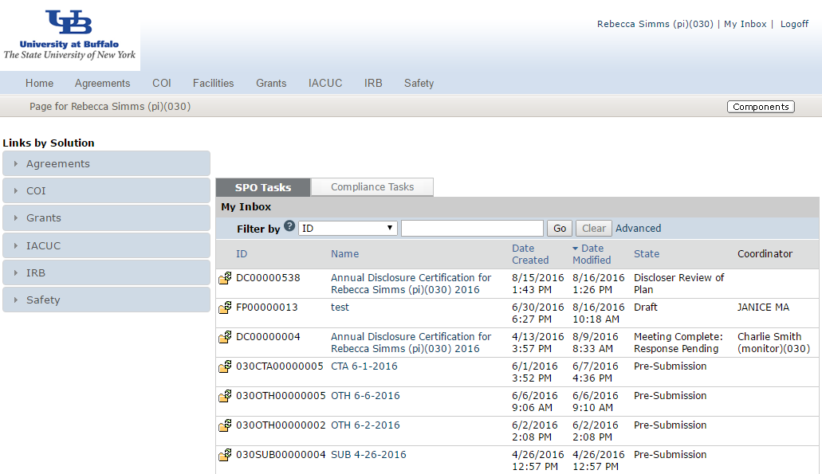
Navigation
My Inbox
From My Inbox, you will see:
Submissions that require action
State in the review process
1
2

Slide 14
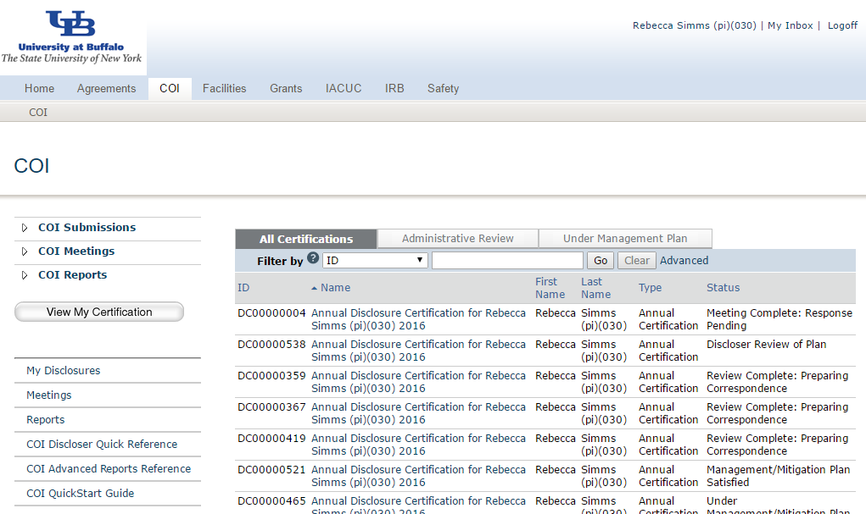
Navigation
From COI Submissions, you will see:
All submissions to the COI module
State in the review process
Link to edit/view certification
Shortcuts to user guides
COI Submissions
1
2
3
4

Slide 15
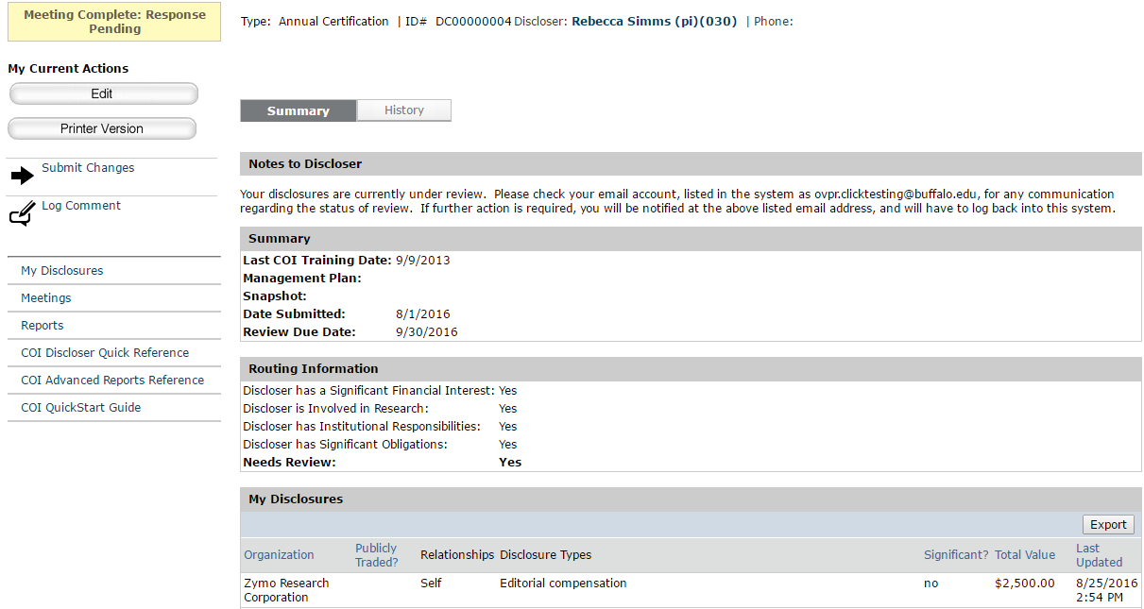
Navigation
Certification Workspace
1
2
4
3
From the Certification Workspace, you will see:
Certification details
The state in the review process
Actions you can take in the certification’s state
Tabs with information about the history of the certification
Disclosure details
5

Slide 16
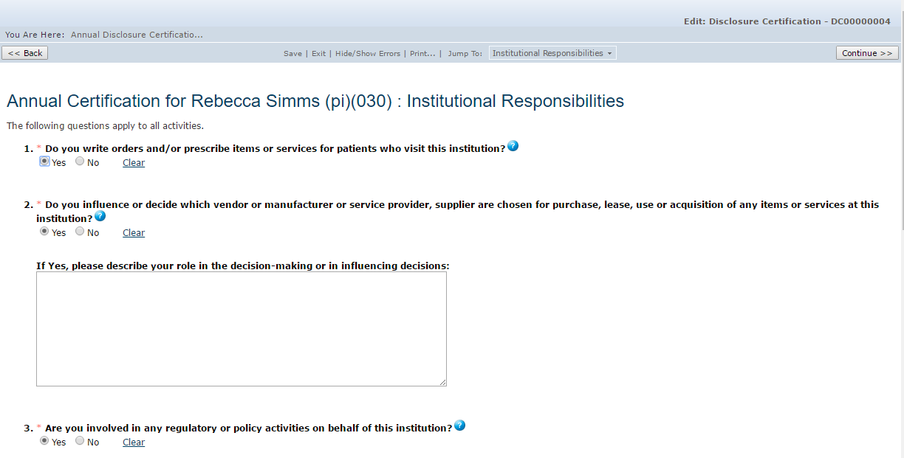
Navigation
COI SmartForm Pages
3
1
On the SmartForm pages, you
will see:
Required fields (*)
Field help ( )
Navigation bar
2
?

Slide 17
Navigation Exercises
Perform the following training exercises:
Exercise 1: Log into the COI Module
Exercise 2: Explore the Inbox
Exercise 3: Explore COI Submissions
Exercise 4: Explore the Certification Workspace
Exercise 5: Explore the SmartForm Pages

Slide 18
Draft
Click COI Module
Pre-Submission

Slide 19
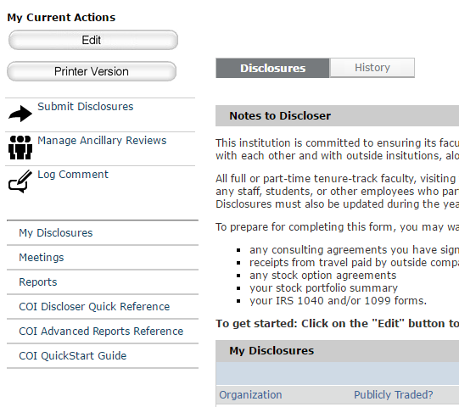
Draft
Draft Activities
The PI/COI Discloser can:
Edit the certification and complete the SmartForm pages
Submit the disclosure(s) for review
1
2

Slide 20
Draft
What to Expect After Submitting
Submitting your disclosure(s) initiates a series of activities that may include:
  Review by a COI Administrator
  Optional ancillary review by individuals, departments, and other organizations
  Review by the Conflict of Interest Committee (CIRC)
  Communication of the reviewers’ decision to the investigator
Any of these may lead to a request for the COI Discloser to take further action, such as providing clarifications regarding the disclosure
Whenever the COI Discloser needs to act, they will receive an e-mail notification, and the certification appears in My Inbox when they log in to the Click Portal

Slide 21
Draft Exercises
Perform the following training exercises:
Exercise 6: Edit a Certification
Exercise 7: Submit Disclosures to Review

Slide 22
Ancillary Review
Click COI Module
Member Review

Slide 23
Ancillary Review
Ancillary Review Process
Ancillary reviews allow individuals, departments, and other organizations to give feedback on the submission in parallel with the disclosure review
The system does not prevent a submission from being reviewed or approved with ancillary reviews outstanding
Decisions about how, when, and whether to interrupt the review process to wait for ancillary reviews are left to the University’s policies and staff

Slide 24
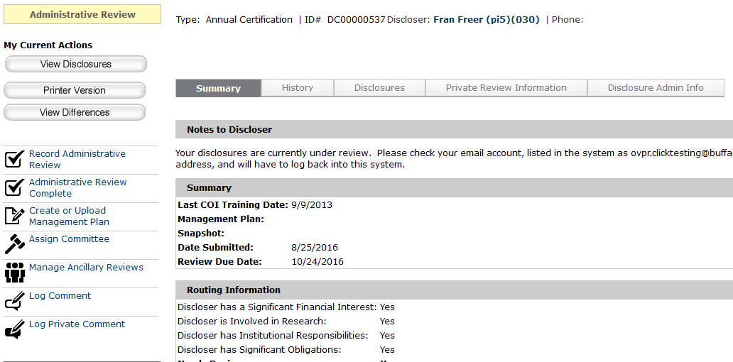
Ancillary Review
Ancillary Review Activities
Ancillary reviews can occur at any time from the Pre-Submission to In-Review states.
They can be requested and managed (1) by COI Administrators, Committee Members, and Monitors
1

Slide 25
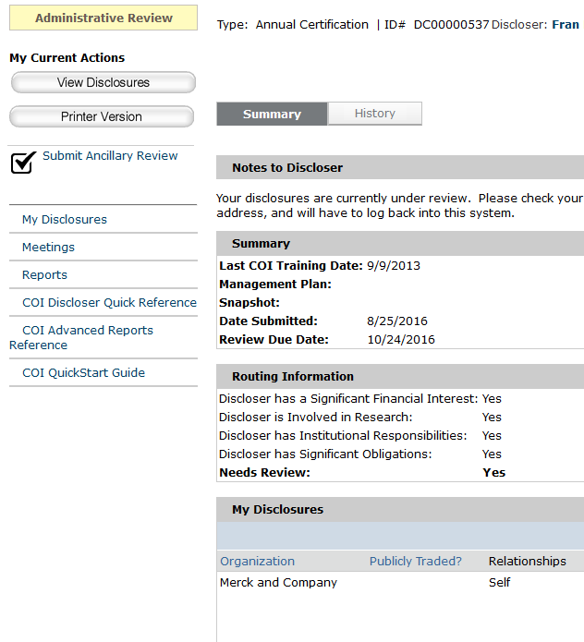
Ancillary Review
Ancillary Review Activities
The Ancillary Reviewer can:
Submit an ancillary review, and request changes to the disclosure.
1

Slide 26
Ancillary Review Exercises
Perform the following training exercises:
Exercise 8: Manage Ancillary Reviews
Exercise 9: Submit an Ancillary Review

Slide 27
Administrative Review
Click COI Module
Specialist Review

Slide 28
Administrative Review
Administrative Review Activities
The COI Administrator can:
Review the disclosure(s) and determine if any edits or an Ancillary Review is needed
Record their administrative review and mark it complete
Assign the agreement to a committee for further review
1a
3
2
1b

Slide 29
Administrative Review Exercises
Perform the following training exercises:
Exercise 10: Review Certification Details
Exercise 11: Assign a Committee
Exercise 12: Record and Complete an Administrative Review

Slide 30
Preparing for Meeting
Click COI Module
Member Review

Slide 31
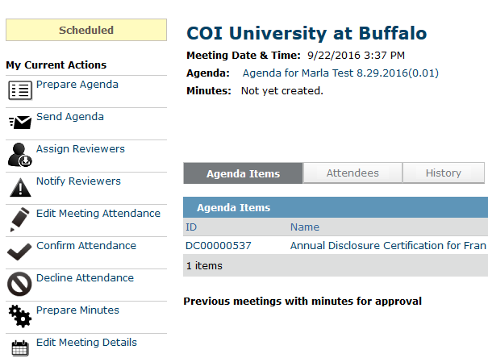

Preparing for Meeting
Preparing for Meeting Activities
The COI Administrator can:
Prepare the agenda for the meeting
Send the agenda to Committee Members
Assign reviewers to the disclosure(s)
2
3

Slide 32
Preparing for Meeting Exercises
Perform the following training exercises:
Exercise 13: Prepare an Agenda
Exercise 14: Send an Agenda
Exercise 15: Assign a Reviewer

Slide 33
Primary/secondary Reviewer
Click COI Module
Specialist Review

Slide 34
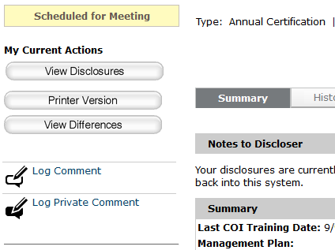
Primary/Secondary Reviewer
Primary/Secondary Reviewer Activities
The Committee Member can:
Review the disclosure(s)
Log a comment (which can be seen by all parties related to the disclosure)
Log a private comment (which cannot be seen by the COI Discloser)
1
2
3

Slide 35
Primary/Secondary Reviewer Exercises
Perform the following training exercises:
Exercise 16: Review Certification Details
Exercise 17: Log Comments

Slide 36
Meeting Convened
Click COI Module
BSO Review

Slide 37
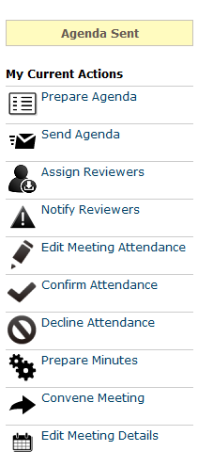
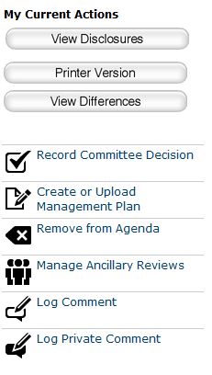
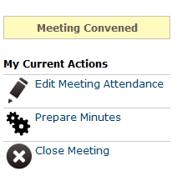
Meeting Convened
Meeting Convened Activities
The COI Administrator can:
Begin the meeting
Record meeting attendance
Upload and approve the meeting minutes
End the meeting
Record the committee’s decision
5
2
1
3
4

Slide 38
Meeting Convened Exercises
Perform the following training exercises:
Exercise 18: Convene a Meeting
Exercise 19: Record Meeting Attendance
Exercise 20: Prepare the Meeting Minutes
Exercise 21: Close a Meeting
Exercise 22: Record the Committee Decision

Slide 39
Review Complete: Preparing Correspondence
Click COI Module
BSO Review

Slide 40
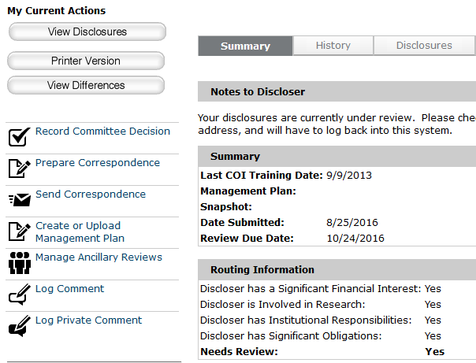
Review Complete: Preparing Correspondence
Review Complete: Preparing Correspondence Activities
The COI Administrator can:
Create or upload a management/mitigation plan
Prepare correspondence
Send correspondence to the COI Discloser
2
3
1

Slide 41
Review Complete: Preparing Correspondence Exercises
Perform the following training exercises:
Exercise 23: Create or Upload Management/Mitigation Plan
Exercise 24: Prepare and Send Correspondence

Slide 42
Discloser Review of Plan
Click COI Module
BSO Review

Slide 43
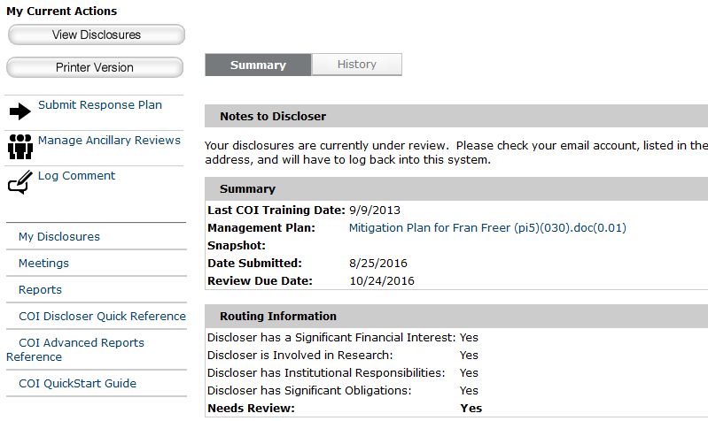
Discloser Review of Plan
Discloser Review of Plan Activities
The COI Discloser can:
Review the management/mitigation plan
Submit a response to the plan
2
1

Slide 44
Discloser Review of Plan Exercises
Perform the following training exercises:
Exercise 25: Review the Management Plan
Exercise 26: Submit a Response

Slide 45
Under Management / Mitigation Plan
Click COI Module
BSO Review

Slide 46
Under Management/Mitigation Plan
Under Management/Mitigation Plan Activities
The COI Monitor can:
Complete the monitor report
Submit a response to the plan
2
1

Slide 47
Under Management/Mitigation Plan Exercises
Perform the following training exercises:
Exercise 27: Complete the Monitor Report
Exercise 28: Indicate that the Plan is Satisfied

Slide 48
Questions?
Click COI Module

Slide 49
Questions
Contact Information
For policy questions regarding Conflict of Interest:
  Ed Zablocki, zablocki@buffalo.edu
For technical questions regarding Click:
  Marla Witkowski, mlw9@buffalo.edu
For assistance with UBIT Names and Passwords:
  eRA Support, support@buffalo.edu

Slide 50

Navigation
Click COI Module – Live Website
Navigate to http://www.buffalo.edu/research
Locate the QUICK LINKS section of the page:
Click on the Click Portal Login link
Enter your UBIT Name and Password, and click the Log In button.

Slide 51
Evaluation
COI Module Training Evaluation
http://bit.ly/2bFrzOZ

