Slide 1
Click Training
Agreements Module
SAMPLE POWER POINT

Slide 2
HELLO
my name is
Mary Kraft
Director, Sponsored Projects Services
mekraft@buffalo.edu
Marla Witkowski
PACS Campus Training Program Coordinator
mlw9@buffalo.edu

Slide 3
Agreements Module
Background
The Pre-Award and Compliance System (PACS) is a multi-year collaborative project to implement the online Click Portal
The Click Portal is being implemented to assist principal investigators, students, compliance and research administration staff with administering sponsored programs
UB is leading the implementation of the Click Portal, working in collaboration with our vendor partner, Huron, and the PACS Leadership Team.

Slide 4
Agreements Module
Training Materials
Click Portal: Agreements Module Training Setup
Click Portal: Agreements Module Training Exercises
Sample Agreement Document
Work Instructions:
  Agreements Module Workflow
  Create an Agreement

Slide 5
Agreements Module
Course Objectives
Provide principal investigators, study staff, compliance and research administration staff an overview of the Agreements module
Demonstrate how to:
  Create an Agreement and submit it for review
  Manage the Agreement review process
  Obtain necessary signatures and activate an Agreement
Allow the participants to practice with hands-on exercises
Provide training materials and references that will provide assistance while using the Agreements module

Slide 6
Roles and Workflow
Click Agreements Module
Roles and Workflow

Slide 7
Roles and Workflow
Agreements User Roles and Responsibilities
Study Team - Individuals who are developing and entering a research protocol. Includes PIs and their contacts, and other study staff.
Agreements Managers- Individuals who guide submissions through the review process. They are responsible for creating an agreement, submitting it to review, and assigning the agreement to a reviewer.
Agreements Reviewers - Individuals responsible for reviewing agreements. Some agreements may also require an optional review by an Ancillary Reviewer.

Slide 8


Roles and Workflow
Agreements workflow
Pre-Submission: During Pre-Submission, the agreement will be created in the system.
Unassigned: In the Unassigned state, the agreement has been submitted and will be assigned to a reviewer
Notes:
At a high level, the system follows this workflow. This training covers the key reviews that Safety protocols can go through: Specialist Review (which includes the Safety Specialist, Biosafety Officer, Member Reviews, and Ancillary Reviews) and Committee Review.

Slide 9


Roles and Workflow
Agreements workflow
In Review: In the In Review state, all necessary parties review the agreement, and come to an agreement regarding the language.
Signing: During Signing, the agreement is routed for internal and external signatures. Once that is complete, the agreement is activated.
Notes:
At a high level, the system follows this workflow. This training covers the key reviews that Safety protocols can go through: Specialist Review (which includes the Safety Specialist, Biosafety Officer, Member Reviews, and Ancillary Reviews) and Committee Review.

Slide 10
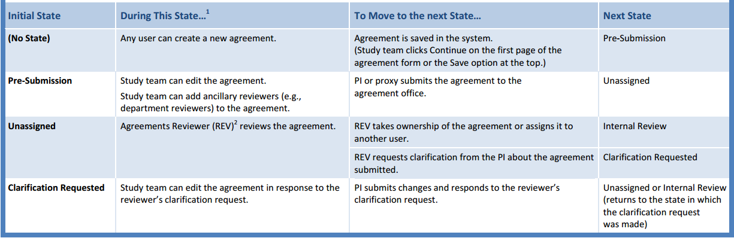
Roles and Workflow
Key Actions by Role
Notes:
Different roles perform different actions when a protocol is in a particular state. Some actions move the submission to another state.
For a listing of actions that cause the protocol to move to a new state, refer to the State Actions and State Transitions table in the Safety Staff Guide.
For example, after a PI submits a Safety Protocol for review, it moves to Specialist Review. In this state, the Safety Specialist can send it for a BSO or member review, approve it administratively, etc.

Slide 11
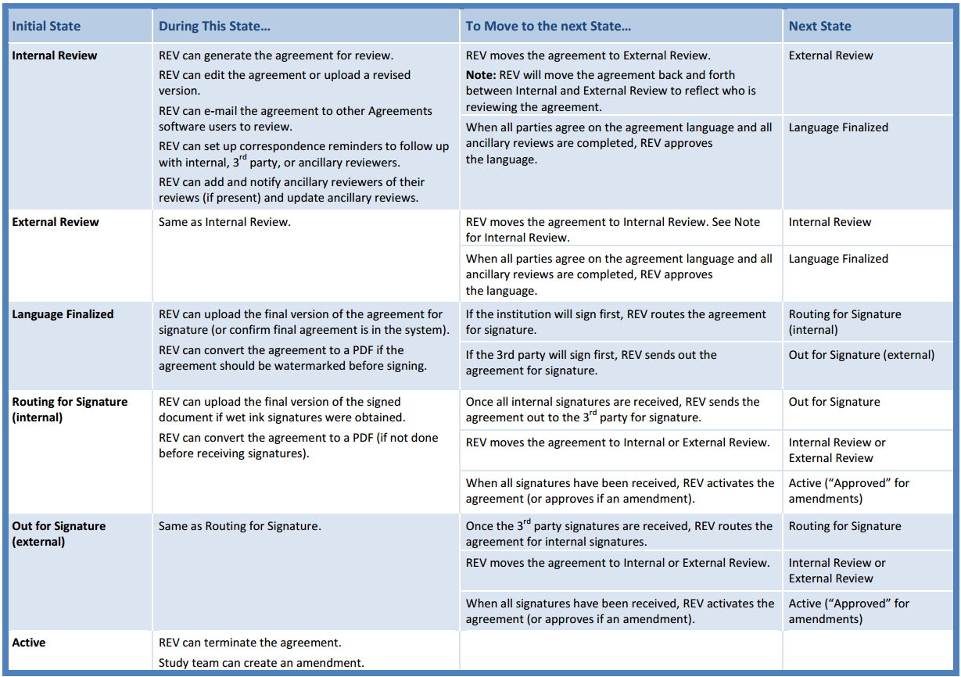
Roles and Workflow
Key Actions by Role
Notes:
Different roles perform different actions when a protocol is in a particular state. Some actions move the submission to another state.
For a listing of actions that cause the protocol to move to a new state, refer to the State Actions and State Transitions table in the Safety Staff Guide.
For example, after a PI submits a Safety Protocol for review, it moves to Specialist Review. In this state, the Safety Specialist can send it for a BSO or member review, approve it administratively, etc.

Slide 12
navigation
Click Agreements Module
Navigation

Slide 13
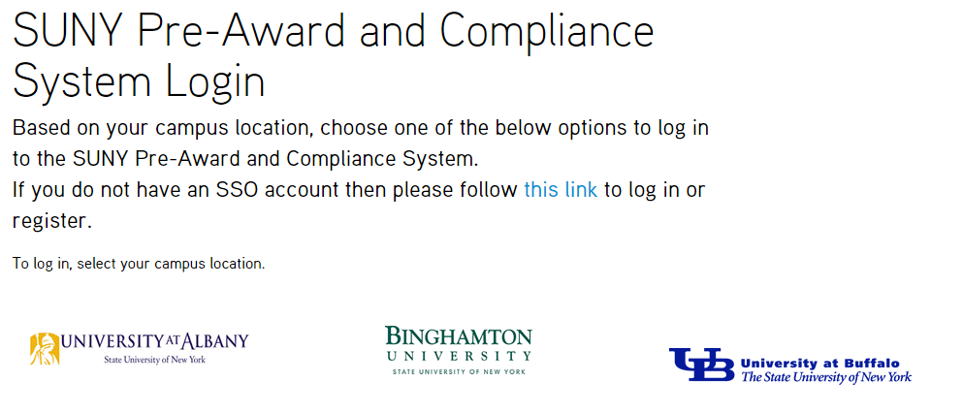
Navigation
Training Website
Navigate to http://pacsstg1.rfsuny.org
Locate the heading ‘SUNY Pre-Award and Compliance System Login’
Click on the words ‘this link’
Enter a User Name and Password, and click the Login button.
Click Training Website

Slide 14
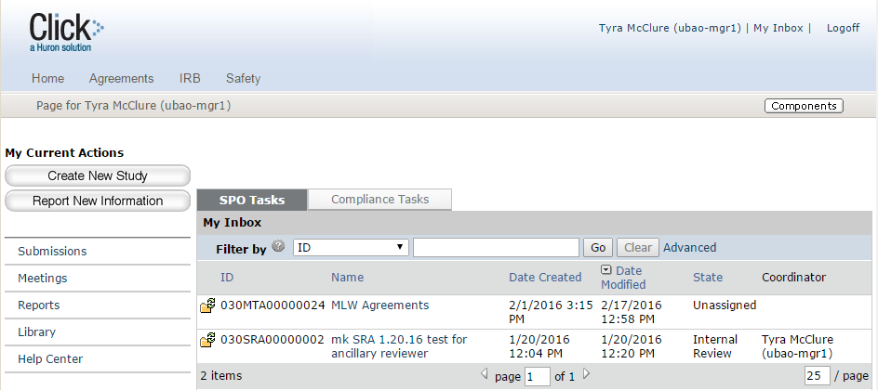
Navigation
My Inbox
From My Inbox, you will see:
Submissions that require action
State in the review process
1
2

Slide 15
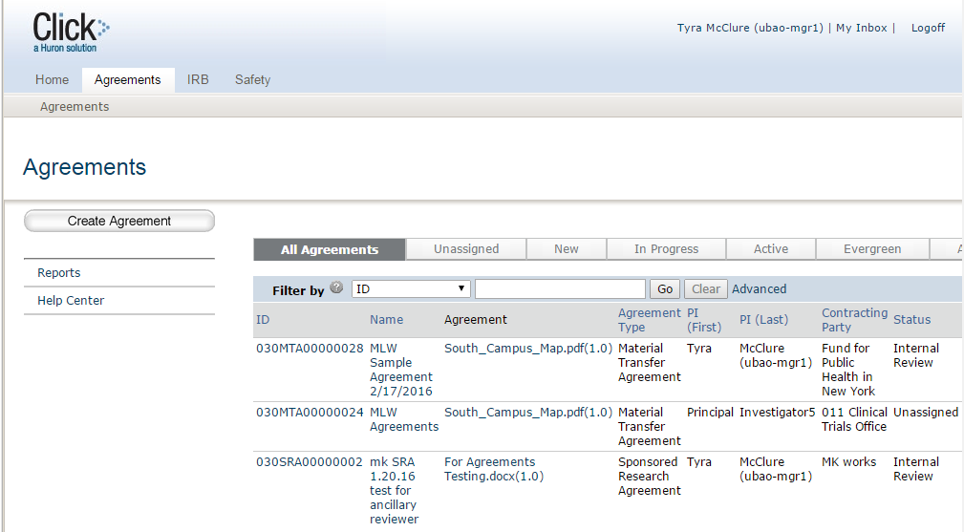
Navigation
All Agreements
From All Agreements, you will see:
All submissions to the agreements module
State in the review process
Shortcut to reporting features
Shortcut to user guides and videos
1
3
2
4

Slide 16
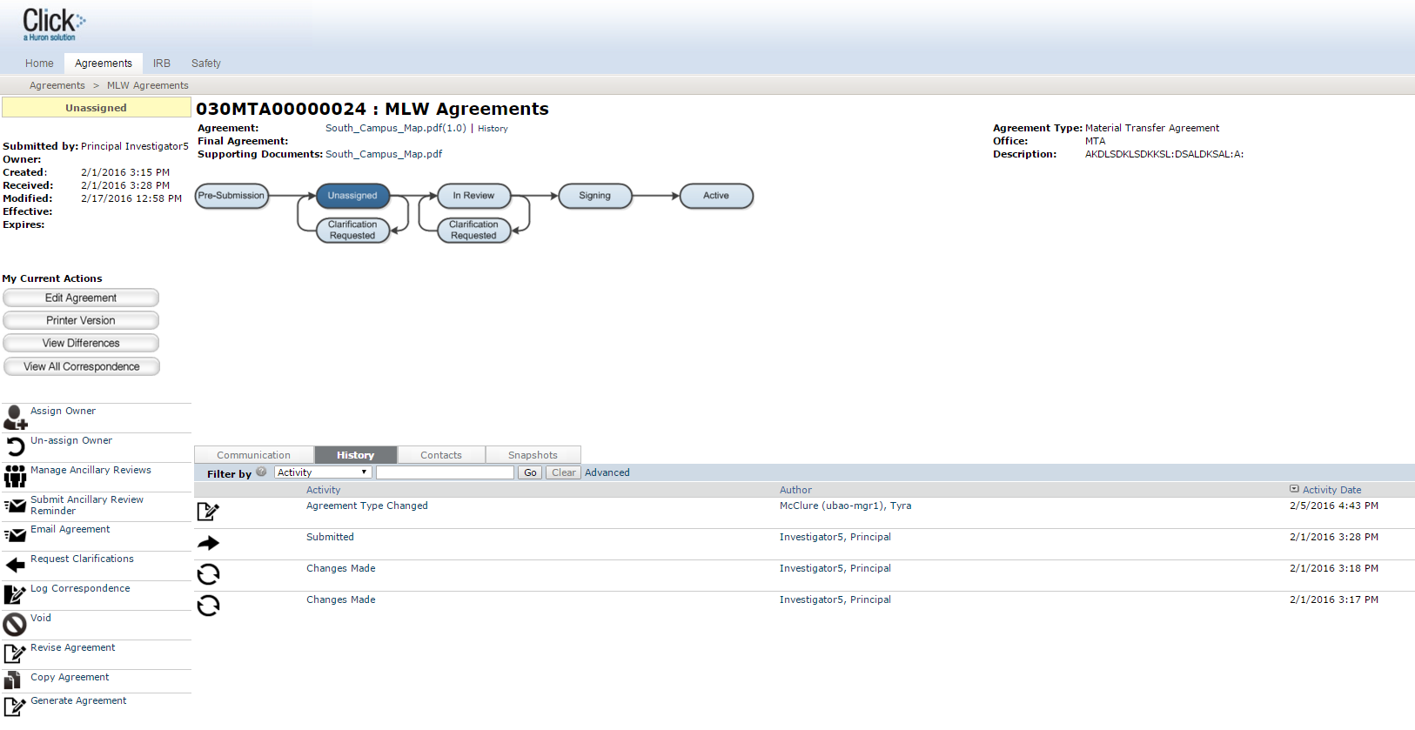
Navigation
Agreements Workspace
1
2
3
4
From the Agreements Workspace, you will see:
Agreement details
The state in the review process
Actions you can take in the agreement’s state
Tabs with information about the history of the agreement

Slide 17
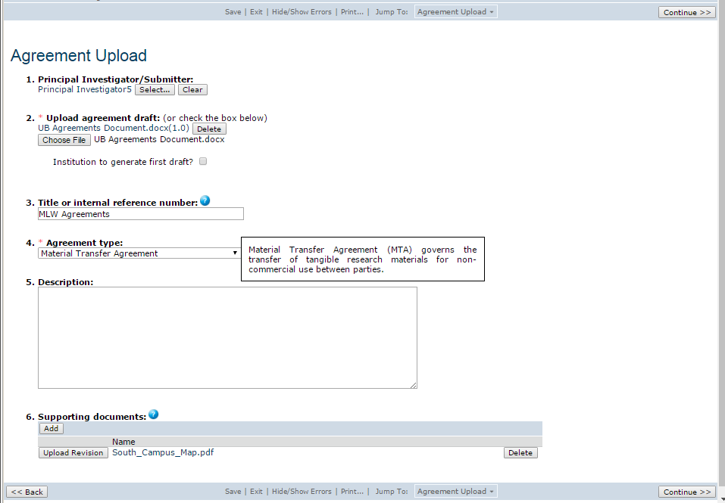
Navigation
Agreements SmartForm Pages
3
1
On the SmartForm pages, you
will see:
Required fields (*)
Field help ( )
Navigation bar
2
?

Slide 18
Navigation Exercises
Perform the following training exercises:
Exercise 1: Log into the Agreements Module
Exercise 2: Explore the Inbox
Exercise 3: Explore All Agreements
Exercise 4: Explore the Agreements Workspace
Exercise 5: Explore the SmartForm Pages

Slide 19
Pre-Submission
Click Agreements Module
Pre-Submission

Slide 20
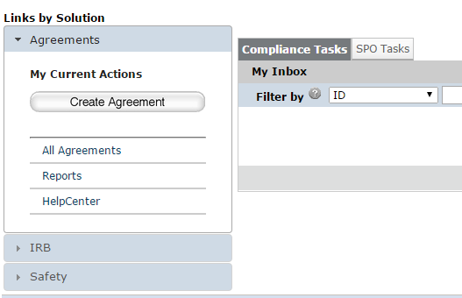
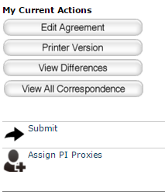
Pre-Submission
Pre-Submission Activities
The Principal Investigator can:
Create the agreement and complete the SmartForm pages
Submit the agreement for review
1
2

Slide 21
Pre-Submission
What to Expect After Submitting
Submitting your agreement initiates a series of activities that may include:
  Pre-review by an Agreements Manager
  Review by an Agreements Reviewer
  Optional ancillary review by individuals, departments, and other organizations
  Communication of the reviewer’s decision to the investigator
Any of these may lead to a request for the study team to take further action, such as providing clarifications regarding the agreement
Whenever the study team needs to act, the PI receives an e-mail notification, and the agreement appears in My Inbox for all study team members when they log in to the Click Portal

Slide 22
Pre-Submission Exercises
Perform the following training exercises:
Exercise 6: Create an Agreement
Exercise 7: Submit an Agreement to Review

Slide 23
Unassigned
Click Agreements Module
Specialist Review

Slide 24
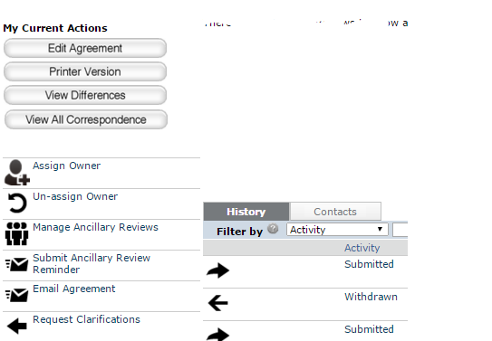
Unassigned
Unassigned Activities
The Agreements Manager can:
Review the agreement and determine if any edits or an Ancillary Review is needed
Request clarifications from the PI as needed
Assign the agreement to an Owner (Agreements Reviewer) for further review
1a
3
1b
2

Slide 25
Unassigned Exercise
Perform the following training exercise:
Exercise 8: Assign an Agreements Reviewer

Slide 26
Ancillary Review
Click Agreements Module
Member Review

Slide 27
Ancillary Review
Ancillary Review Process
Ancillary reviews allow individuals, departments, and other organizations to give feedback on the submission in parallel with the agreements review
The system does not prevent a submission from being reviewed or approved with ancillary reviews outstanding
Decisions about how, when, and whether to interrupt the review process to wait for ancillary reviews are left to the University’s policies and staff

Slide 28
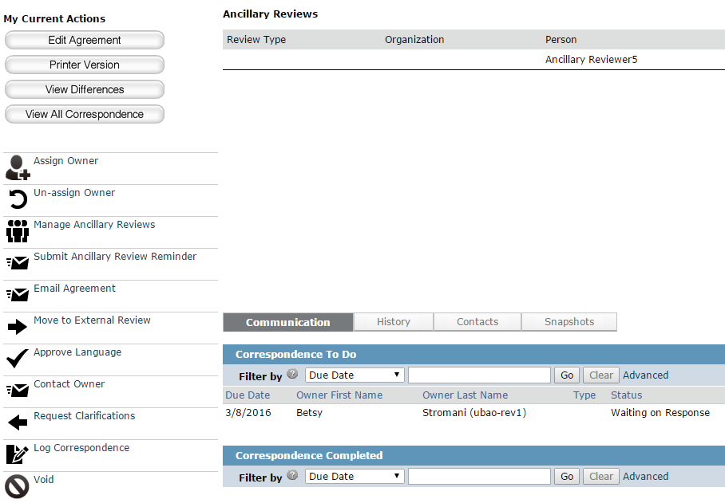
Ancillary Review
Ancillary Review Activities
Ancillary reviews can occur at any time from the Pre-Submission to In-Review states.
They can be requested and managed (1) by PIs, Agreements Managers or Reviewers.
1

Slide 29
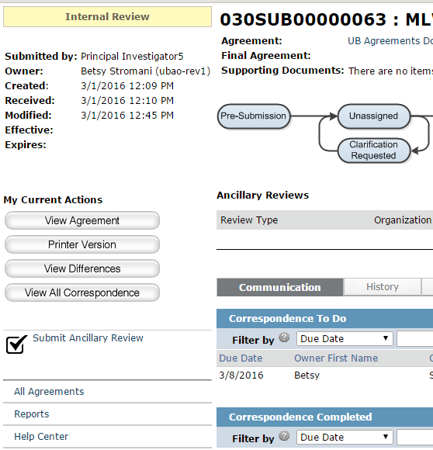
Ancillary Review
Ancillary Review Activities
The Ancillary Reviewer can:
Submit an ancillary review, and request changes to the proposed agreement.
1

Slide 30
Ancillary Review Exercises
Perform the following training exercises:
Exercise 9: Manage Ancillary Reviews
Exercise 10: Submit an Ancillary Review

Slide 31
Correspondence
Click Agreements Module
Member Review

Slide 32
Correspondence
Log Correspondence
The portal provides a way for users to set up correspondence reminders to follow up with internal, 3rd party, or ancillary reviewers
Use the Log Correspondence activity to create action items for yourself or other Agreements users
  Calls
  Emails
  Faxes
  Meetings
The system will provide email notification when the item is created, as well as on a selected reminder date

Slide 33
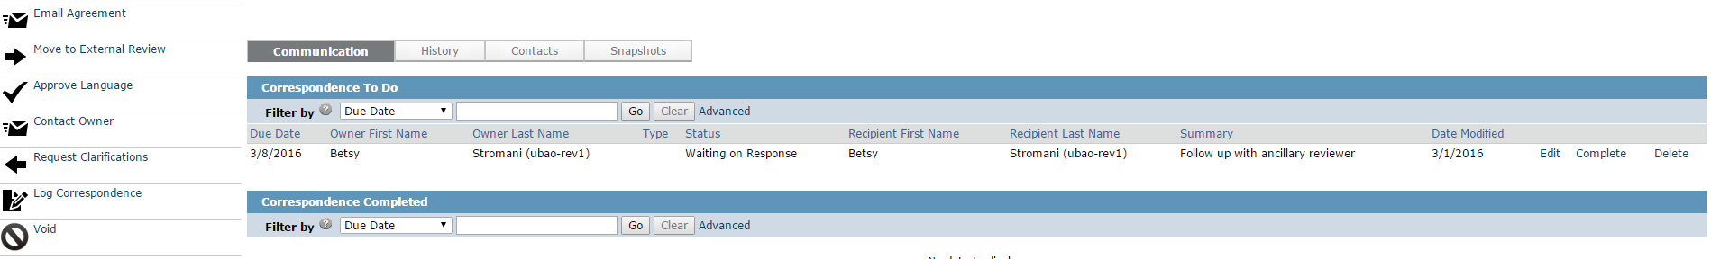
Correspondence
Correspondence Activities
The Agreements Manager or Reviewer can:
Log Correspondence; create to-do lists for the agreement
Edit, complete, or delete the Correspondence
1
2

Slide 34
Correspondence Exercises
Perform the following training exercises:
Exercise 11: Log Correspondence
Exercise 12: Update Correspondence

Slide 35
In Review
Click Agreements Module
Specialist Review

Slide 36
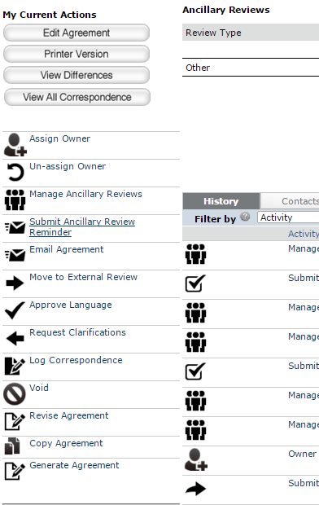
Internal Review
Internal/External Review Activities
The Agreements Reviewer can:
Edit the agreement or upload a revised version
Add and notify Ancillary Reviewers
Email the agreement to other users to review
Move the agreement to External Review
Request clarifications from the PI as needed
Set up correspondence reminders
Approve the language of the agreement
1a
2
3
4
7
5
6
1b

Slide 37
In Review Exercises
Perform the following training exercises:
Exercise 13: Request Clarifications
Exercise 14: Respond to a Reviewer Request
Exercise 15: Move the Agreement to External Review
Exercise 16: Move the Agreement to Internal Review
Exercise 17: Approve the Language of the Agreement

Slide 38
Signing
Click Agreements Module
BSO Review

Slide 39
Signing
Signing Activities
The Agreements Reviewer can:
Approve the language of the agreement, and rout it for internal and external signatures
Upload a final copy of the agreement
Convert the final copy of the agreement to a PDF document
Activate the agreement
1
2

Slide 40
Signing Exercises
Perform the following training exercises:
Exercise 18: Send the Agreement Out for Signature
Exercise 19: Revise the Agreement
Exercise 20: Convert the Agreement to PDF and Activate It

Slide 41
Questions?
Click Agreements Module

Slide 42
Questions
Contact Information
For policy questions regarding Agreements:
  Mary Kraft, mekraft@buffalo.edu
For technical questions regarding Click:
  Marla Witkowski, mlw9@buffalo.edu
For assistance with UBITNames and Passwords:
  Tom Wendt, wendt@buffalo.edu

Slide 43
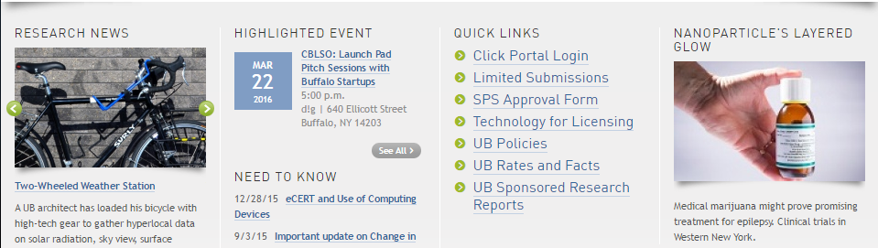
Navigation
Click Agreements Module – Live Website
Navigate to http://www.buffalo.edu/research
Locate the QUICK LINKS section of the page:
Click on the Click Portal Login link
Enter your UBITName and Password, and click the Log In button.

Slide 44
Evaluation
Agreements Module Training Evaluation
http://bit.ly/1Mnob1l

