Slide 1
Open Enrollment and Wellness Update
Learning Tuesday
October 20, 2015

Slide 2
Learning Objectives
Learn about how open enrollment impacts you
New rates / Compare Plans
New Disability Carrier and enrollment opportunity
Flexible Spending Account (FSA) reminders

Slide 3
Learning Objectives
Learn how to get paid for making smart health choices
Wellness Plan – join anytime!
Surgery Decision Support
Gym Reimbursement (PPO Plan)
Notes:
Expand on Wellness for the benefit of the HRO audience

Slide 4
Open Enrollment
New Rates / Compare Plans
Health plan rate increases vary
Some plans decreasing
PPO individual rate increasing about 10%, and
RF contribution rate unchanged at 85% single and 70% dependent share.
NO CHANGE in Dental rates

Slide 5
Open Enrollment
New Rates / Compare Plans
Read details in the Benefits Bulletin, which you should receive this week.
Or, online.

Slide 6
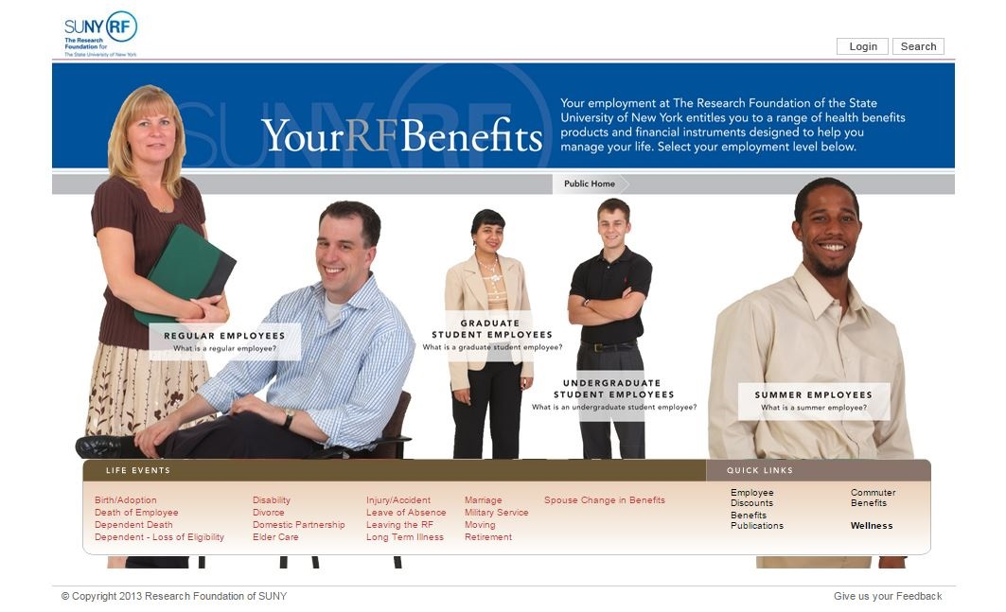
www.rfsuny.org/benefits, select “Benefits Publications” in Quick Links

Slide 7
What changes can I make?
Medical, Dental and Vision Coverage
Add or remove dependents
Enroll in, or waive coverage
Change health plans
Life insurance
Update beneficiary
Enroll in Flexible Spending Accounts
Required every year – no rollovers

Slide 8
Ms. Stephanie Gruarin
SUNY Buffalo State
Human Resources Assistant

Slide 9
2016 Employee Rates
Deductible PPO is still the lowest priced option statewide

Slide 10
Traditional or Deductible PPO?

Slide 11
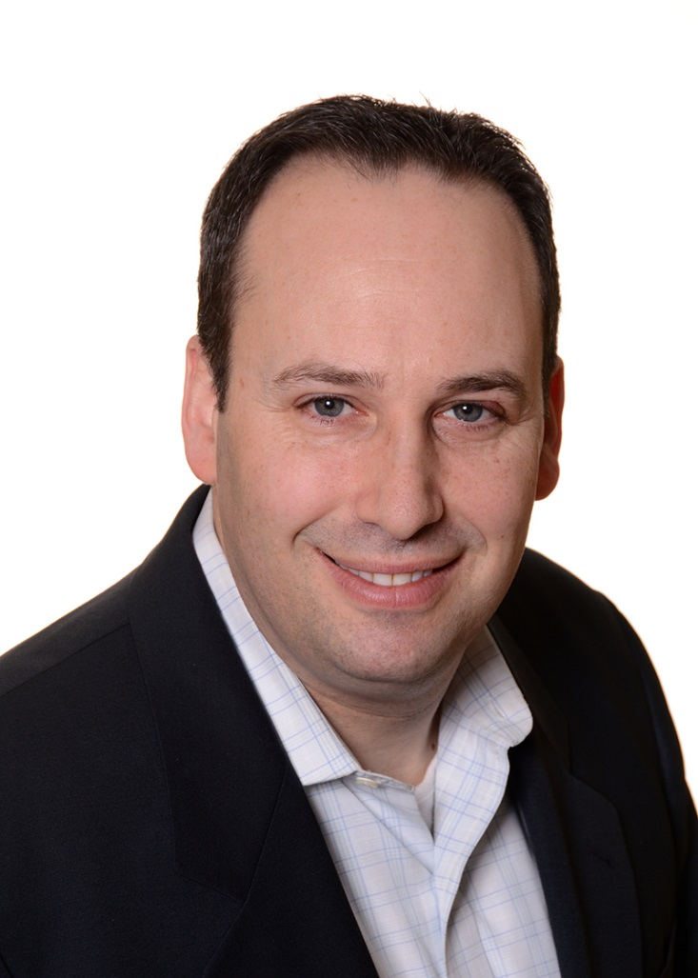
Mr. Wayne R. Klein
First Reliance Standard Life Insurance Company
Sales Representative

Slide 12
New Disability Carrier
Returning to First Reliance Standard
Our carrier from 2009-2013
Impacts all disability coverage
New York State Short Term Disability
Voluntary Short Term Disability (supplement)
Long Term Disability
No change in benefits
Cost slightly higher, but guaranteed for a longer period

Slide 13
New Disability Carrier
Open Enrollment Opportunity
Rare chance to join voluntary plan or increase coverage

Slide 14
Get paid to make smart health choices
Wellness Plan enters second year
Earn up to $400 a year
Earn points for healthy activities and logging nutrition
Surgery Decision Support (SDS™)
Earn a $400 gift card for using the ConsumerMedical program if you are planning to have one of 5 major surgeries
Gym Reimbursement (PPO Plans)
Up to $300/yr in gym reimbursements

Slide 15
Surgery Decision Support (SDS™)
$400 Gift card for participating in a decision support program for any of the following five elective surgeries:
Knee Replacement
Hip Replacement
Weight Loss Surgery
Hysterectomy
Low Back Surgery
www.myconsumermedical.com
1-888-361-3944 (toll-free)
M-F, 8:30 a.m. to 11:00 p.m. ET

Slide 16
Who is ConsumerMedical?
Consumer Medical provides comprehensive, current, objective, and personalized information on ANY diagnosis or medical topic. Information that can help you and your family, with your doctor, make some of the most important decisions of your life. And if you need a second opinion, Consumer Medical can also identify top physician experts for any diagnosis anywhere in the U.S. As a Research Foundation employee, you are eligible to sign up for access to Consumer Medical.

Slide 17
ConsumerMedical™
Learning Tuesday October 20, 2015

Slide 18
ConsumerMedical-Your GPS for Healthcare™
Helps answer the 5 most important questions in healthcare:
What do I have?, guidance to understand & confirm diagnosis is correct.
What do I need?, understand all available treatment options.
Where do I go?, getting to leading doctors and hospitals for care.
What does it cost?, how to shop for best quality, price and save money.
How do I connect?, build a strong support network with friends, family.
Current, comprehensive, objective, and personalized information
Physician-led teams from leading medical schools
State-of-the-art integrated model of web, phone, and print-based material.
Almost 20 years experience; offered to Research Foundation in 2001
Any medical condition, Any decision, Any point in time
Support for any surgical decision
18
Proprietary and Confidential

Slide 19
19
Proprietary and Confidential

Slide 20
Surgery Decision Support (SDS™)
A program that targets the following non-emergent surgical procedures where 2 or more medically acceptable treatment options exist and where participants (patients) have legitimate choices among those treatment options.
Low back surgery
Hysterectomy
Knee replacement
Hip replacement
Weight loss surgery
Requirements: to earn $400 Gift Card:
Participant's physician recommends surgery as treatment option
Participant engages at least 30 days prior to a scheduled surgery
Participant reviews personalized materials and engages in ongoing interaction with physician-led support teams
Participant completes a brief telephonic feedback survey
20
Proprietary and Confidential

Slide 21
How to Reach ConsumerMedical
Connect to ConsumerMedical
Call ConsumerMedical at 1-888-361-3944 (toll-free)
Monday-Friday, from 8:30 a.m. – 11:00 p.m. ET.
(24/7 secure voicemail to leave a message; calls are
returned within 3 hours the next business day)
Register at www.myConsumerMedical.com.
Enter “Research Foundation” in the company code field on the registration page.
21
Proprietary and Confidential

Slide 22
Key Points for Employees
ConsumerMedical is a clinical decision-making benefit that helps participants answer the five most important questions in healthcare: 1) What do I have? 2) What do I need? 3) Where do I go? 4) What will it cost? 5) How do I connect?
ConsumerMedical’s physician-led research team provides objective, comprehensive, and personalized research, available treatment options, and information for any medical diagnosis or health topic to help empower participants to be smart healthcare consumers.
Participants can access ConsumerMedical throughout the continuum of their care—including the time of diagnosis, treatment, prevention, and coping—and can utilize the service as many times as they need to, for an unlimited number of health topics.
ConsumerMedical can help you with any surgery procedure such as low back surgery, hip replacement, knee replacement, hysterectomy and weight loss surgery. . Knowing your treatment options, the benefits and risks, and any possible complications will help you make the best choices for you and your loved ones.
Research Foundation pays for this program; it is and will always be completely free of charge for all employees, their insured dependents, Retirees and employees on COBRA.. The program is completely confidential—Research Foundation will never know why an employee engages with the program—and is independent of any insurance company.
22
Proprietary and Confidential

Slide 23
Gym Reimbursement (PPO Plans)
Earn up to $150 per family every six months
Taxable benefit
Must make 50 visits to gym in six month period (about twice a week)
Submit reimbursement form with log printout from gym

Slide 24
How to get more information?
Employee Self Service
www.rfsuny.org/selfservice
Benefits Bulletin
www.rfsuny.org/benefits and select the Regular Employees > Benefits Publications Quick Link
Conexis
866-279-8385
https://mybenefits.conexis.com
Wellness program
Sign up at http://join.virginpulse.com/rfsuny

Slide 25
Questions from our viewers

