Slide 1
Managing Projects for Success at the RF
Ellen Kelly, Gayle Noel, Joanne Lafrancois, Donna Kiley

Slide 2
Process Groups
(or Project Phases):
Initiating
Planning
Executing
Monitoring and Controlling
Closing

Slide 3
What is a Project?
A temporary endeavor with a beginning and an end
Creates a unique product, service, or result
In addition, at the RF we consider any work that meets the following criteria as a project:
Requires the coordination of cross-departmental or cross- campus resources within specific timeframes.
Is identified as a priority to the organization.
Requires significant visibility within the RF.

Slide 4
What is Project Management?

Slide 5
Other Important Terms
Project Owner or Sponsor
Stakeholders
Deliverables, Milestones, Tasks, Resources

Slide 6
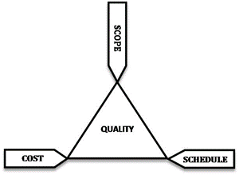
Project Triangle
Projects must be delivered within cost.
Projects must be delivered on time.
Projects must meet the agreed scope – no more, no less.
Projects must also meet customer quality requirements –
change impacts

Slide 7
Project Charter

Slide 8
RF’s Mini Project Charter

Slide 9

Project Communication - It’s Your Job!
Focus your 90% on the audience, the message, the medium, and the plan.
PMs and their teams must learn to speak the language of the business – the what and the why; not minutiae of the work.
Notes:
Ellen – 5 minutes
90%
As a PM – communication is your job. We’ve had a model where you assign a communication lead, which is great, but really the ownership falls on you.
If you are doing your job well you are communicating every day – you aren’t at your computer creating charts or deliverables, you are making that happen and driving results through strong communication skills.
This is really why it’s hard for us to manage projects successfully along with our day jobs – who has time for that 90%?
What and Why is what will resonate with people.

Slide 10

How to Lead and Manage Project Communication
Step 1: Build a strong foundation
Identify a Communication Lead.
Make sure that project documents are understandable to/for the masses, and clearly state the project purpose and goals.
Notes:
In most cases, the project manager is the communication lead.
On larger projects, the project manager will work closely with the communication lead need to create, implement and monitor the communication plan.
Clear communication starts with the project name, which should be used consistently, and a simple plain English statement that answers the questions
1. What is the project?
And 2. Why are we doing it?
This goes back to the What and Why point Ellen made earlier.
You might want to create an FAQ or a short elevator speech that answers these questions.
Again, for consistency, future project communication will incorporate and/or link back to this core message.
Any questions or comments?
Ellen will guide you through Step 2.

Slide 11
How to Lead and Manage Project Communication
Step 2: Know your audiences and how to reach them
  Who are your audiences?
  What do they need to know?
  What is the best way to reach them?
  How frequent is the communication?
  Who is responsible for each communication?
Notes:
Ellen:
Talking points here:
Why I chose this – how important the activity is to successful out comes as well as to influence change in your organization.
Read questions
When you do this – initially at charter phase to help develop the project scope; Then again at the beginning of the project – Stakeholder Analysis.
Stakeholder analysis tool – talk through tool

Slide 12
Step 3: Create the Project Communication Plan
Use the project plan to identify milestones that trigger communication.
Use the Stakeholder Analysis to make sure you are reaching all audiences.
Assign and schedule communication tasks.
Notes:
To build the initial plan, I look at two documents:
The project plan to identify events– such as selecting a tool or vendor, deadlines for completing training and other milestones that might trigger a need or opportunity to communicate.
The Stakeholder Analysis to make sure that we are reaching all of our audiences and are using the right tools to provide them with the information they need.
Then I take this information to schedule and assign communication tasks.
It’s important to note here that owning the communication plan doesn’t mean that the Project Manager and the Communication Lead are responsible for all project communication.
Different team members will take on different communication tasks as appropriate.
For example, a project training lead might handle communications to campus training contacts.

Slide 13
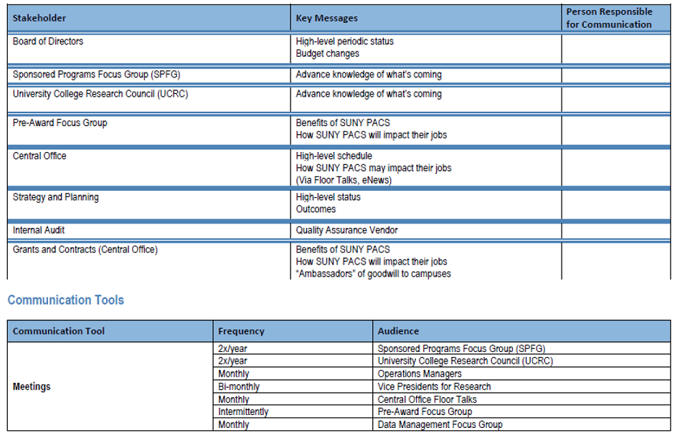
PACS Communication Plan

Slide 14
The Story of Zach and Malcome
https://www.youtube.com/watch?v=eVJuIZElOXE

Slide 15

Influencing Change
Influencing Change:
For each stakeholder consider the From -> To mindset.
Notes:
Ties social phychology with communication
Anything we do introduces a change – and we want that change to be embraced.

Slide 16
Project Planning Basics
Tasks
Deliverables and Milestones
Resources

Slide 17
Tasks
In project management a task is an activity that needs to be accomplished within a defined period of time or by a deadline to work towards work-related goals.
Task management is the process of managing a task through its life cycle. It can involve activities such as planning, monitoring cost and progress and reporting when complete.
Many people believe that task management is the foundation for project management activities.

Slide 18
Deliverables and Milestones
Deliverable is a term used in project management to describe a tangible or intangible object produced that is intended to be delivered to a customer. It may be either an outcome to be achieved or an output to be provided.
A project milestone is a measurement of progress against the project schedule timeline whereas the deliverable is the result of the work completed.
For a project, a milestone might be the completion of a staff training session while the deliverable is the training quick start guides distributed as a handout in the course.

Slide 19
Resources
Resources are required to carry out project tasks. They can be people, equipment, facilities, funding, or anything else capable of definition (usually other than labor) required for the completion of a project activity.
Resource scheduling, availability and optimization are considered key to successful project management. The lack of a resource will therefore be a constraint on the completion of the project activity.

Slide 20
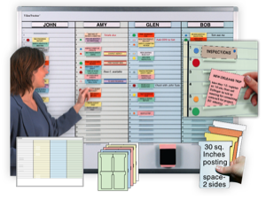
Project Planning Tools
Planning tools can be as simple as a visual aid posted in the office or software that helps organize complex plans.
Some common software tools you may already be familiar with are Microsoft Excel and Microsoft Project.

Slide 21
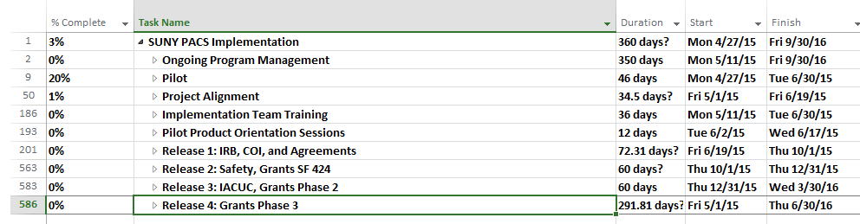
SUNY PACS RFCO Project Plan
Microsoft Project Plan rolled up to show key milestones:

Slide 22
Campus PACS Plan
Dovetails from RFCO plan to identify campus activities:
  Identifies specific deliverables that will be implemented at the campus (IRB, COI, Grants etc.)
  Weekly meetings for Proposal, Budget, COI, Compliance and IT technical teams
  Create Campus Project Website, Blog and Yammer Groups to provide news and discussion forums
  Schedule project sponsor and stakeholder monthly updates on project progress
  Provide campus research community quarterly updates on project milestones
  Analyze campus business processes and coordinate changes to take advantage of new software functionality
  Identifies dates and locations for faculty and staff system training
  Identifies local campus contact(s) for questions about the project
  Links names of who is working on the project tasks during what time frame so that staff understand the role that they have to provide project support

Slide 23
Contact Us
Ellen Kelly: ellen.kelly@rfsuny.org
Joanne Lafrancois: joanne.Lafrancois@rfsuny.org
Gayle Noel: gayle.noel@rfsuny.org
Templates:
  http://www.rfsuny.org/Our-Work/RF-Projects-

