Slide 1
Sponsored Programs Administration Overview
The Research Foundation for SUNY Orientation

Slide 2
Sponsored Programs
What is Research Administration?
Where We Fit In
Lifecycle
System-Wide Support

Slide 3
What is a Research Administrator?
How did we get here??
Realizing the importance of what we do!
Many career paths in research administration
Many professional organizations: NCURA, SRA, AUTM, etc.

Slide 4
Two models of sponsored research support within SUNY system
De-centralized: * Albany * Binghamton * Buffalo State * University at Buffalo * Upstate Medical * Stony Brook * SUNY Poly Each with own Office of Sponsored Programs.
Central Office OSP: * Alfred * Morrisville * Brockport * New Paltz * Canton * Oneonta * Delhi * Optometry * Cobleskill * Old Westbury *Oswego *Plattsburgh * Cortland * Potsdam * Downstate Medical * Purchase * Empire State * ESF * Farmingdale * Fredonia * Geneseo * Maritime

Slide 5
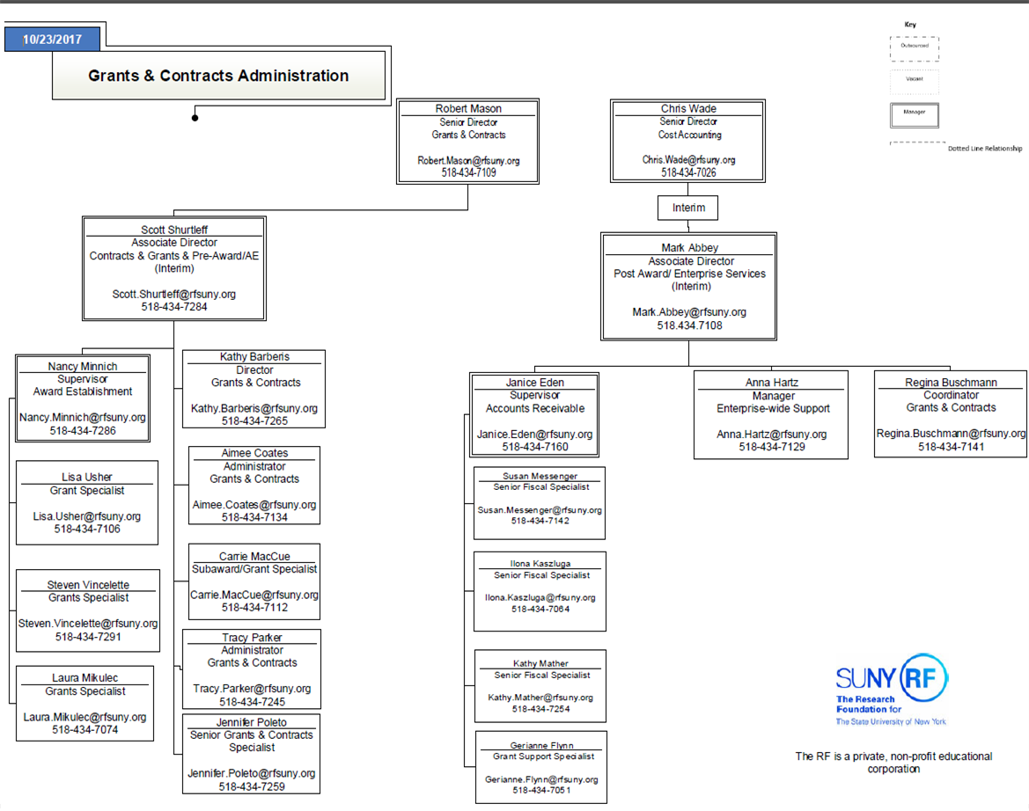
Central Office Sponsored Programs 22 campuses plus systems wide support

Slide 6
Collective Volume Position Among Campuses FY 2017
Poly
$271.7M
Stony Brook University
$169.2M
U of Buffalo
$164.0M
CO Centralized Campuses
$116.2M
SUNY Albany
$103.0M
Binghamton University
$39.8M
Upstate Medical
$33.3M
Buffalo State
$23.6M

Slide 7
Portrait by the Numbers
Total of 22 Campuses
3 Doctoral Colleges
12 Arts and Sciences Colleges
7 Technical Colleges
Total Expenditures by Campus Location (FY 2017 SPAR)
Downstate Medical Center $ 47.5M
ESF 16.6
Optometry 3.0
12 University Colleges 38.8
7 Technical College 10.3
Subtotal $116.2M

Slide 8
Portrait by the Numbers
Total Expenditures by Campus Location (FY 2017 SPAR)
*SUNY Poly $271.7M
*Stony Brook $169.2
*University at Buffalo $164.0
* Albany $103.0 * Binghamton University $39.8 * Upstate Medial $33.3 *Buffalo State $23.6

Slide 9
Sponsored Program Lifecycle
Proposal Preparation and Submission
Award Negotiation and Acceptance
Award Management and Reporting
Award
Close-Out
Award Establishment

Slide 10
Sponsored Program Lifecycle
Proposal Preparation and Submission
Award Negotiation and Acceptance
Award Management and Reporting
Award
Close-Out
Award Establishment
Seek funding opportunities
Submit proposals, respond to RFP’s
Budget prep and F&A costs
Specific sponsor guidelines
Cost Sharing
Subawards

Slide 11
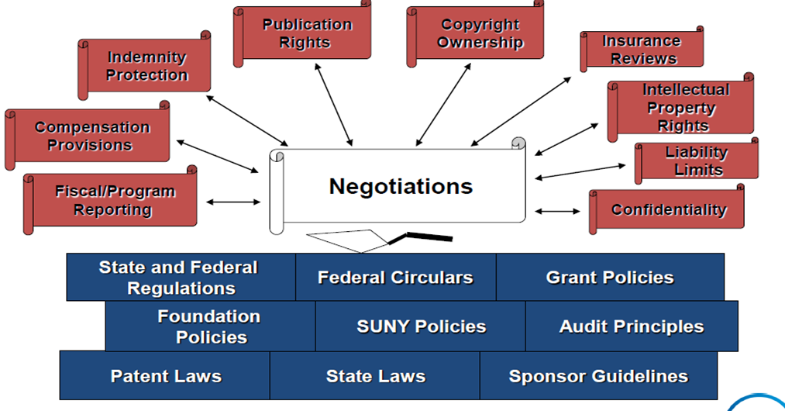
Sponsored Program Lifecycle
Proposal Preparation and Submission
Award Negotiation and Acceptance
Award Management and Reporting
Award
Close-Out
Award Establishment

Slide 12
Sponsored Program Lifecycle
Proposal Preparation and Submission
Award Negotiation and Acceptance
Award Management and Reporting
Award
Close-Out
Award Establishment
NOA or contract
Oracle set-up
Agreement types
File set-up
Subawards and subrecipient monitoring
Reporting
Cost sharing

Slide 13
Sponsored Program Lifecycle
Proposal Preparation and Submission
Award Negotiation and Acceptance
Award Management and Reporting
Award
Close-Out
Award Establishment
Billing files
Invoice type
Sponsor specific requirements
Financial reporting
Cost sharing
F&A reconciliation & adjustments
Subrecipient monitoring
Cost transfers

Slide 14
Sponsored Program Lifecycle
Proposal Preparation and Submission
Award Negotiation and Acceptance
Award Management and Reporting
Award
Close-Out
Award Establishment
Final financial reconciliation
Review F&A
Final reporting
Record retention

Slide 15
SYSTEM-WIDE SUPPORT
CAMPUS
ASSISTANCE
PreAward and
Compliance System
EXTRA SERVICE
E-VERIFY
EFFORT
REPORTING
AUDITS
FCOI
OMB
UNIFORM GUIDANCE
COGR
Proposal Preparation and Submission
Award Negotiation and Acceptance
Award Management and Reporting
Award
Close-Out
Award Establishment
FDP
COST SHARE
CLINICAL TRIALS
TASK FORCE
POLICY DEVELOPMENT
NYS GRANTS
GATEWAY
SYSTEM FOR
AWARD MANAGEMENT
FLSA
TRAINING AND PRESENTATIONS
Risk: Mitigate Manage Monitor

Slide 16
Technology Transfer Overview
RF Overview
December 14, 2017
Presenters:
Matthew Mroz, Director, Enterprise Technology Transfer
Tanya Waite, Partnership Manager
Steven Wood, Assistant Director, Innovation Services
Notes:
Audience: Faculty

Slide 17
Outline
Technology Transfer at SUNY
What is it?
What supports it?
How does it work?

Slide 18
Technology Transfer at SUNY is…
…getting technology to market!
Notes:
The SUNY Innovation Ecosystem begins with our talent – the faculty and students innovating every day on campus. And it includes diverse resources to support the development and commercialization of new technologies; space and services to support emerging businesses; and training and development opportunities for entrepreneurial faculty and students.
The RF provides the flexible interface for SUNY to engage the private sector in innovation partnerships:
Industry sponsored research
IP licenses
Strategic partnerships
Joint ventures
Startups
SUNY’s Technology Transfer program is just one element of a broad ecosystem that fuels innovation and economic development in New York State.
Technology transfer at SUNY is not a fully decentralized or centralized model; it is a hybrid model with eight offices across the state, all working together. Additional information on statewide operations, including costs and services, is included in the companion document accompanying this presentation.
While each of the right offices has its own unique culture, objectives and strategies, we all operate under a common vision – to get SUNY technology to market – using the RF’s flexible administrative infrastructure to engage the private sector in partnerships.
Supported by the central I&P Team, these people and their teams on campus all collaborate to develop partnerships between SUNY and the private sector; and develop and implement programs, services, and tools to move SUNY technology from lab to market.
Last fiscal year, this team evaluated 306 disclosures, filed 235 patents, executed 66 licenses and celebrated the formation of SUNY’s 93rd startup based on university IP. Additional data and metrics appear on the following slide.

Slide 19
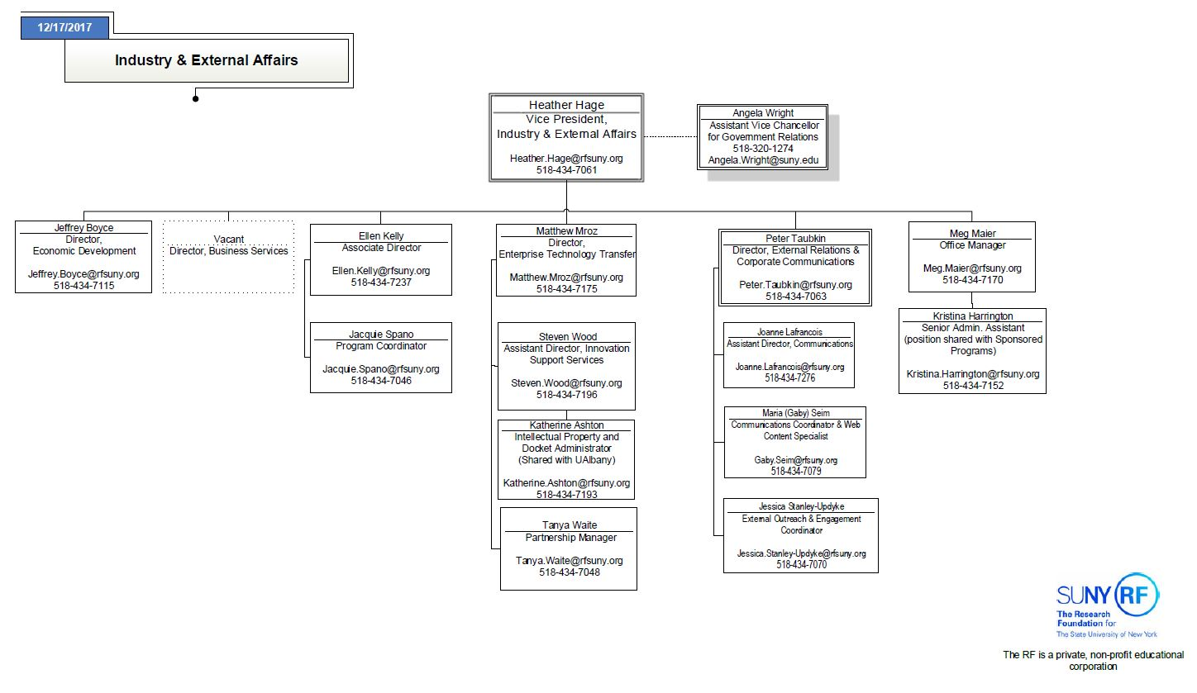
Industry & External Affairs Organizational Chart

Slide 20
Technology Transfer Ecosystem
Faculty/ Inventors
Large Corporations - GE
Small Businesses/ Start-ups
Sponsors - DHHS
Technology Transfer Office
Investors - Angel or VCs
Empire State Development Corporation
SUNY
U.S. Patent and Trademark Office
Customer
Notes:
Thinking of making this more of a graphic. Public and government, through governmental sponsorship and legal facilitation of protection for TT
Research specific entities; public or private stand-alone entities
Individual researchers, TTOs, TLOs and entity employees, consultants, suppliers, financiers, insurers, recipients, regulators and investors

Slide 21
Notes:
Common terms you may hear in Technology Transfer: Technology
Innovation
Disclosure
Invention
Commercialization
Knowledge Exchange
Intellectual Property
Licensing

Slide 22
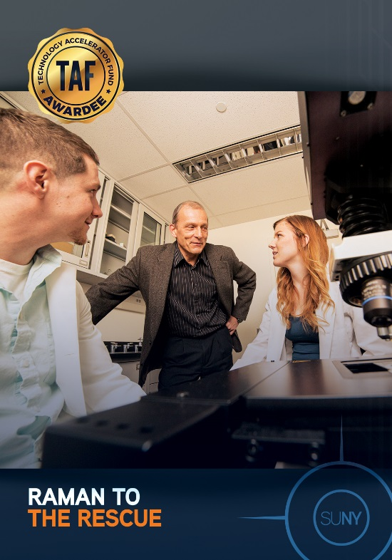
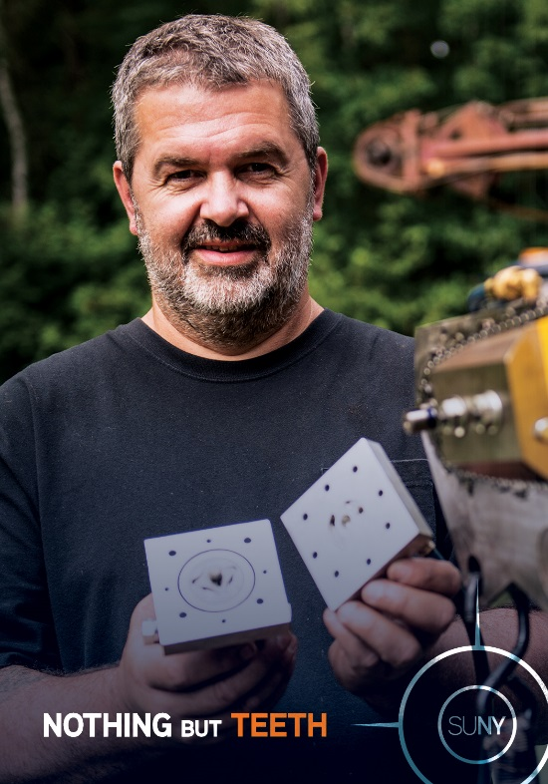
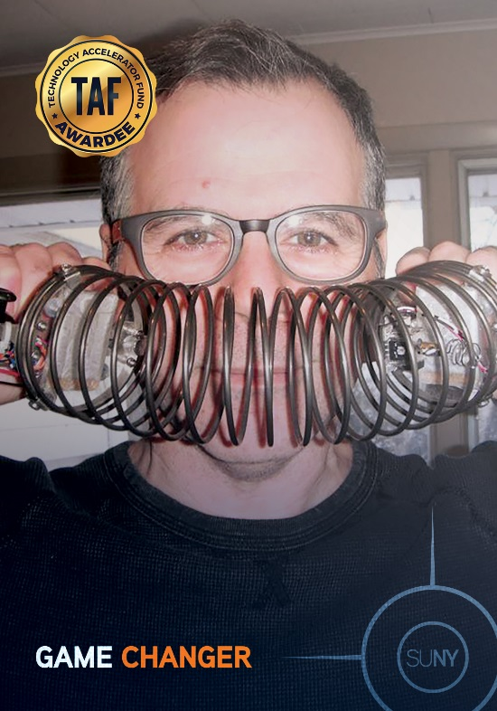
Discovery
Disclosure
SUNY Inventor Portal – tool for inventors to disclose a discovery
http://www.rfsuny.org/Our-Work/Innovation-and-Partnerships/Services/Information-for-Inventors/
Notes:
Research or idea

Slide 23
Evaluation
Evaluation
Keys: Marketability and Protectability
Collaboration - inventors and tech transfer office
Technology Transfer Transaction Toolbox
Pieces of Market Opportunity Assessment
How Technology Fits in Market
Intellectual Property
Substitutable technologies or products
Potential partners
Notes:
IP Status - Patentability and Prior Art
IP Strategy
Technology Readiness Level (TRL)
New Developments

Slide 24
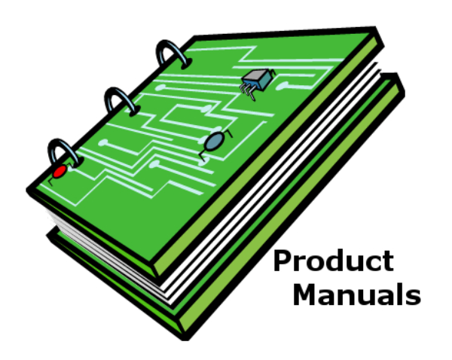
What Is Intellectual Property?
Intellectual Property Protection
Patents
Copyrights
1 year Grace
Period
Publication
Filing
Software Apps
Notes:
Intellectual Property (IP) refers to creations of the mind protected by law:
Writings (e.g., software code), drawings, music and other artistic creations (Copyright)
Discoveries and inventions (Patents)
Trade secrets and know-how (Confidentiality Agreements)
Words, phrases, symbols, and designs (Trademarks)
IP laws grant owners of IP the exclusive right to exclude others from “practicing, copying, making, using, distributing or selling” the IP
Enables recovery of R&D costs, which would otherwise be “sunk”
Competition would drive COGS to marginal cost of production and make R&D investment a competitive disadvantage as to copiers
Know-How:
Unpatented, confidential information such as drawings, designs, formulas, processes and methods, that together with accumulated skills and experience may confer advantages in manufacture or use
Trade Secret:
Information that: 1) is valuable because it is not generally ascertainable or known, and 2) is the subject of efforts reasonable to maintain its secrecy under the circumstances (e.g., mark proprietary materials, secure physical storage, encryption, limit employee access to “need to know”, and educate employees on the value of company trade secrets)
Trade Marks:
Renewable every 10 years, indefinitely
Protect distinctive names, logos and slogans of companies and products

Slide 25
Customer Discovery
Marketing
Based on NSF Innovation Corps Program curriculum
Scientific Method
Create product and business model hypotheses
Validate hypothesis through customer/industry interviews
Determine product market fit and optimal business model
Promoting Discoveries
Website, Facebook, Twitter
Conferences
One-on-One Networking
Sponsorships
Notes:
Research or idea

Slide 26
Partnering
Partnering
Many forms of partnering
Sponsored Research
Commercialization Programs
Evaluative Testing
Joint Development
License
Start-up company
Large companies
Confidentiality Agreement
Notes:
Research or idea

Slide 27
Final Steps
Notes:
Product development - outside the university
Programs - SUNY Technology Accelerator Fund
Long-term investment realized
Commercialization revenue sharing

Slide 28
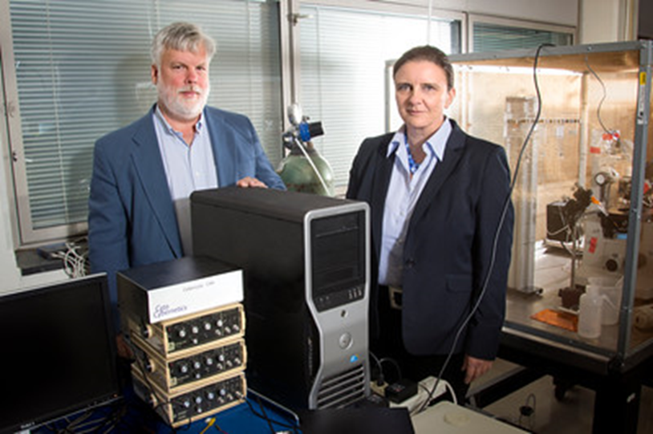
Sponsored Program Success
Just One of
7,102 Awards
Notes:
We’ll;to wrap up with a great example of a sponsored program.
UB Professors Glenna Bett and Randall Rasmusson’s work to revolutionize the drug development first began as a sponsored program. An American Heart Association and National Institutes of Health are cited as two awards administered through the RF infrastructure that led to the development of their invention, called the Cybercyte.
Participants across the spectrum that support this activity:
Preaward – work with the faculty members to have the proposal reviewed appropriately on campus and submitted to the sponsor
Postaward – work with the faculty member to put the award on the system, purchase equipment and supplies, travel, appoint employees and ensure they get paid and enroll in benefits programs, draw down the cash and/or bill the sponsor, provide financial reports to the sponsor, ensure that appropriate F&A rates are applied, ensure that property is tagged and inventoried,
For both pre and postaward, alert/brief the PI on any special terms and conditions in the grant/contract that will need to be adhered to
And as we saw on the “RF Facts” page, there are more than 7,000 of these awards active right now. We do what we do so faculty can pursue their passion for inquiry and innovation.

Slide 29
Commercialization Success
Won business plan competitions, TAF, and STTR awards
Notes:
Heather

Slide 30
Contact Info
http://www.rfsuny.org/Our-Work/Innovation-and-Partnerships/
Matthew A. Mroz
Director, Enterprise Technology Transfer
Tel: 518-434-7061 matthew.mroz@rfsuny.org
Tanya Waite
Partnership Manager
Tel: 518-434-7048
tanya.waite@rfsuny.org
Steven Wood
Assistant Director, Innovation Services
Tel: 518-434-7196
steven.wood@rfsuny.org

Slide 31
RF Finance 101
Keith Kaplan
December 14, 2017

Slide 32
TOPICS
How to Get Financial Info
Sources of RF Income
Sponsored Program Volume at Campuses
Uses of RF Income

Slide 33
But First, A Question:
What year is it????

Slide 34
Where to Get RF’s Financial Reports

Slide 35
What They Look Like: Operating Plan

Slide 36
What They Look Like- Financial Statements

Slide 37
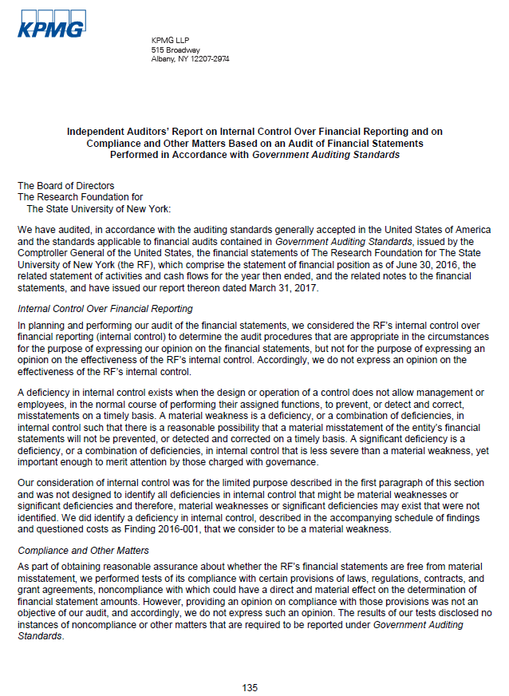
What They Look Like- Single Audit

Slide 38
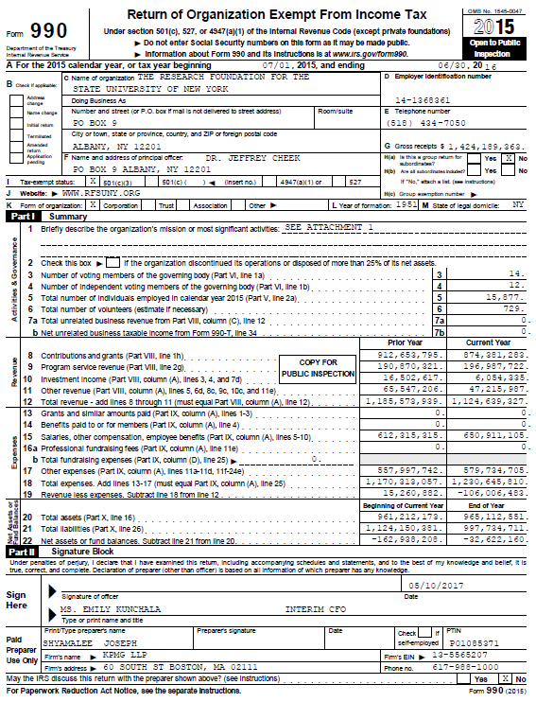
What They Look Like- Form 990

Slide 39
Primary Sources of RF Income
Sponsored Programs Administration
Direct (±$753 mil)& Indirect (±$135 mil)
Royalties from Licenses ($7 mil). Generally:
60% campus
40% inventor
Agency Services Fees ($8 mil)
Contracted services to campus related organizations
Notes:
Sources of income – SP, Roy, Agency, Investment, which one is our core??
Sponsored Programs Administration – funds come in the form of grants and contracts and are expected to be about $825 mil for FY 2016.
Direct activity is the expenditures that can be identified specifically with a particular sponsored project. Examples: salaries, supplies, equipment and travel.
Indirect aka F&A – reimbursements from sponsors for things that cannot be directly and uniquely assigned to a particular project, such as utilities, buildings & grounds, operations & maintenance.
Our sponsors are grouped by major sponsor type Federal, Federal flow thru, State and Private/Other. Federal/FFT activity makes up about 60% of our activity.
Royalties are funds generated from intellectual property. These services help move technology and invention to the marketplace for public benefit. The RF is expected to generate $9.8 mil in royalty income for FY 2018.
Agency Services – (shared services, contracted services) RF provides agency services to campus-related organizations. Services include human resources, payroll and purchasing services. Clinical practice plans, university foundations, etc. The RF expects about $201 mil in agency income for FY 2018

Slide 40
Primary Sources of RF Income (cont’d)
Investment Income ($21 mil)- mostly on operating pool
This operating pool is about $215 million
Does not include Post-retirement plan trust account
Nonsponsored/Other Income ($29 mil)
Gifts, balance accounts, etc.
Awards given without terms and conditions
Third party Income ($11 mil)
Business & industry using RF-owned facilities
Notes:
Investment Income –FY 2018 expected income is $10.0 mil.
Nonsponsored & Other income – differ from grants and contracts in that they are not given with terms & conditions. They include LLC income, gifts, balance accounts, and any awards given without any terms and conditions. FY 2018 expects $7.6 mil plus $1.8 mil in equity distribution from BSA.
Third party fees – The RF recovers costs from businesses and industries using RF-owned facilities, such as an MRI facility or nanotechnology clean room.

Slide 41
Research Expenditures
Total cost of a sponsored agreement is comprised of the allowable direct costs incident to its performance plus allowable indirect costs of the institution (F&A)
Direct Costs
Costs that can be identified specifically with a particular cost objective
Must be reasonable, allowable, and allocable
Indirect Costs
Shared costs not readily identified with a particular cost objective
Notes:
We won’t go deep into these concepts; please refer to the Sponsored Programs Learning and Development modules for more on allowable costs and Federal compliance.

Slide 42
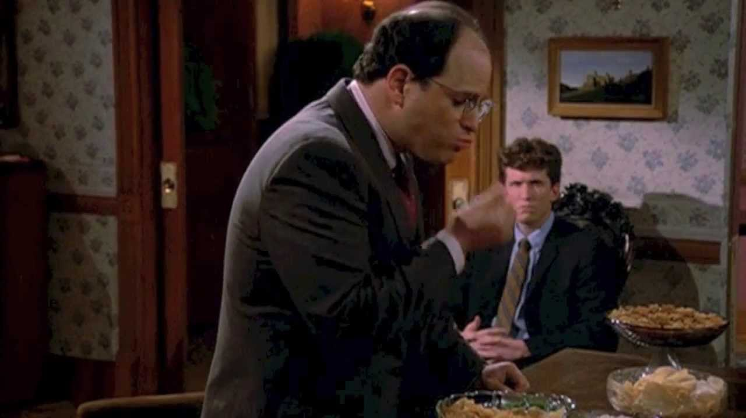
Consistent Treatment
No double dipping!

Slide 43
Notes:
Total Expenditures include two components; direct expenditures and facilities and administration (Indirect Costs)

Slide 45
Notes:
Most of our federal flow through is coming from the state so we don’t get the full F+A.

Slide 46
How the RF Uses Funds
Funds Sponsored Programs Administration
majority of the funds are used to run sponsored research at SUNY campuses
Allocates Funds to SUNY Campuses
Sponsored Program Indirect cost recoveries (aka IDC)
Agency cost recoveries
RF’s share of royalties
Fees paid by business/industry to use campus service centers
Equity distribution from Brookhaven Science Associates
Nonsponsored & other income
Notes:
Majority of the funds we receive are used to fund research projects at the campus as specified by the sponsoring entity.
We also allocate funds to SUNY campuses. Sponsored & agency cost recoveries are given to the campuses through an allocation process. They generally get 80% of their projected recoveries at the start of a fiscal year and then we do a true-up once the year has completed.
Royalties, fees paid, equity distrib and nonspon & other are allocated as earned.

Slide 47
How the RF Uses Funds (cont’d)
Funds for Systems and Infrastructure
RF provides services, systems and infrastructure at campuses and Central Office that support the SUNY research enterprise
Assessment
Tool used to allocate Central Office costs based on type of cost and campus revenue
.3% to all campuses for SUNY Strategic Plan
Agency fee at cost
Notes:
Read first bullet
CO provides the administrative, legal, financial, regulatory and technical infrastructure required to manage the corporation.
We consist of 120 professionals that serve the 31 SUNY campuses locations and programs and employees located around the world. We perform tasks that otherwise would have to be performed at individual sites, promoting efficiencies of scale.
In order to fund the CO costs we assess the campuses.

Slide 48
How the RF Uses Funds (cont’d)
Funds for Corporate Reserve
Target is to keep on hand 10% of F&A ($13.5 million)
Primarily used to cover major initiatives
Investment Reserve
Designed to lessen impact to campuses from investment income fluctuations
RF has been rebuilding the balance
Notes:
Like many corporations, the RF maintains a corporate reserve to cover cash flow and contingency needs. We have used the reserve in the past to fund system upgrades. Our goals is to fully fund the reserve up to 10% of indirect cost recoveries; it is currently around $10 million.
Investment Reserve: for several years, was in a negative position due to the market crash in 2009. We lost about $45 mil and have used the investment income we earn each year to bring the reserve back into a positive position. Management in consultation with the board and campus leadership will revisit the plan for resuming the distribution of investment income as part of the formulation of the 2019 Operating Plan.

Slide 49
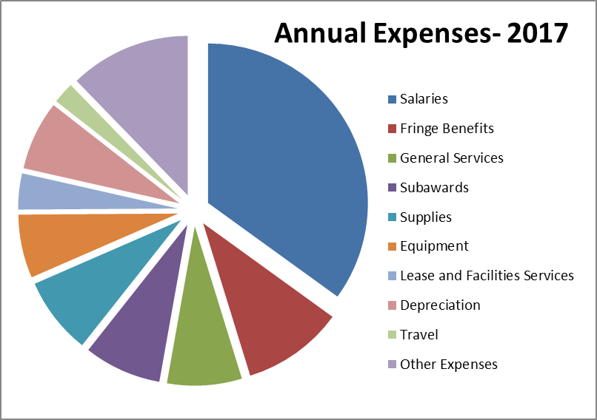

Slide 50
QUESTIONS?
Contact:
Keith B. Kaplan, CPA
Financial Accounting Manager
518-434-7035
keith.kaplan@rfsuny.org

