Slide 1

Week 7
Strategies for Unstoppable Success with Arel Moodie

Slide 2

Course Schedule
Week | Date | Course Title | Presenters
1 | June 5 | Entrepreneurship 101 – What It Takes To Commercialize Your Tech | Felix Litvinsky, Abakama Allison Yacci, DataCicada
2 | June 12 | Discover Customer Discovery | Olga Petrova, Binghamton University Kathryn Cherny, Binghamton University
3 | June 18 | Evaluation of the Opportunity – Patentability and Marketability Basics | Lance Reich, SUNY RF Andrew Scheinman, SUNY RF
4 | June 26 | How To Win Grants – Mastering Non-Dilutive Funding Sources | Kirk Macolini, InteliSpark
5 | July 2 | Forming and Structuring Your Company Like a Boss | Rich Honen, Phillips Lytle
6 | July 10 | Team Chemistry – Leveling Up Your Company | Doug Benel, SUNY RF Ana-Maria Galeano, Galeano Law Firm
7 | July 17 | Strategies for Unstoppable Success | Arel Moodie, Reed Oak
8 | July 24 | Telling and Selling Your Story | Maureen Ballatori, Agency 29 Michael Lightman, Hate Your Deck
9 | July 29- August 2 | 1:1 Meeting With SUNY Venture Advisors
10 | August 7 | Demo Day and Graduation | You!
✅
✅
✅
✅
✅
✅
📍

Slide 3
Course Schedule: What you need to know
June 5 - July 24: Instructional Zoom webinars will be held every Wednesday from 10:30-12:00 PM ET. Invites have been sent. Please keep an eye out for Zoom meeting invites.
July 1 – July 31: Virtual I-Corps short regional course.
July 1 – July 12: Application period to pitch at Demo Day. Now closed.
July 29 – August 2: Office hours with Venture Advisors to apply what you are learning and prep for your Demo Day pitch.
August 7: S4 culminates with a Demo Day and Graduation celebration where participants pitch their technology or venture for one or more $50k Technology Accelerator Fund Catalyst Investments. Demo Day and Graduation are scheduled to be in person at the University at Albany's ETEC Complex in Albany, NY on August 7.

Slide 4
SUNY Technology Accelerator Fund (TAF)
S4 Catalyst Investment Eligibility
To be eligible for a TAF S4 Catalyst Investment, teams and/or companies must meet all of the following requirements:
  Developing technology that is SUNY intellectual property;
  Enrolled in the S4 Class of 2024;
  Participate in the S4 Demo Day pitches on August 7, 2024;
  By December 31, 2024, complete the company formation process if a company has not already been formed; and
  By December 31, 2024, the company receiving the TAF S4 Catalyst Investment must demonstrate that it has an active license or option to the technology it plans to commercialize from a SUNY campus.

Slide 5
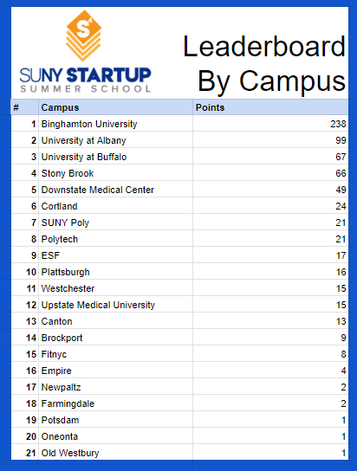
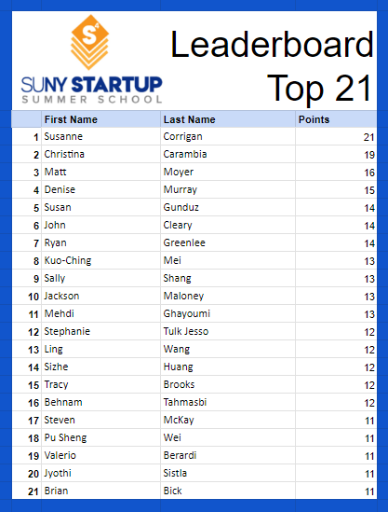
S4 Leaderboard

Slide 6
Questions about S4?
Email us at S4@rfsuny.org
Let’s jump into our session on
Strategies for Unstoppable Success with Arel Moodie

