Slide 1
Open Enrollment and Wellness Update
Learning Tuesday
November 18, 2014

Slide 2
Learning Objectives
Learn about how open enrollment impacts me
New rates / Compare Plans
Lower premiums on Deductible PPO
New online enrollment through Employee Self Service
Flexible Spending Account (FSA) changes
New Administrator
New Debit Card for Medical FSA

Slide 3
Learning Objectives
Learn how to get paid for making smart health choices
Wellness Plan
Surgery Second Opinion
Gym Reimbursement (PPO Plan)

Slide 4
Open Enrollment
New Rates / Compare Plans
What changes can I make?
Dramatically lower rates for Deductible PPO Plan
How the Deductible PPO plan compares to the Traditional PPO
Features that are different (in-network deductible)
Features that are the same (gym reimbursement, prescriptions)

Slide 5
What changes can I make?
Medical, Dental and Vision Coverage
Add or remove dependents
Enroll in, or waive coverage
Change health plans
Life insurance
Update beneficiary
Enroll in Flexible Spending Accounts
Required every year – no rollovers

Slide 6
2015 Employee Rates
New lower rate for Deductible PPO

Slide 7
Traditional or Deductible PPO?

Slide 8
Flexible Spending Account (FSA) Changes
New Administrator – Conexis
How do Flexible Spending Accounts work?
Health Care Spending Accounts – set aside up to $2,500 pre-tax dollars to pay for qualified medical expenses that are not covered by insurance
Dependent Care Spending Accounts – set aside up to $5,000* pre-tax dollars to pay for eligible dependent care expenses such as day care services, before and after school care, etc.
* Annual maximum is determined by your tax filing status

Slide 9
Flexible Spending Account (FSA) Changes
New Debit Card for Health FSA
Provides instant access to the money in your health care FSA
Use your debit card to make common health care purchases such as copayments, co-insurance, deductibles, prescription drugs, glasses, etc.
Most transactions which have a standard copayment will not require any documentation to be submitted.
Important Transition Reminders
Claims for your 2014 FSA account should be submitted to WageWorks
Claims for your 2015 FSA account should be submitted to Conexis

Slide 10
Flexible Spending Account (FSA) Changes
Important Information
Open Enrollment ends on November 30, 2014
You must enroll in Employee Self Service at www.rfsuny.org
Employees will receive an FSA confirmation statement from Conexis confirming your 2015 annual election towards the end of December.
After you receive this confirmation statement, register for an account with Conexis at https://mybenefits.conexis.com
Employees enrolling in Health Care Spending will receive their debit card around January 1, 2015

Slide 11
Conexis Presentation

Slide 12
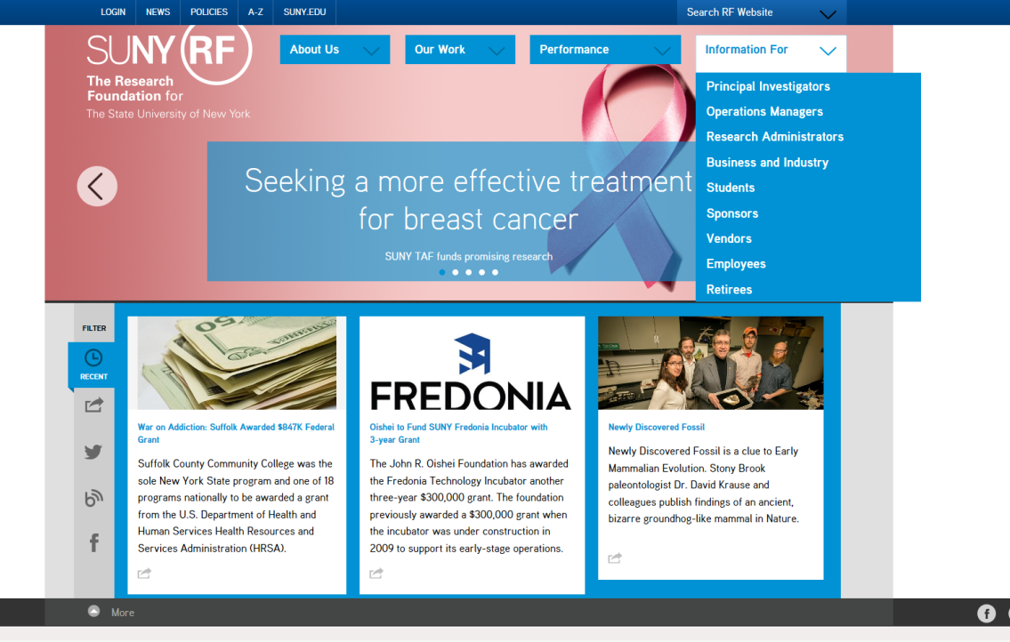
Online Enrollment
Visit www.rfsuny.org, Select Information For Employees

Slide 13
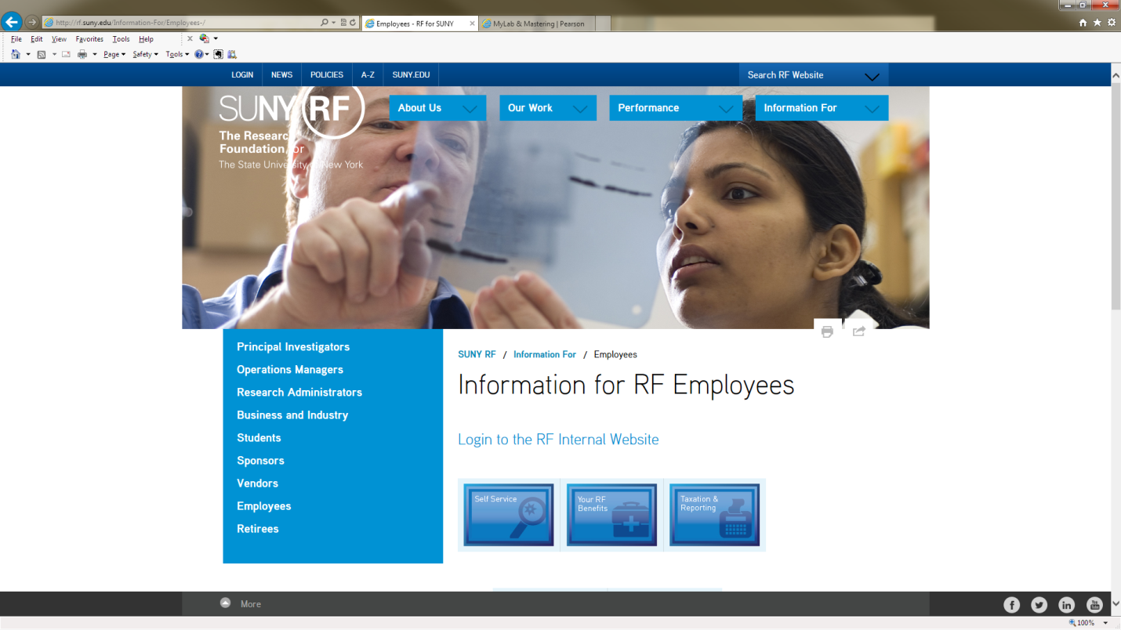
Online Enrollment
Select Self Service

Slide 14
Employee Self Service Guide
Online enrollment guide
(Insert screen shots of navigation and enrollment guide

Slide 15
Break

Slide 16
Get paid to make smart health choices
New Wellness Plan
Earn up to $400 a year
Earn points for healthy activities and logging nutrition
Surgery Second Opinion
Earn a $400 gift card for using the ConsumerMedical program if you are planning to have one of 5 major surgeries
Gym Reimbursement (PPO Plans)
Up to $300/yr in gym reimbursements

Slide 17
New Wellness Plan
Launched October 1, 2014
Over 850 RF participants to date, and growing
Join anytime at join.virginpulse.com/rfsuny
Get up to $100 in cash during each quarterly game
Taxable benefit
Participate in challenges or create your own
Social network

Slide 18
Virgin Pulse Presentation

Slide 19
Surgery Second Opinion
$400 Gift card for participating in a second opinion program for any of the following five surgeries:
Knee Replacement
Hip Replacement
Gastric Bypass
Hysterectomy
Back Surgery
www.myconsumermedical.com
1-888-361-3944 (toll-free)
M-F, 8:30 a.m. to 6:00 p.m. ET

Slide 20
Who is ConsumerMedical?
Consumer Medical provides comprehensive, current, objective, and personalized information on over 100 diagnoses and medical topics. Information that can help you and your family, with your doctor, make some of the most important decisions of your life. And if you need a second opinion, Consumer Medical can also identify top physician experts for any diagnosis anywhere in the U.S. As a Research Foundation employee, you are eligible to sign up for access to Consumer Medical.

Slide 21
Gym Reimbursement (PPO Plans)
Earn up to $150 per family every six months
Taxable benefit
Must make 50 visits to gym in six month period (about twice a week)
Submit reimbursement form with log printout from gym

Slide 22
How to get more information?
Employee Self Service
www.rfsuny.org/selfservice
Benefits Bulletin
www.rfsuny.org/benefits and select the Open Enrollment or Benefits Publications Quick Link
Conexis
866-279-8385
https://mybenefits.conexis.com
Wellness program
Sign up at http://join.virginpulse.com/rfsuny

Slide 23
Questions from our viewers

