Slide 1
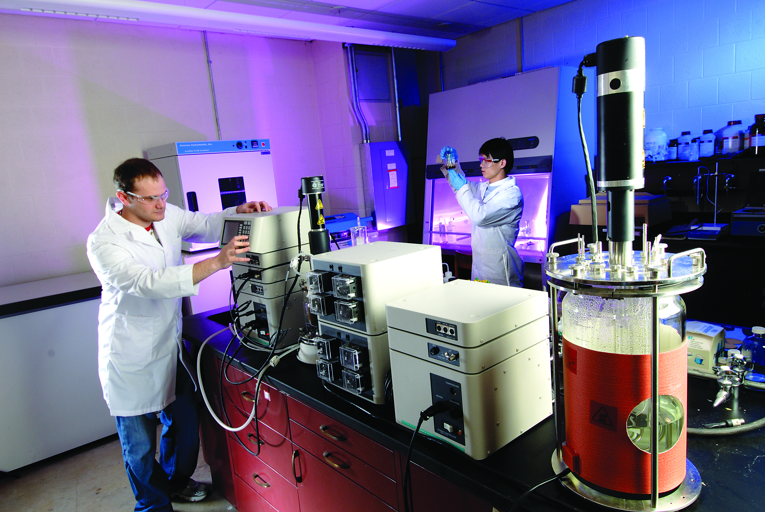
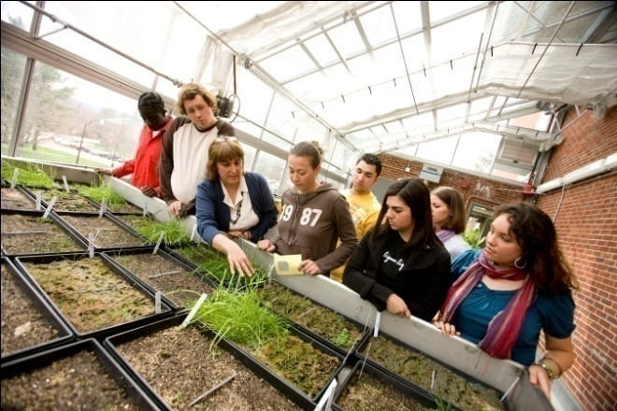
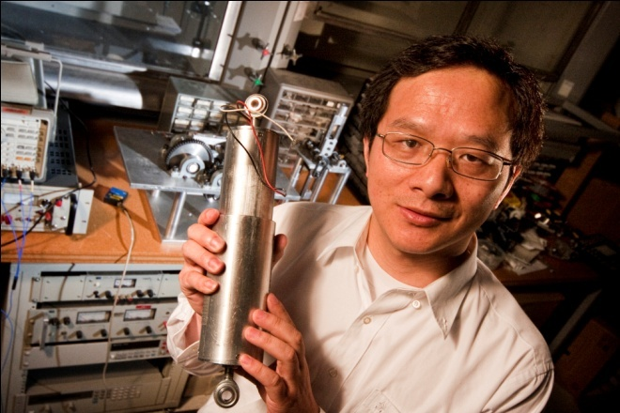
SUNY Pre Award and Compliance Systems Institutional Review Board (IRB)
System Training Practice Exercises

Slide 2
Chapter 2 Practice Exercise – Creating a New Study
Please follow the steps below:
Steps | Description of Step
1 | Navigate to the Click Portal website that can be accessed from myRF or your Campus Website
2 | Log into Click Portal with your User name and Password as follows: User Name: pi Password: 1234
3 | Click the “IRB” tab on the left side of the navigation screen
4 | Under My Current Actions: Click on Create New Study to create a new study. You will be directed through a series of SmartForms to complete
5 | Basic Information: You will be prompted to answer the following questions on this form Enter the following information: 1. * Title of Study: Enter “Last Name – DNA of Mice” Training Study (i.e. Smith - DNA of Mice) 2. * Short title: Enter “DNA of Mice” (i.e. Smith – DNA of Mice) 3. * Brief description: Enter “Study of DNA for Mice” (i.e. Study of DNA for Mice) 4. * Principal Investigator (PI): Click the “Select…” button and choose a name from the list of values. 5. * Does the investigator have a financial interest related to this research? Select the “No” radio button 6. * Will an external IRB act as the IRB of record for this study? Select the “No” radio button 7. * Attach the protocol: Click the “Add” button and then “Browse…” - access the form from your network drive Note: Required fields are marked with an asterisks (*)
RF Report Center

Slide 3
Chapter 2 Practice Exercise – Creating a New Study
Please continue to follow the steps below:
Steps | Description of Step
6 | Once all of the required questions have been answered, select the “Continue” button located both in the upper and lower right hand side of the SmartForm to continue to the next form
7 | Funding Sources: You will be asked to identify each organization supplying funding for the study Enter the following information: Click: Add Name: Enter Dept. of Health (Do not Select from the list of values) Type: Choose Federal
8 | Once all of the required questions have been answered, select the “Continue” button located both in the upper and lower right hand side of the SmartForm to continue to the next form
9 | Study Team Members: You will be asked to add information about each person involved in the design, conduct or reporting of the research Enter the following information: Click: Add Study Team Member: Enter in Hao Wang Role in Research: Investigator Is the team member involved in the consent process? Answer NO Does the team member have a financial interest related to this research? Answer NO
RF Report Center

Slide 4
Chapter 2 Practice Exercise – Creating a New Study
Please continue to follow the steps below:
Steps | Description of Step
10 | Once all of the required questions have been answered, select the “Continue” button located both in the upper and lower right hand side of the SmartForm to continue to the next form
11 | Study Scope: You will be asked to identify each organization supplying funding for the study Enter the following information: Are there external sites where the investigator will conduct or oversee the research? Answer NO Does the study do any of the following: Answer YES Specify the use of an approved drug or biologic? Use an unapproved drug or biologic? Use a food or dietary supplement to diagnose, cure, treat, or mitigate a disease or condition? Does the study do any of the following: Answer NO Evaluate the safety or effectiveness of a device? Use a humanitarian use device (HUD)?
12 | Once all of the required questions have been answered, select the “Continue” button located both in the upper and lower right hand side of the SmartForm to continue to the next form
13 | Drugs: Do not add information on this screen and click Continue to the next form Note: You were unable to move forward because there was a required field
RF Report Center

Slide 5
Chapter 2 Practice Exercise – Creating a New Study
Please continue to follow the steps below:
Steps | Description of Step
14 | To correct missing information, you will need to go back to the Drugs form: Click Add Drug Type: Choose Investigational Select the drug: Type Placebo Choose that the drug is IND exempt Who holds the IND? Choose Sponsor Click OK
15 | Now all of the required questions have been answered, select the “Continue” button located both in the upper and lower right hand side of the SmartForm to continue to the next form
16 | Click Continue through the Consent Forms and Recruitment and through the next form Supporting Documents. Note: You can “Jump To:” and form section by choosing the form from the list of values
17 | The submitter was unable to locate the consent form needed so he is going to exit the study and then go back later and finish Click Save Click Exit
RF Report Center

Slide 6
Chapter 2 Practice Exercise – Creating a New Study
Please continue to follow the steps below:
Steps | Description of Step
18 | To add the consent form, follow the below steps: Click on My Inbox Click on Submissions under the Shortcuts Area Click on your study Click Edit Study Jump to: Consent Forms and Recruitment Materials Click Add and then Browse - Access the form from your network drive Jump To: Drugs Delete the drug information Jump to: Supporting Documents Continue to the Final Page
19 | Before we finish the study, we are going to check the study for errors or missing information Click on Hide/Show Errors on the top tool bar Error / Warning Messages should appear below Click on Jump To on the window pane located at the bottom of the form
20 | To correct missing information, you will need to go back to the Drugs form: Click Add Drug Type: Choose Investigational Select the drug: Type Placebo Choose that the drug is IND exempt Who holds the IND? Choose Sponsor Click OK
RF Report Center

Slide 7
Chapter 2 Practice Exercise – Creating a New Study
Please continue to follow the steps below:
Steps | Description of Step
21 | To complete the study: Jump To: Supporting Documents Click Continue. Click on Hide/Show Errors on the top tool bar Ensure that there are no errors Click: Finish Note: The study has not yet been submitted
22 | This concludes Chapter 2 Practice Exercise - Congratulations, you now have created a study
RF Report Center

Slide 8
Chapter 3 Practice Exercise – Submitting the Study for Review
Please follow the steps below:
Steps | Description of Step
1 | Navigate to the study that you created in the previous exercise by selecting “My Inbox” located in the upper right hand corner. Then select your study. Note: You can also access all of the studies (that you have permission to view) by selecting “Submissions.”
2 | In your workspace, you will see “Study Created” under the Activity and additional details including the Author and Activity Date. Note: Your study has not been submitted yet, it is still in the Pre-Submission state as identified by the workflow diagram above the workspace.
3 | Click “Submit” listed under “My Current Actions.” This activity will remind the PI of their responsibilities and the system will check the submission for any missing required information.
4 | Enter your user name and password to authenticate and click the “OK” button to submit the study to the IRB.
5 | If the submission is successful, the page will refresh and the study will transition from the “Pre-Submission” state to the “Pre-Review” state. In your workspace, another Activity will appear with the submission details.
6 | View the details of your submission, by selecting the name of your study. This will provide you with additional details for that Activity.
7 | To close the details page and return to your workspace, select the “<< Return to Workspace” located in either the upper or lower left hand side of the window.
8 | The workflow diagram above your workspace shows the status of your study.
9 | This concludes the Chapter 3 Practice Exercise. Congratulations!
RF Report Center

Slide 9
Chapter 4 Practice Exercise –
Responding to a Request for Clarification or Modifications
Please follow the steps below:
Steps | Description of Step
1 | If the IRB requests clarification, the PI, any PI proxy, and primary contact will receive an email. The study also appears in My Inbox for each member of the study team. Note: Any study team member can update the study, but only the PI can submit the response to the IRB.
2 | From My Inbox, click the name of the study to open it.
3 | For clarification requested: In the Activity column under Clarification Requested, read the request details.
4 | For modifications required: Click the letter link near the top of the page on the right side. The letter contains the modification requirement details.
5 | Edit the study to incorporate changes as needed.
6 | Click “Submit Response” to return the study to the reviewers. Note: Only the PI can submit the study.
7 | To change documents prior to study approval: Note: These steps apply if the IRB decision was modifications required, disapproved, or deferred.
8 | Click the name of the study to open it. Click the Documents tab to view attached documents.
RF Report Center

Slide 10
Chapter 4 Practice Exercise –
Responding to a Request for Clarification or Modifications
Please follow the steps below:
Steps | Description of Step
9 | Select the document in the “Draft” column and save it to your computer. Open the document and update the content accordingly. Note: when updating the document, enable the Track Changes feature. When the IRB approves the document, all tracked changes will be accepted and comments removed in the final version.
10 | To change documents on an approved study: Click IRB in the top left navigation area and select the Active tab.
11 | Select the approved study which you would like to change the attached documents.
12 | Click the Documents tab from your workspace.
13 | Click the document in the Final column and save it to your computer.
14 | Open the document and revise it in tracked-changes format. When finished, replace the original document with the tracked-changes version in the modification. When the IRB approves the document, all tracked changes will be accepted and comments removed in the final version.
15 | This concludes the Chapter 4 Practice Exercise. Congratulations!
RF Report Center

Slide 11
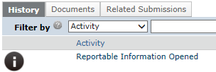
Chapter 5 Practice Exercise – Reportable New Information (RNI)
Please follow the steps below:
Steps | Description of Step
1 | Select “My Inbox” and under “My Current Actions,” select the “Report New Information” Note: You do not select a study at this point.
2 | This will open a form with required fields to be completed.
3 | Use the “Add” button under the “Related studies and modifications” section to link to your study that you previously created.
4 | Use the “Add” button under the “Attach files containing supporting information” section to attach additional documents or information.
5 | Once you have completed the SmartForm, click to “Continue” button.
6 | In your workspace for the study you selected, under Activity, will list “Reportable Information Opened”
7 | This concludes the Chapter 5 Practice Exercise. Congratulations!
RF Report Center

