Slide 1
Click Grants
Administrator Training
Jared Eicher 11/29/2016

Slide 2
Course objectives
1 | Explain who uses the system and the overall workflow
2 | Navigate the system
3 | Perform different activities to move a proposal through the workflow, from end to end

Slide 3
Click Grants Major functional areas
Click Portal concepts
Inbox, Workspace, State, SmartForm, Activities, State transition, etc.
Funding Proposal
Budgeting
SF424 & Mapping
Proposal Review & Approval Workflow
Award Setup & Modifications
Management Reporting

Slide 4
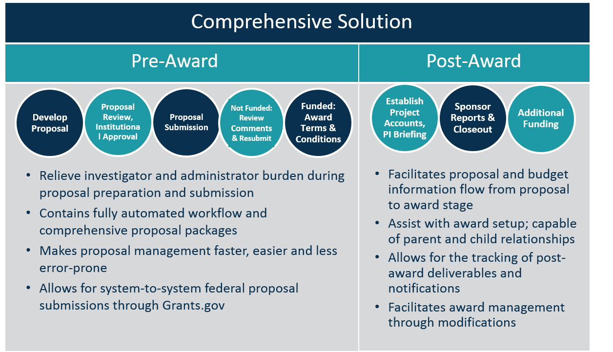
Huron Click Grants TITLE HERE
La dolor ant fugit quas molut qui voluptas magnia dolupta tusciant, ulpa qui beriae sae vit omnisi vel min re dent fuga. Equatur? Quide mo volenis cum qui denduciis earum el molenitem sed eat.
Body Header 1
Epeliqui stiuntiae sit et am, sin perum eria pa nat restiam que doluptatis qui nihit ullest es aut ut quas nobis autempore porempo ritaqui ut es de velest, quam, utatque exere nimiliqui con estrum sum, sinctur, ad utamustem. Upta ant enda cum volum escil et quiant, volut aborem. Um eaque rem dernate ceaque volupis doluptatur autem im nos soloreptas aditium et, ut que peratem poresci assit, cupiscil molupta sum eum alia vene nullit, as ium ipit a qui aciis mi, illaces tiaerch ilitatatios velestion et est ex enient. Xim nonet vel isciatem sinciistis eatusdam quos molestiandit molut ad utatur?
Body Header 2
Cum facium atist, ex expere perum quae vellest enda que volorro blautas periassinit aut reprepedit aut rem quos aut facilis et apiciatem aspidebis vero eatustrum excerias aut re num quibus antiasim voluptatur, optatem qui blam quid quis eicatur aute simaxim oluptiis doluptas nis quiassiniam

Slide 5
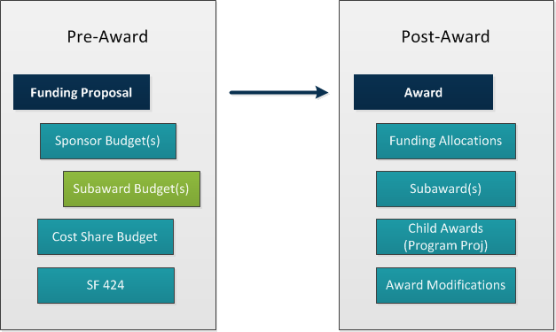
Click Grants Component structure

Slide 6
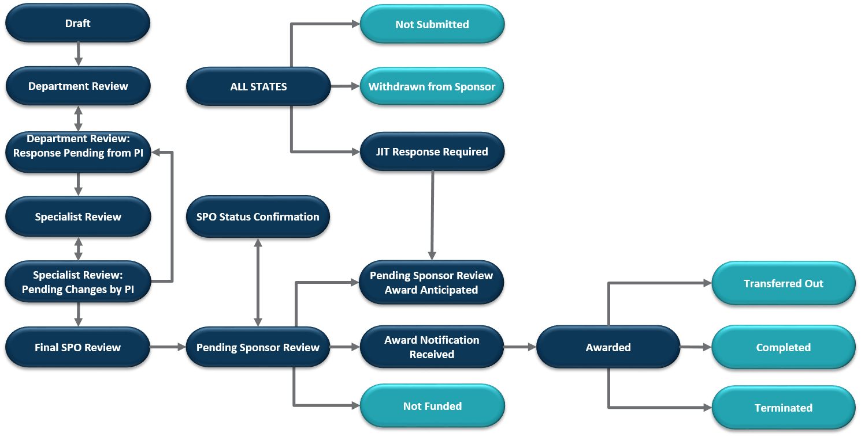
Click Grants proposal workflow

Slide 7
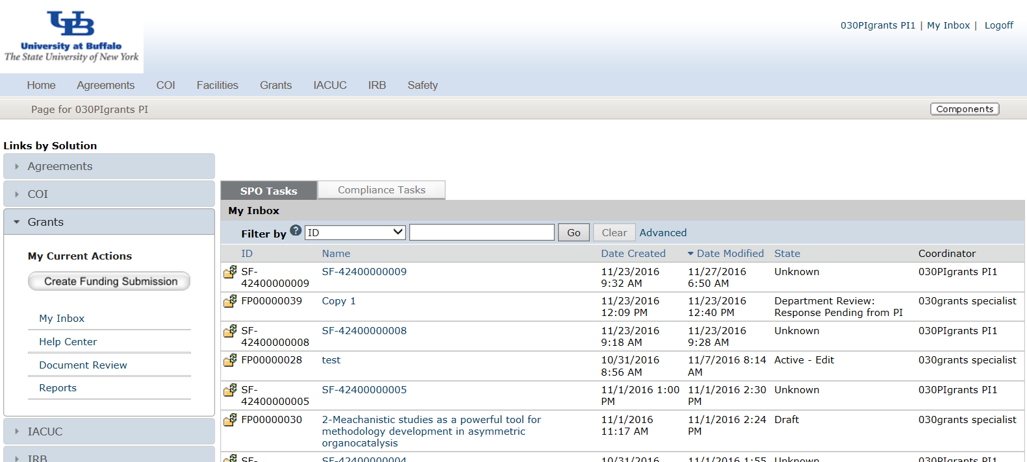
navigation my inbox
3
From My Inbox, you will see:
1. Submissions that require action
2. State in the review process
3. Access to all modules
4. Create a new funding proposal
1
1
2
4

Slide 8
navigation proposal workspace
2
4
1
3
1
From the protocol workspace, you will see:
Proposal details
The state in the review process
Actions you can take in the proposal’s state
Tabs with information about the proposal and the review process

Slide 9
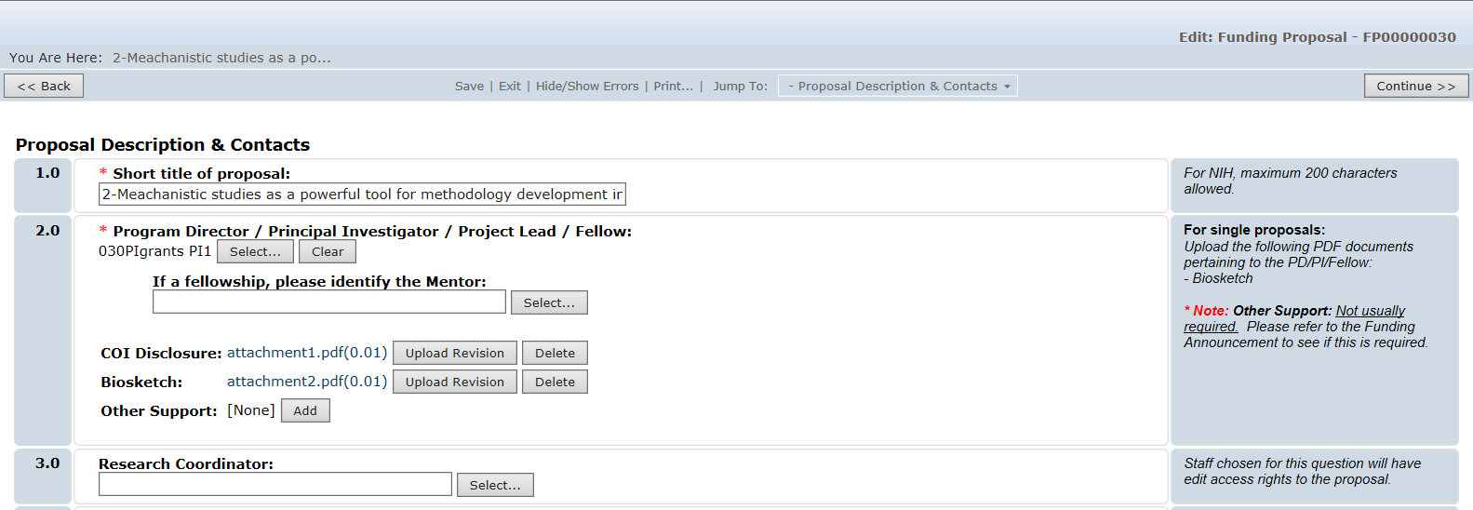
Click Grants smartform
3
1
2
On the proposal pages, you will see:
Required fields (red asterisk)
Field help
Navigation bar

Slide 10
Questions?

