Slide 1
OMB Uniform Guidance
2 CFR Part 200
Notes:
Caroline Mattiske: opening remarks
Donna Kiley: Good morning. Thank you for joining us today. I would like to begin by acknowledging the many people who participated in the successful implementation of the new Office of Management and Budget otherwise known as OMB Uniform Guidance 2 CFR Part 200. In January of 2014 a central office matrix team was formed to begin the process of disseminating the requirements under the new OMB Uniform Guidance 2 CFR Part 200. During the spring and summer of last year a number of our campus constituents were presented with the implications that this new guidance required. Beginning in September of 2014 and going through last month approximately 45 of our campus colleagues participated in either weekly or bi-weekly conference calls. The outcome of this collaboration included a new policy, updated policies, procedures and guidelines with some language and citation changes.

Slide 2
Learning Objectives
Todays presentation will focus on:
Understanding the major changes under the new OMB Uniform Guidance 2 CFR Part 200
How the changes may directly impact your daily activities
Resources available for implementing the OMB Uniform Guidance 2 CFR Part 200 requirements
2
Notes:
Donna Kiley - Slide 2
Today’s presentation will focus on the major and minor changes under the new OMB Uniform Guidance 2 CFR part 200. We will explain how these changes may directly impact your sponsored programs administration daily activities, as well as resources that are available for implementing the OMB Uniform Guidance 2 CFR Part 200 at your campus.

Slide 3
OMB Uniform Guidance – 2 CFR Part 200
Uniform Administrative Requirements, Cost Principles, and Audit Requirements for Federal Awards
The final guidance was issued on December 26, 2013 and supersedes and streamlines requirements from OMB Circulars A-21, A-110,
  A-133 and 5 other circulars.
The OMB Uniform Guidance 2 CFR Part 200 became effective on December 26, 2014
  With the exception of the procurement provisions which due to an election become effective as of July 1, 2016
The guidance for the Audit Requirements becomes effective for the RF with the fiscal year that begins July 1, 2015
3
Notes:
Donna Kiley - Slide 3 Let’s begin with some background information.
The final Uniform Administrative Requirements, Cost Principles, and Audit Requirements for Federal Awards was issued on December 26, 2013 in the Federal Register. This will be referred throughout the program as OMB Uniform Guidance 2 CFR Part 200. This final guidance supersedes and streamlines requirements from 8 OMB Circulars. A-21, A-110, A-133, circulars that we are all familiar with along with five other circulars, A-87, A-89, A-102, A-122 and A-50. These 5 other circulars applied to State and Local Government, Indian Tribal Governments, Non-Profit Organizations, Executive Departments and Agencies as well as Audit follow up.
The final guidance became effective on December 26, 2014 one year after the issuance. There is one exception to the effective date and that pertains to the procurement provisions. There was an election to extend the effect date for procurement which the Research Foundation chose to do, so the requirements for procurement will become effective as of July 1, 2016. Dave Martin will speak about this later in the program.
The final OMB Uniform Guidance 2 CFR Part 200 Audit requirements will become effective for the Research Foundation with the fiscal year that begins on July 1, 2015.
What this really means is that there will be a transition period where both the current regulations and the new OMB Uniform Guidance 2 CFR Part 200 regulations will be applicable.

Slide 4
OMB Uniform Guidance – 2 CFR Part 200
Uniform Administrative Requirements, Cost Principles, and Audit Requirements for Federal Awards
The interim joint final rule was issued on December 19, 2014 implementing the OMB Uniform Guidance 2 CFR Part 200 published by OMB on December 26, 2013.
2 CFR Part 200 is effective for new awards and selected funding increments issued on or after December 26, 2014
4
Notes:
Donna Kiley - Slide 4
On December 19, 2014 OMB issued an interim joint final rule which in effect implemented the OMB Uniform Guidance 2 CFR Part 200 that was published on December 26, 2013.
What the interim joint rule did was made OMB Uniform Guidance 2 CFR Part 200 effective for new awards and selected funding increments issued on or after December 26, 2014.
The interim joint final rule also included introductory comments, technical corrections and amendments and the posting of each agencies implementation plan.

Slide 5
Key Considerations
Prior Approvals
Administrative and Clerical Charges
Effort Reporting
Procurement
Other Direct Charges
Cost Sharing
Closeout
Subrecipient Management and Monitoring
Other Considerations
5
Notes:
Donna Kiley - Slide 5
During the program we will be discussing some key considerations that you should be aware of as you administer sponsored programs. Those key considerations are: prior approvals, administrative and clerical charges, effort reporting, procurement, other direct charges, cost sharing, closeout, subrecipient management and monitoring as well as a few others.
With that I will now pass it over to Justine Gordon who will talk specifically about some of the key considerations.

Slide 6
Prior Approvals
200.407
New emphasis on agency prior approvals
  May slow down research activities. Not clear that Federal agencies have adequate staffing to respond quickly
Examples where prior approval is required:
  Unrecovered F&A as cost sharing Rebudgeting
  Fixed price Subawards Pre Award Costs
  Charging administrative salaries Unusual cost items
  Participant support costs
6
Notes:
Justine – to include her talking points
Donna to listen to NSF presentation (only power points posted so far no audio)and provide quote from Jean Feldman…………………..
Email from Kim Moreland include in talking points
NSF presentation
Revision of the Grant General Conditions
(GC-1), dated December 26, 2014 -- Highlights
• In the absence of Research Terms and
Conditions, the GC-1 was modified to
implement the new Uniform Guidance for use
with all recipient types
▪ Previously, the GC-1 was used with for-profit entities
and State and local governments only
• Terminology modified throughout for
consistency with the Uniform Guidance
• Prior approval requirements have been
updated in Article 2
See documents

Slide 7
Charging Administrative and Clerical Salaries
200.413
“The salaries of administrative and clerical staff should normally be treated as indirect (F&A) costs. Direct charging of these costs may be appropriate only if all of the following conditions are met:
  Administrative or clerical services are integral to a project or activity;
  Individuals involved can be specifically identified with the project or activity;
  Such costs are explicitly included in the budget or have the prior written approval of the Federal awarding agency; and
  The costs are not also recovered as indirect costs.”
“Major Project” requirement for direct charging is removed
7
Notes:
Justine – to include her talking points

Slide 8
Effort Reporting
200.430
Same concepts as circulars but less prescriptive
  A-21 examples of acceptable systems were removed
  “Confirmation”, “statement…signed by the employee”, “report…signed by the employee” all removed
Requires a consistent written definition of institutional base salary (IBS).
Charges for salaries and wages must be based on records that are supported by a system of internal controls.
8
Notes:
Liz
Thanks Justine. Hello everyone. I’m going to cover the differences between the Compensation Personnel Services section in the Uniform Guidance, section 200.430, and Circular A-21, section J.10.
Let’s start with acceptable methods of payroll distribution. The Uniform Guidance removes the prescriptive examples that were previously in A-21. Under A-21, the RF used the “After the Fact” activity record method. This method was removed from the Uniform Guidance. The guidance also eliminated references to a formal certification process, activity reports, certification frequency and signature requirements.
This change should provide us with greater flexibility, and I’ll touch on that in a few minutes.
The Uniform Guidance also changed base salary to Institutional Base Salary, and cited the need to have a consistent written definition of the work covered by IBS. However, more emphasis is placed on the need to specifically define what is included in IBS, what is out of IBS, and when IBS is exceeded.
In addition to this specificity, the Uniform Guidance also places greater focus on a strong system of internal controls. Charges for salary and wages must be based on records that accurately reflect the work performed. The internal control system must include processes that review after-the-fact charges based on budget estimates.
While reasonableness is acceptable for budget estimates, the final amounts charged to awards needs to be accurate.

Slide 9
Effort Reporting (cont.)
200.430
The current effort reporting process, including ECRT, is compliant with the Uniform Guidance.
A subgroup will be evaluating the effort reporting process after more information is released by federal agencies, the audit community, organizations such as COGR, and other institutions.
9
Notes:
Liz
Our current effort reporting process, including ECRT, is compliant with the Uniform Guidance. Our process will not change in the foreseeable future.
However, the changes I described should provide us with more flexibility. For example, changing how often we certify effort.
The effort reporting project team will evaluate our effort reporting process to identify ways in which we can take advantage of the flexibility presented in the Uniform Guidance and further reduce administrative burden. We’ll review information released by the federal agencies, the audit community, other institutions and professional organizations with the idea of making changes while maintaining compliance.
I am now going to turn things over to Dave Martin. Dave, can you share with us the procurement changes in the Uniform Guidance?

Slide 10
Procurement Standards
200.317 – 200.326
Outlines 5 procurement methods:
(1) Procurement by Micro-Purchases (up to $3,000) – no need to solicit competition if price deemed reasonable
Procurement by Small Purchase Procedures ($3,000 to $150,000) – requires solicitation of quotations from an “adequate number” of sources
This is the biggest & potentially most onerous change
Current RF policy requires competition at $50,000
Could potentially require significant additional effort resulting in delays in acquiring goods and services
10
Notes:
Dave - Slide 10
Thank you Liz. The OMB Uniform Guidance has a section that is called “procurement standards” which are contained in Subpart 200, in Sections 317 through 326. These sections describe the applicable procurement standards, the methods of procurements that are allowed, and a listing of specific items that must be included in contracts under Federal awards. In general, the new procurement standards adopt the majority of the language used from Circular A-102, which previously applied to state and local governments. Therefore, non-Federal entities such as the RF that were previously subject to Circular A-110 are affected more significantly. One of the biggest areas of change is that the new procurement standards outline five procurement methods that must be used. The first procurement method is for micro-purchases which would cover the acquisition of goods or services where the aggregate dollar amount does not exceed $3,000. Micro-purchases may be awarded without soliciting competitive quotations if the price is deemed reasonable. The second method is procurement by small purchase procedures. This method would cover relatively simple and informal procurements of goods and services that do not cost more than the Simplified Acquisition Threshold which is currently set at $150,000. If small purchase procedures are used, price or rate quotations must be obtained from an adequate number of qualified sources. The standards do not define how many quotations constitute an “adequate number” but COFAR has clarified this to be more than one. The small purchase procedure requirement is the biggest and potentially most onerous change for campuses because the current RF procurement policy requires competition at $50,000 so lowering this threshold to $3,000 could require significant additional effort for small procurements resulting in delays in acquiring goods and services.

Slide 11
Procurement Standards (cont.)
(3) Procurement by Sealed bids (more than $150,000) – preferred in construction or other purchases where price is the major component (formal advertising required)
(4) Procurement by Competitive Proposals (more than $150,000) – RFP must be publicized and awarded to most advantageous offer with price and other factors considered
(5) Noncompetitive purchases (single source) – used when product or service is only available from one source or in other limited instances
11
Notes:
Dave
Slide 11
The third procurement method that is outlined is procurement by sealed bids. This method would only be required for purchases over $150,000. Using this method, bids are publicly solicited and a firm fixed price contract is awarded to the lowest bidder. This method is preferred in construction or other purchases where price is the major component. The fourth procurement method is procurement by competitive proposals. This method would be appropriate for procurement of services or other complex purchases exceeding $150,000. Using this this method, an RFP would be issued and awarded to the most advantageous offer with price and other factors being considered. A new requirement under this method is that there must be a written method for conducting technical evaluations of the proposals received and for the overall selection process. The final procurement method outlined in the uniform guidance is procurement by noncompetitive proposals. This method of procurement should only be utilized when the product or service is available from one source or in other limited instances. In these instances, the RF Single Source documentation form must be completed to document all the circumstances around the procurement which doesn’t allow for any of the competitive procurement methods to be used.

Slide 12
Procurement Standards (cont.)
Other changes of interest include:
Listing of detailed “affirmative action steps that must be taken” to assure that MWBEs and labor surplus firms are used when possible
Cost or price analysis required for all procurements above the simplified acquisition threshold ($150k)
Negotiation of profit required for each contract over $150k in which there is no competition (single source procurements)
Must maintain records sufficient to detail the history of the procurement (rationale for the method of the procurement, selection of contractor type, reasons why contractors selected and basis for the contract price)
12
Notes:
Dave
Slide 12
Other changes in the new procurement standards include new language listing out the detailed affirmative steps that must be taken by entities to assure that minority and women owned business entities and labor surplus firms are used when possible. There is also language that a cost or price analysis is required for all procurements above the simplified acquisition threshold of $150,000. There is also new language that requires the negotiation of profit for each contract over the simplified acquisition threshold in which there is no competition. We’re trying to get some clarification on exactly what this would entail because we believe it could be challenging to get vendors to provide their profit margins on goods and services. There is also language that detailed procurement records must be maintained of the procurement including the rationale for the method of procurement used, the selection of contract type, the reasons why vendors were selected or rejected, and the basis for the contract price.

Slide 13
Procurement Standards (cont.)
OMB recognized that these changes may take significant effort to implement which has resulted in them providing a one year grace period for implementing the Procurement Standards
RF has opted to comply with A-110 for FY16 and has documented in the procurement policies
New standards only apply to procurements for goods and services charged directly to a Federal award so consideration is being made to have exceptions in some areas when indirect or non-Federal awards are used
Campus team is reviewing proposed revisions to procurement policy & procedures that will be effective 7/1/2016
13
Notes:
Dave
Slide 13
If there is any good news related to the new procurement standards, it is that OMB recognized that the proposed changes may take significant effort to implement which has resulted in them providing a one year grace period for implementing. The RF has opted to continue complying with Circular A-110 through fiscal year 2016 as are all our peer institutions that we have spoken with. There was a requirement that institutions that opt for the grace period must document that they are in compliance with Circular A-110 in their procurement policies which we have done. It should be noted that the new procurement standards only apply to procurements for goods and services that are charged directly to a Federal award. Because of the new restrictions being placed on Federal procurements, campuses have requested that we consider making exceptions in some areas when indirect or non-Federal funds are used. There is a campus procurement team that is charged with updating and reviewing the proposed changes to the procurement policy and procedures. Because of the one year grace period, the new procurement policy and related procedures will become effective on July 1, 2016. And now I will pass it over to Chris Wade who will cover Other Direct Charges.

Slide 14
Other Direct Charges
Computing devices now allowable
  need to be “essential and allocable”
  Not necessarily solely dedicated to the performance of the award
Employee health and welfare costs
  elimination of “employee morale”
Participant support costs
  needs prior approval
14
Notes:
Chris
Slide 14 Other Direct Charges
Good morning, thanks Dave. We want to talk a little bit about some other direct charge changes in the Uniform Guidance.
Computing devices have been clarified in the uniform guidance that they are allowable direct charges. However, they need to meet the test that they are essential for and allocable to the sponsored award. They do not need to be necessarily solely dedicated to the performance of the award.
In the area of Employee Health and Welfare costs, the phrase “employee morale” has been eliminated. Often times under A-21, we would defend costs under the premise that they met the “employee morale” criteria.
As noted earlier, Participant Support Costs now require prior approval by the federal agency

Slide 15
Other Direct Charges (cont.)
Short term travel visa costs
  allowed if directly connected to an award
Publication and Printing Costs
  allowed if incurred prior to closeout
Travel dependent care costs
  allowed but must be consistently applied
15
Notes:
Chris
Slide 15 Other Direct Charges (cont.)
The uniform guidance now also clarifies that short-term visa costs are allowable if directly connected to a federal award.
Publication and printing costs can now be charged up to the time of closeout of an award if even if the costs are not incurred during performance period of the federal award.
Temporary dependent care costs above and beyond regular dependent care that directly results from travel to conferences are now an allowable if a direct result of travel on a federal award and consistent with the entity’s travel policy. We are updating the RF Travel Handbook to note that each campus should determine if this can be adopted for the campus consistently.
Now back to Justine to talk about cost sharing.

Slide 16
Cost Sharing
200.306
Office of Management and Budget (OMB) Uniform Guidance 2 CFR Part 200 defines the federal requirements on sponsored programs
200.306 Cost Sharing or Matching:
  Clarifies policies on voluntary committed cost sharing
  Stipulates that voluntary committed cost sharing is not expected under federal research proposals and cannot be used as a factor during the merit review of the proposal
16
Notes:
Justine – to include her talking points
Cut to the excerpt from the cost sharing learning Tuesday on December 9th marked at 25.15 – 27.50

Slide 17
Cost Sharing
200.306
Restrictions on Voluntary Committed
  “voluntary committed cost sharing is not expected”
  “cannot be used as a factor during the merit review of applications”
  Exceptions (but those must be specified in notice)
Only cost share that is mandatory or committed in the project budget must be included in the organized research base for computing F&A
2/12/14 FAQ states that OMB Memorandum 01-06, Clarification of Uncommitted Cost Sharing is still in effect
17
Notes:
Justine – to include her talking points
“Under Federal research proposals, voluntary committed cost sharing is not expected. It cannot be used as a factor during merit review of applications or proposals, but may be considered if it is both in accordance with Federal awarding agency regulations and specified in a notice of funding opportunity. Criteria for considering voluntary committed cost sharing…must be explicitly described in the notice of funding opportunity.”

Slide 18
Closeout
200.343
No stated change for recipient, but…
All reports due “no later than 90 calendar days after the end date of the period of performance”
  New emphasis on progress reports
New circumstances
  Pressure on agencies (OMB 7/2012 Controller Alert)
  Changes in NIH and NSF financial reporting – award by award
  Enforcement through 90 days for cash draw
  Frustration over progress reports
Closeout is the focus of a new FDP/COGR working group
18
Notes:
Regina to prerecord -
Justine will then introduce Chris…….

Slide 19
F&A and DS-2s
Third-party cost sharing needs to be in the base (denominator)
10% de minimis F&A rate
Acceptance of Negotiated Indirect cost rates. Deviations must have agency head approval with notification to OMB
19
Notes:
Chris
Slide 19 F&A and DS-2
The next two slides deal with Facilities and Administrative or F&A rates or also referred to as indirect costs.
The first change in this area now specifically notes that third-party cost sharing needs to be included in the base of the F&A rate. In the past, we at the RF would exclude this cost sharing.
The uniform guidance now allows for a 10% de minimus F&A rate for institutions that don’t have a federally negotiated rate agreement. More on this in the subrecipient management material presented later.
The uniform guidance also specifically stipulates that federal agencies use the federally negotiated F&A rates and that deviations must be approved by agency heads with a notification to OMB.

Slide 20
F&A and DS-2s (cont.)
One-time F&A extension for up to 4 years
DS-2s for schools with over $50 million in federal awards (SBU, UB, UA)
New 1.3% utility cost adjustment (UCA)
Only mandatory cost sharing included in the base but 2001 OMB memo still applicable
20
Notes:
Chris
Slide 20 F&A and DS-2 (cont.)
There is new language in the uniform guidance that allows for a one-time F&A rate extension of up to 4 years.
DS-2s are Disclosure Statements which have been required by colleges and universities since the late 1990s whereby the institution discloses its accounting practices in detail. Previously under A-21, the threshold for requiring completion of a DS-2 was $25 million in federal awards annually. The uniform guidance raised the threshold to $50 million. SUNY schools that are still required to complete the DS-2 are Albany, University at Buffalo and Stony Brook University. Upstate Medical, Downstate Medical, Buffalo State College and SPO no longer need to maintain a DS-2.
Another change in the uniform guidance is that the Utility Cost Adjustment or UCA is now applicable for all colleges and universities. This adjustment will allow for slightly higher F&A rates as it recognizes that research labs generally use more utilities than other types of rooms. Previously in A-21, the UCA was grandfathered in in the mid-1990s for schools that completed and accepted utility studies.
The last change in this area is the confirmation that only mandatory cost sharing needs to be included in the F&A base. However, the FAQs also confirm that the 2001 OMB memo on voluntary uncommitted cost sharing still applies which essentially notes that generally most federally-funded research programs should have some committed faculty (or senior researcher) effort, either paid or unpaid.
And with that we will take a five minute break so come back in five minutes and we will talk about subrecipient management and monitoring.

Slide 21
Subrecipient Management and Monitoring
  Definitions: Subaward §200.92, Subrecipient §200.93 and Fixed Amount Awards §200.45
  Subrecipient Monitoring and Management: §200.300-332
    Subrecipient and contractor determinations §200.330
    Requirements for pass-through entities §200.331
    Fixed Amount subawards §200.332
21
Notes:
Justine – to include her talking points
The sections of the OMB Uniform Guidance 2 CFR Part 200 that reference Subrecipient Monitoring and Management is provided for your reference.

Slide 22
Subrecipient Management and Monitoring
  Pre-Award (2 CFR Part 200.330)
    Subrecipient vs. contractor determination must be made and documented
    Perform a risk assessment of the subrecipient
  More prescriptive Post-Award requirements (2 CFR Part 200.331)
    Add a lengthy list of elements to the subaward terms
    Establish a monitoring plan for the subrecipient and enforcement action against noncompliant subrecipients
      Financial review
      Programmatic review
    Must use subrecipient’s negotiated F&A rate or provide a 10% MTDC “de minimis” rate (or another negotiated rate with the subrecipient)
  Fixed amount subawards require written prior approval from the federal agency (2 CFR Part 200.332)
22
Notes:
Justine – to include her talking points

Slide 23
5 Step Toolkit
Subrecipient Monitoring and Management
The Research Foundation must comply with any prime award’s specific requirements for issuance of subawards.
  All of the terms and conditions applicable to the subaward must be flowed down to the subrecipient.
  The 5 step toolkit was developed to assist in determination, risk assessment and periodic monitoring of subrecipients.
  These steps are required for federal awards and are considered best practice for all others.
Additional Federal Requirements
2 CFR Part 200 places certain additional requirements for monitoring and managing subrecipient activities on federally-funded awards. In order to ensure that the Research Foundation is in compliance with federal regulations, the requirements at 2 CFR 200.330-332 shall apply to subrecipient arrangements funded with federal funds.
23
Notes:
Justine – to include her talking points
Next slide has a copy of the webpage with the toolkit and resources

Slide 24
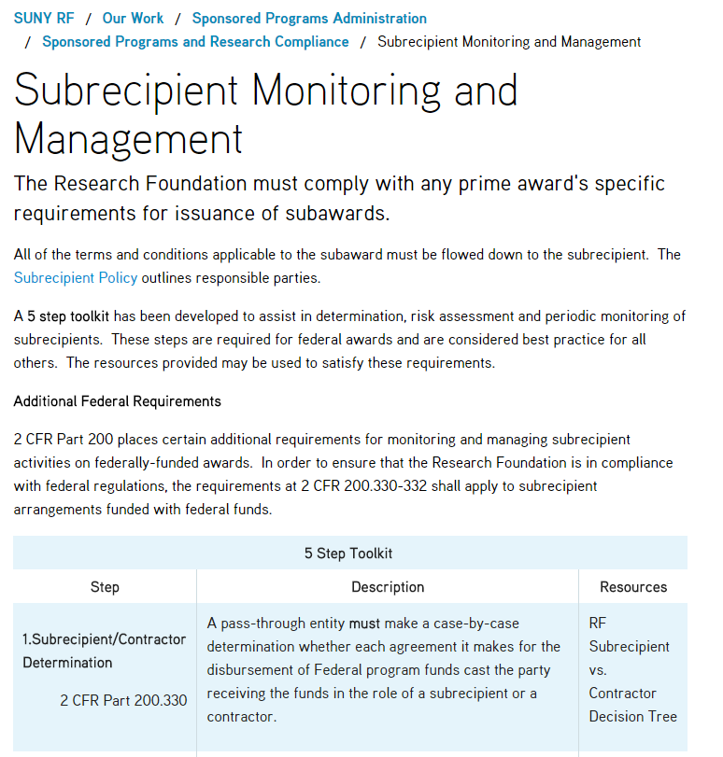
5 Step Toolkit
Subrecipient Monitoring and Management
24
Notes:
Justine – to include her talking points
Copy of the webpage with the toolkit and resources

Slide 25
Subrecipient and Contractor Determinations 200.330
Subrecipient:
  Has performance measured against the objectives of the Federal program
  Has responsibility for making programmatic decisions
  Has responsibility for adherence to Federal program compliance requirements
  Uses Federal funds to carry out a program of the organization, not to provide goods or services for a program of the pass-through entity
  Determines who is eligible to receive Federal financial assistance
Contractor:
  Provides the goods or services within normal business operations
  Provides similar goods or services to many different purchasers
  Operates in a competitive environment
  Provides goods or services that are ancillary to the operation of the Federal program
  Is not subject to compliance requirements of the Federal program
Pass-through entities must make determinations
“Contractor” has replaced “vendor”
Characteristics of a subrecipient and of a contractor (formerly vendor) have not changed
25
Notes:
Sharon to include her talking points

Slide 26
Subrecipient and Contractor Determinations 200.330
Toolkit - Step 1 (Subrecipient/Contractor Determination)
  RF Subrecipient vs. Contractor Decision Tree
Federal agencies may supply and require specific support for determinations
  Could create a significant documentation burden
  Could result in unintended agency influence on determinations
26
Notes:
Sharon to include her talking points
Next slide has a copy of Subrecipient vs. Contractor Decision Tree

Slide 27
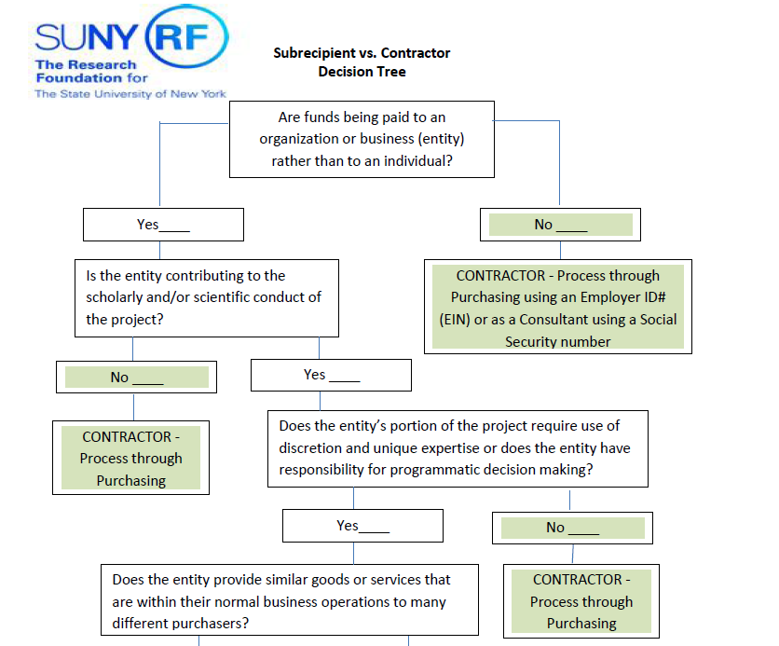
Toolkit - Step 1
RF Subrecipient vs. Contractor Decision Tree
27
Notes:
Sharon to include her talking points

Slide 28
Requirements for Pass-through Entities 200.331
All pass-through entities must…
  Include required information in the subaward §200.331(a)(1)
    Honor subrecipient federally recognized, IDC rate
    If no rate exists
      Negotiate a rate or use the de minimus rate of 10% MTDC §200.331(a)(4)
Toolkit - Step 2 (Risk Assessment)
  Evaluate subrecipient risk to determine appropriate monitoring §200.331(b)
28
Notes:
Sharon to include her talking points
Next slide has a copy of Subrecipient Risk Assessment Questionnaire

Slide 29
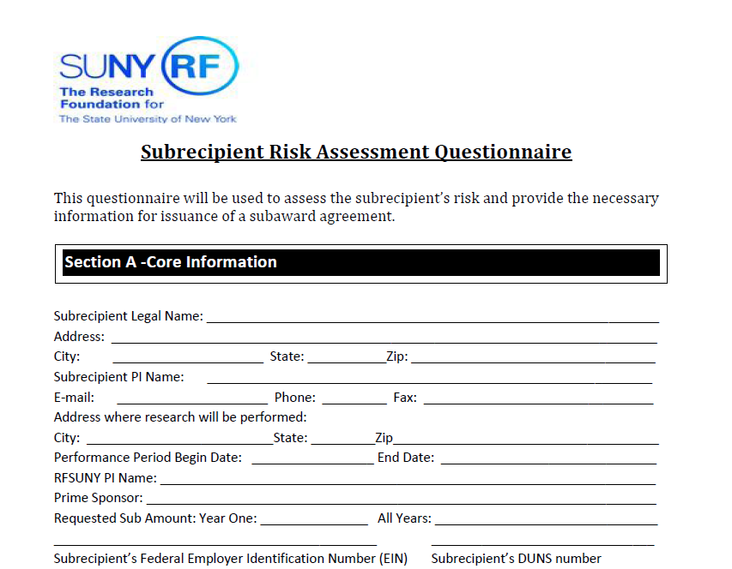
Toolkit - Step 2
RF Subrecipient Risk Assessment Questionnaire
29
Notes:
Sharon to include her talking points

Slide 30
Requirements for Pass-through Entities 200.331 (continued)
All pass-through entities must…
    Toolkit - Step 3 (Risk Mitigation)
  Consider imposing specific conditions upon subrecipient if appropriate §200.331(c)
30
Notes:
Sharon to include her talking points
Next slide has a copy of Subrecipient Risk Analysis-High Low Risk Entities

Slide 31
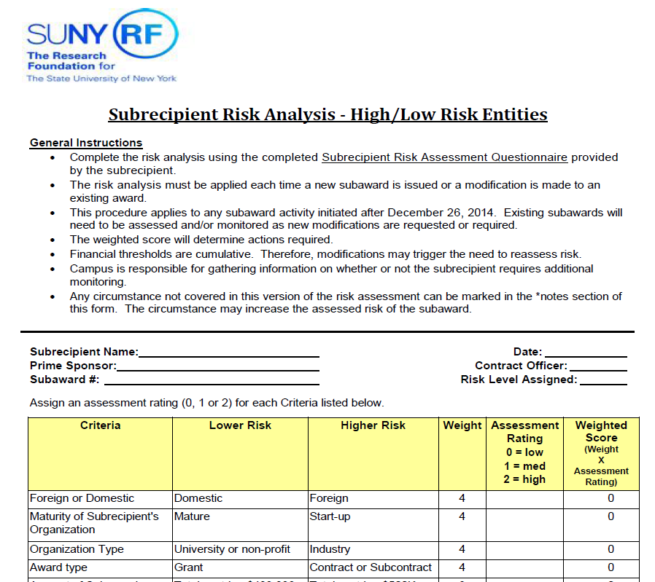
Toolkit - Step 3
RF Subrecipient Risk Analysis-High Low Risk Entities
31
Notes:
Sharon to include her talking points

Slide 32
Requirements for Pass-through Entities 200.331 (continued)
All pass-through entities must…
    Toolkit - Step 4 (Monitoring)
  Monitor the activities of the subrecipient §200.331(d)
    Review financial and programmatic reports §200.331(d)(1)
    Follow up and ensuring that timely action on all deficiencies are taken §200.331(d)(2)
    Issue a management decision for audit findings §200.331(d)(2)
32
Notes:
Sharon to include her talking points
Next slide has a copy of Subrecipient Invoice Checklist, Performance Monitoring, and Final Payment Authorization

Slide 33
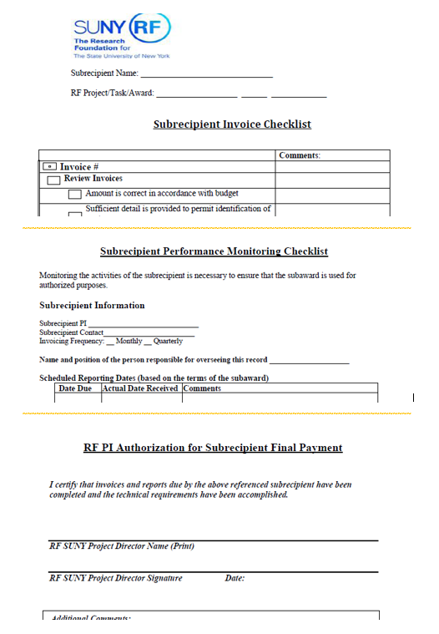
Toolkit - Step 4
RF Subrecipient Invoice Checklist, Performance Monitoring, and Final Payment Authorization
33
Notes:
Sharon to include her talking points

Slide 34
Requirements for Pass-through Entities 200.331 (continued)
All pass-through entities must…
    Toolkit - Step 5 (Enforcement)
  Consider taking enforcement action against noncompliant subrecipients §200.331(h)
34
Notes:
Sharon to include her talking points
Next slide has a copy of Subrecipient Enforcement Measures

Slide 35
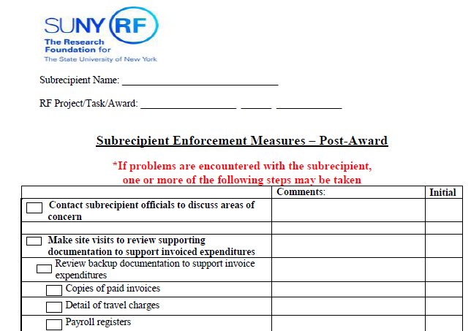
Toolkit - Step 5
RF Subrecipient Enforcement Measures
35
Notes:
Sharon to include her talking points

Slide 36
Fixed Amount Subawards – Limits 200.332
Fixed amount awards defined at 200.45
Allowed “with prior written approval from the Federal awarding agency up to the Simplified Acquisition Threshold” currently $150,000
36
Notes:
Sharon to include her talking points
COGR Implementation and Readiness guide – December 12, 2014
“For fixed price subawards exceeding $150K, develop a process to create separate statements of work and deliverables that stay within the $150K threshold, or decide when you will consult the agency for guidance.
COFAR FAQ’s in November addressed a question about the limit
“Non-federal entities having special circumstances, including and unanticipated need to increase a fixed price subaward above the threshold, should consult with their Federal Awarding agency for guidance on how to complete the planned scope of work with the lease amount of administrative burden.

Slide 37
Other Considerations
Overall focus on Internal Controls
Electronic records are now acceptable for collection, transmission and storage
Conflict of Interest
37
Notes:
Donna
Thank you, Sharon. It’s always helpful to hear a campus perspective.
Other considerations to keep in mind is the overall focus on internal controls. The OMB Uniform Guidance 2 CFR Part 200.303 requires strong internal controls. The Federal Demonstration Partnership (FDP) and the Council on Government Relations (COGR) published a joint white paper on the OMB Uniform Guidance. In the white paper the issue that was addressed was “Internal Controls is one of the most repeated phrases in the OMB Uniform Guidance 2 CFR Part 200, 103 times. Reference to internal controls went from a single section of the annual compliance supplement in A-133 to one of the most frequently repeated phrases in 2 CFR Part 200.
Another clarification in the OMB Uniform Guidance 2 CFR Part 200.335 states that electronic records are now acceptable for collection, transmission and storage. When original records are electronic and cannot be altered, there is no need to create and retain paper copies.
Also, the federal awarding agency must establish conflict of interest policies for federal awards as stated in OMB Uniform Guidance 2 CFR Part 200.112. In COFAR’s (Council on Financial Assistance Reform) frequently asked questions it specifies that section 112 does not refer to scientific conflicts of interest related to research. Instead, it refers to conflicts related to how decisions are made for selecting subrecipients or procurements.

Slide 38
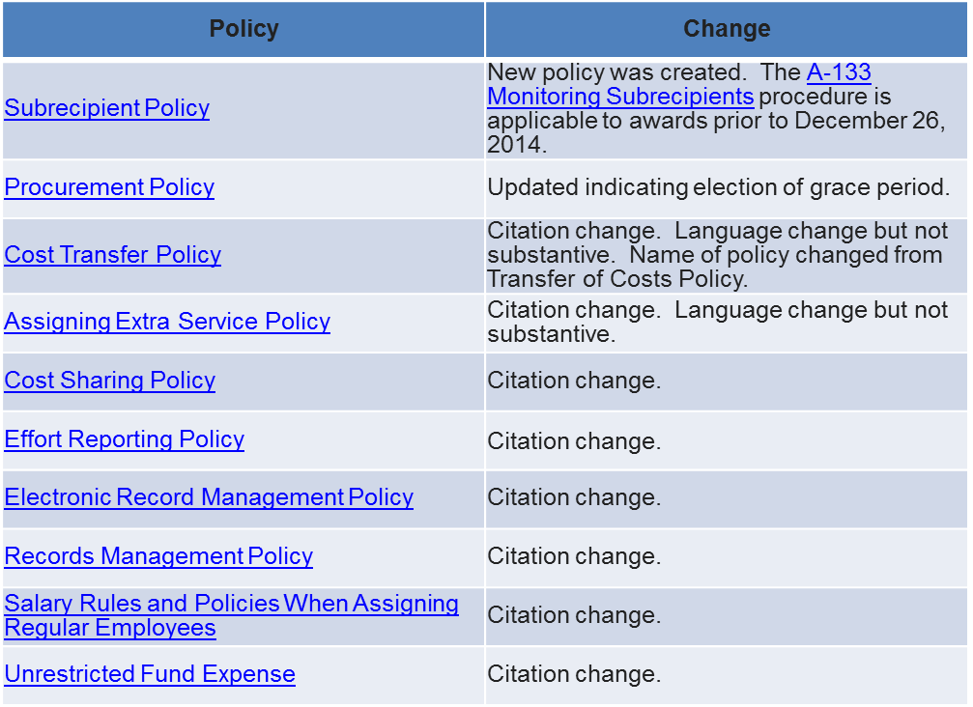
The following chart reflects Research Foundation Policies created and updated to comply with OMB Uniform Guidance 2 CFR Part 200. All policies can be found at RF Polices A to Z.
38
Notes:
Donna
The chart on this slide lists the policies that were either created or updated to comply with OMB Uniform Guidance 2 CFR Part 200. The only new policy that was created to comply with 2 CFR Part 200 is the Subrecipient Policy. This new policy is posted to the website along with other policies that were updated for slight language change or citation changes.

Slide 39
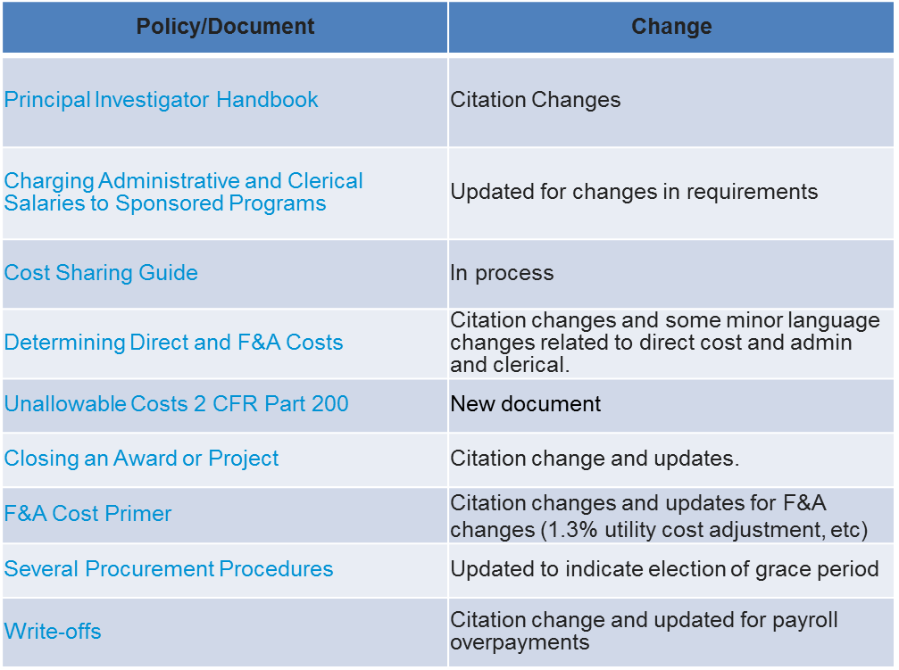
The following chart reflects key Research Foundation procedures or other documents created or updated to comply with OMB Uniform Guidance 2 CFR Part 200.
39
Notes:
Donna
This chart reflects KEY procedures or other documents created or updated to comply with 2 CFR Part 200.
The Principal Investigators Handbook included some citation changes as well as changing the reference to contractor from vendor.
Charging Administrative and Clerical Salaries to Sponsored Programs was updated for changes in the requirements of 2 CFR Part 200.
Several procurement procedures were updated to indicate election of the grace period.
As well as a number of other documents

Slide 40
Questions?
40
Notes:
Have a canned question or two here.

Slide 41
Resources
Public webpage on the Research Foundations website:
  OMB Uniform Guidance
    COGR Implementation and Readiness Guide for OMB Uniform Guidance
    COFAR FAQs
41
Notes:
Donna
As we mentioned in our learning objectives there are a number of resources available which provide the background and detail of OMB Uniform Guidance 2 CFR Part 200 and the implications to the Research Foundation sponsored programs administration. These documents can be found on the Research Foundations Public Website under the OMB Uniform Guidance Webpage. The two bulleted references, COGR implementation and readiness guide for OMB Uniform Guidance and COFAR FAQ’s are concise documents that outline questions that might come up in the course of sponsored program administration.
The materials presented and links mentioned in this program are included under the materials for the Learning Tuesday Program

Slide 42
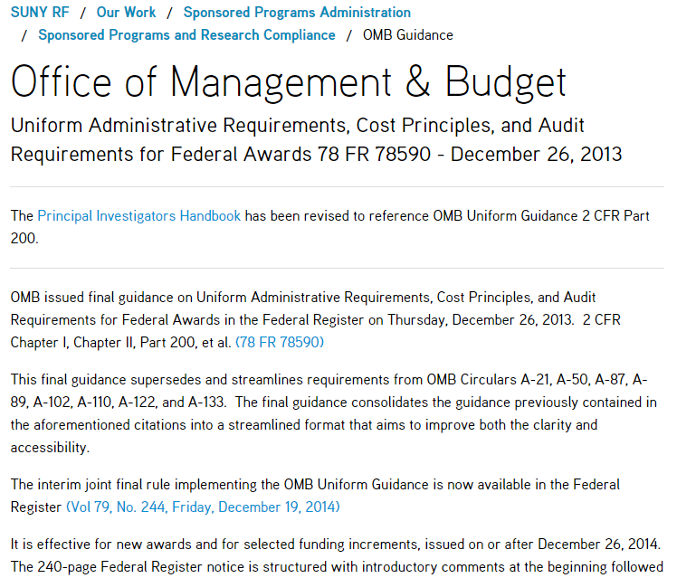
OMB Uniform Guidance - Webpage
42
Notes:
Donna

Slide 43
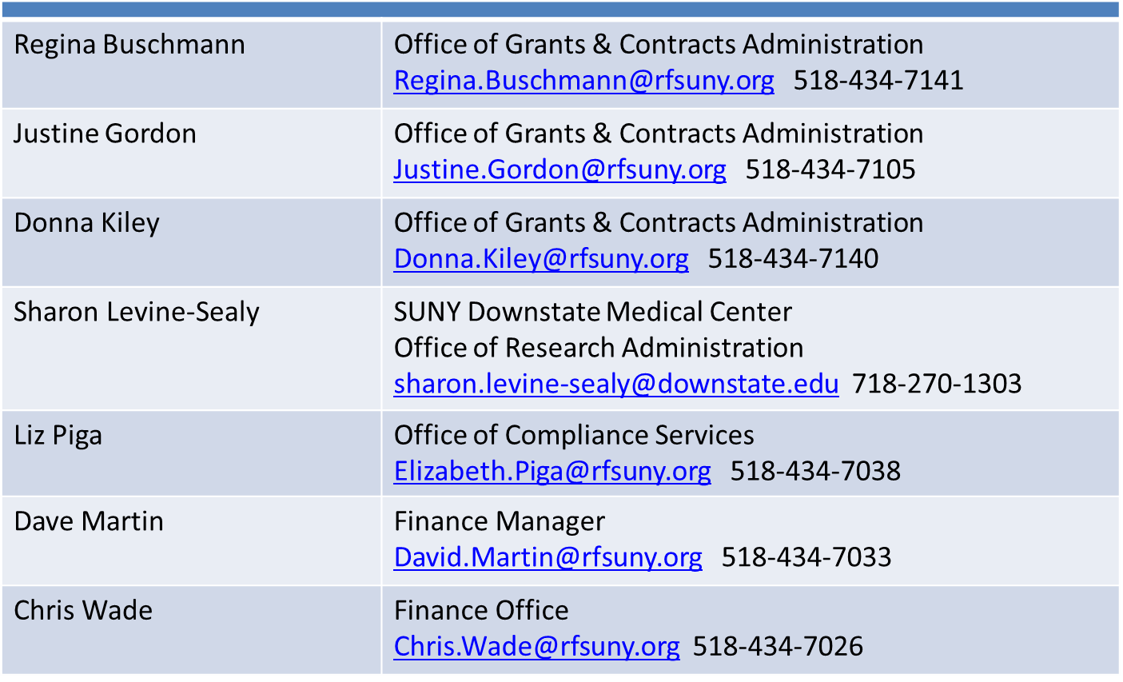
Contacts
43
Notes:
Donna As I mentioned in the introduction a number of campuses were involved in the drafting of the new subrecipient policy, all other policy revisions, training materials and procedure and guidance documents. Please reach out to your sponsored programs office for specific questions.
Listed on this slide is the contact information of today’s presenters.
Closing
We would like to thank you for taking the time to attend this learning and development program today. Please take two minutes and let us know what you thought of today’s program by completing the exit survey.
If you registered in advance, you’ll receive a link to the survey in an email very shortly. However, if you did not register, we still want to hear from you, and I encourage you to use the link on the live stream webpage you are on right now. As always, your feedback is used to improve future programs.
The next Learning Tuesday program is scheduled for March 3rd, 2015 and will be a preview to the Research Foundation for SUNY Symposium to be held on March 24-25 at SUNY Plaza in Albany NY. The symposium provides and exciting and unquiet opportunity for all SUNY and RF employees working in research administration to learn from and participate in cross-functional panel discussions and workshops. On March 24th we will also be streaming live from the symposium bringing you Chancellor Zimphers’s opening remarks. As always, we encourage you to attend the next Learning Tuesday on March 3rd, so register and mark your calendar. Thanks again and have a great day.

Slide 44
OMB Uniform Guidance
2 CFR Part 200
Notes:
Caroline Mattiske: opening remarks
Donna Kiley: Good morning. Thank you for joining us today. I would like to begin by acknowledging the many people who participated in the successful implementation of the new Office of Management and Budget otherwise known as OMB Uniform Guidance 2 CFR Part 200. In January of 2014 a central office matrix team was formed to begin the process of disseminating the requirements under the new OMB Uniform Guidance 2 CFR Part 200. During the spring and summer of last year a number of our campus constituents were presented with the implications that this new guidance required. Beginning in September of 2014 and going through last month approximately 45 of our campus colleagues participated in either weekly or bi-weekly conference calls. The outcome of this collaboration included a new policy, updated policies, procedures and guidelines with some language and citation changes.

