Slide 1
What All Supervisors Need to Know
Management Training for RF Supervisors
Notes:
Kate

Slide 2
Learning Objectives
Participants will be able to understand and explain the basic principles of supervising Research Foundation employees, including:
classification of employees, student employees, independent contractors, and fellows.
exempt versus nonexempt.
leave under Family and Medical Leave Act (FMLA) and paid time off.
recruitment and onboarding.
performance management and professional development opportunities.
concepts of employment-at-will and managing performance/behavior correction through progressive discipline.
motivation and engagement.
Notes:
Kate

Slide 3
What All Supervisors Need to Know
Classification
Employee vs Independent Contractor
Misclassifying employees can result in liability
Minimum wage and overtime violations
Benefits coverage violations
Unpaid employment taxes
Workers compensation coverage

Slide 4
What All Supervisors Need to Know
Employee vs Independent Contractor
FLSA definition of “employee” is very broad
Employment relationship – is the individual economically dependent on the employer?
Independent Contractor – is the worker in business for him/her self?
DOL 6 factor “economic realities” test

Slide 5
What All Supervisors Need to Know
Student Employees
Must be enrolled full time
Engaged in work related to their academic program
Work part time
Do not get benefits
Fellowship Recipient
support academic study or fellow-initiated research and recognize recipients promise as a research or teaching scholar
No service to the RF

Slide 6
What All Supervisors Need to Know
EXEMPT | NON EXEMPT
Paid as a salaried employee, not hourly | Can be paid hourly or salaried
Paid for professional obligation | Paid for every hour worked
Record time off in full or quarter day increments | Record time off in hour or quarter hour increments
Submit monthly exception reports | Submit bi-weekly time sheets
Not subject to overtime pay or minimum wage orders | All hours worked over 40 are paid at time and a half
Eligible for a meal period | Required to take a meal period and record on timesheet
Notes:
Kate

Slide 7
What All Supervisors Need to Know
Family medical leave act (FMLA)
1 year of service and 1250 hours in past 12 months
Employees out with an illness or care of a family member for more than 3 consecutive calendar days (this includes weekends)
Unpaid job protection
May supplement with appropriate accruals
Call HR!

Slide 8
What All Supervisors Need to Know
Vacation
For rest and relaxation
Approved in advance
Sick leave
Employee illness or injury
Out 5 or more days, then need return to work note
Family sick/bereavement – 15 sick days allowed
Personal time – pressing personal business

Slide 9
What All Supervisors Need to Know
Recruitment Issues
Application process – make sure all applicants complete an RF application
Interviewing
Reference checks
Nepotism Policy

Slide 10
What All Supervisors Need to Know
Application process
Forms/Application
Approvals
Self Identification
Recruitment
Desire for a diverse and inclusive pool of candidates
Nepotism
Notes:
Matt -

Slide 11
What All Supervisors Need to Know
Reference checks
Best practices
Consistency

Slide 12
On-Boarding at the Research Foundation
Best practices from UAlbany
Paperwork
New staff orientation
Required training
Training
On-boarding plan
Supervision
Routine check-ins
Remote Employees
Notes:
Jerry

Slide 13
Performance Management
Frequent feedback - the what and the how!
Supervision expectation – schedule 1:1’s
Appraisals – no surprises
Notes:
KCS

Slide 14
Supervision
Coaching for performance
What you do and how you do it
“Knee to knee” meetings consistently
Strength-based
Open door policy – just not good enough!
Focus on professional development
Notes:
KCS

Slide 15
Notes:
KCS – Will ask Barbara and Kate to share their development goals

Slide 16
Potential Development Opportunities
Outside Seminars / College Courses | Self Directed Experiential Learning | Improve Financial Acumen | Self-Directed Knowledge Transfer | Open Chair Staff meetings/ Department events
Internal Workshops | Mentoring | Special Assignments/ Workgroups | Books/ Readings | Other – Your Good Ideas!
Notes:
KCS
Commit to one external workshop in your field – come back and present what you’ve learned; get certified, finish degree
Self Directed
Experiential Learning
Participate in Learning Tuesdays; HUB meeting; Lunch & Learn; NCURA TV; Instruct a course
Improve Financial Acumen
Attend legislative hearing; review financial statements with finance staff; attend Finance staff meeting
Self Directed
Knowledge Transfer
Ask to be an Open Chair at staff meetings; Speak publicly 3x per year; Use RF meetings to present your work
Improve Leveraging Skills and Influencing Others
Shadow executive members; attend Research Council, Operations Manager’s , or Board meeting
Internal Workshops
Attend any and all
Internal workshops that your schedule allows – Build your Full Knowledge of the RF
Mentoring
Be a Mentor; Get a Mentor. Someone committed to your professional growth not in your supervisory chain. In Development – A Pool of NYS Mentors
Special Assignments Workgroups
Ask manager to keep you in mind for Opportunities to be on RF/SUNY workgroups; NCURA Peer Review; Region 2 Teams
Books
Readings
Now, Discover Your Strengths, Good to Great, Death by Meeting, Leading Change, Lincoln on Leadership
Other – Your Good Ideas!

Slide 17
Notes:
KCS

Slide 18
Leadership Academy
Professional Development Focused
Public Speaking Modules
Improved Communication
End of Program project
Mentors Assigned
Campus Tours and more….
Notes:
Jerry

Slide 19
Book Review: From Good to Great led by Jerry Gauriloff, UAlbany
Notes:
Jerry

Slide 20
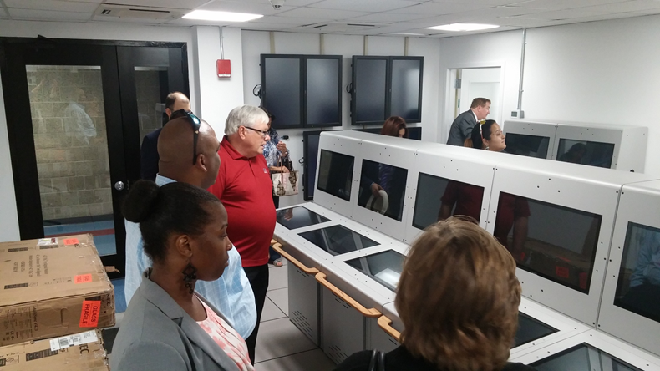
Tour of Maritime – Tugboat Simulator
Notes:
Jerry

Slide 21
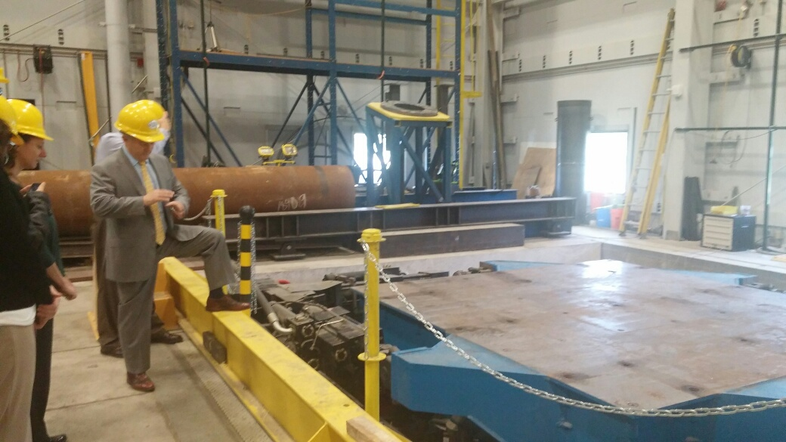
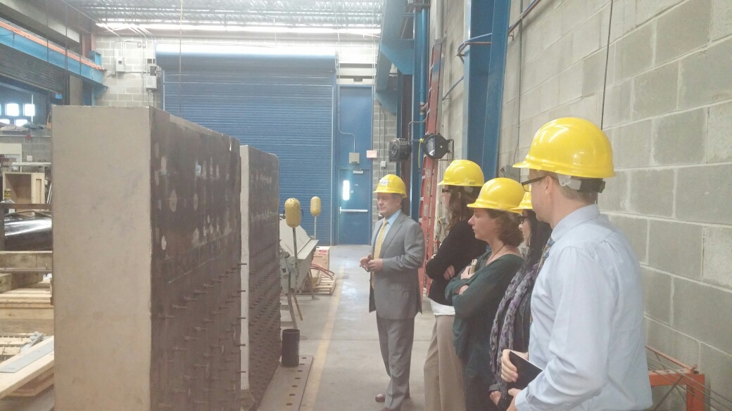
UB Earthquake Simulator Tour
Notes:
Jerry

Slide 22
Employment-at-Will
A doctrine that states that an employment relationship may be terminated by the employer or employee at any time and for any or for no reason.
Notes:
Barbara

Slide 23
Employment-at-Will
Employees can be terminated at-will, but not for the following reasons:
Cannot be terminated for a discriminatory reason (e.g., based on the employee’s race, national origin, religion, color, sex, disability, etc.)
Cannot be terminated out of retaliation for performing a legally protected action (e.g., filing a Workers’ Compensation claim, filing a discrimination or harassment suit, participating in a workplace investigation, taking FMLA leave, refusing to perform illegal activities, etc.)
Cannot be terminated if the employee has an employment contract that outlines the terms of employment (in other words, the contract terms supersede the employment-at-will doctrine).
Notes:
Protections are afforded to employees within the doctrine of employment-at-will.

Slide 24
Employment-at-Will
Steps for Supervisors to Minimize Employers Liability for Adverse Employment Actions
- Ensure your employment expectations for employees are clear.
- Use disclaimers (at-will language) in the new hire process, including in offer letters and in new employee orientations.
- Follow the RF’s Progressive Discipline Policy and Guidelines to demonstrate that if there is a termination there is a valid, nondiscriminatory reason for the termination.
- Document any disciplinary actions being taken.
Involve human resources in the disciplinary process.
Engage employee relations and, if needed, legal counsel, prior to making decisions and/or taking adverse employment decisions.

Slide 25
What is Progressive Discipline?
Method used by RF supervisor/coach to attempt to address employees’ performance and/or behavior issues.
Key is to make the employee aware of the specific performance and/or behavior issue, and to give him/her the opportunity to improve in order to become successful in position.
Notes:
Barbara

Slide 26
Principles of Progressive Discipline
Corrective
Fair and consistent
Employee is provided a chance to give his/her side
Notes:
Barbara

Slide 27
Steps of Progressive Discipline
Step 1 Step 2
Verbal Counseling(s)
Written Counseling(s)
Step 3 Step 4
Performance Improvement Plan (PIP)
Termination
Notes:
Barbara

Slide 28
Engagement and Morale
#1 reason employees leave their jobs because of their supervisor
Engagement teams
Business of the RF
Research Symposium
SPA fundamentals
Mentoring program
Leadership Academy
Learning Tuesdays
Notes:
KCS

Slide 29
Questions?

Slide 31
From the campuses, we heard…
Nepotism
Union staff supervision
ADA and FMLA notice to HR
Employment at will
Interviewing
Notes:
Kate

