Slide 1
Policies, Procedures, & Guidelines

Slide 2
Policy vs. Procedure vs. Guideline
Policy – A governing rule or principle that requires or prohibits conduct.
Procedures – Required steps to implement or comply with a related policy.
Guidelines – Optional steps outlining suggested ways to perform a function or adhere to a policy or procedure.

Slide 3
Disclaimer
It is important to note that the “Social Media Policy” being created and discussed in this Learning Tuesday is entirely fictional. The “Social Media Policy” is simply illustrating the process in which a real policy would be created, according to the “Create or Update Policies” procedure. Lastly, all real Policies, Procedures and Guidelines can be found on the RF SUNY website, under Compliance in the Policies and Procedures section.

Slide 4
SCENE 1
Step 1: Conduct an Environmental Scan and determine what changes need to be made or whether new policy is required.
Step 2: Contact the Office of Compliance Services to confirm the type of document being created/updated (Policy, Procedure or Guideline), and determine next steps.
Step 3: Formulate the draft using the Policy Template in Microsoft Word.

Slide 5
SCENE 2
Step 4: Work with campus colleagues (either established focus groups or specific staff based on policy content), SUNY System Administration as needed, and RF Counsel for draft.

Slide 6
SCENE 3
Step 5: Develop a communication and training plan. Consult with External Relations, Training Unit or Office of Compliance Services.
Step 6: Submit draft to ECT for review.
Step 7: Begin filling out the New or Updated Policy form. At each of the following review stages (Management Council & President’s Council), this form must accompany the Policy draft.

Slide 7
SCENE 4
Step 8: Submit to the Management Council for review and recommendation to the President’s Council.
Step 9: Submit to RF President’s Council, who will advise the President to approve or reject the policy.
Step 10: Ensure that RF counsel has reviewed and signed off on the final draft prior to presentation to RF President.

Slide 8
SCENE 5
Step 11: If approved and signed by President, submit the final draft to, rfpolicy-procedure@rfsuny.org and request that it be posted on RF website. Include the completed New or Updated Policy form.
Step 12: If updating a current Policy, archive the former version.
Step 13: Enter all changes into Author IT, post Policy on RF website and notify the Policy owner.
Step 14: Once the notification has been received, update the New or Updated Policy form.

Slide 9

Questions

Slide 10
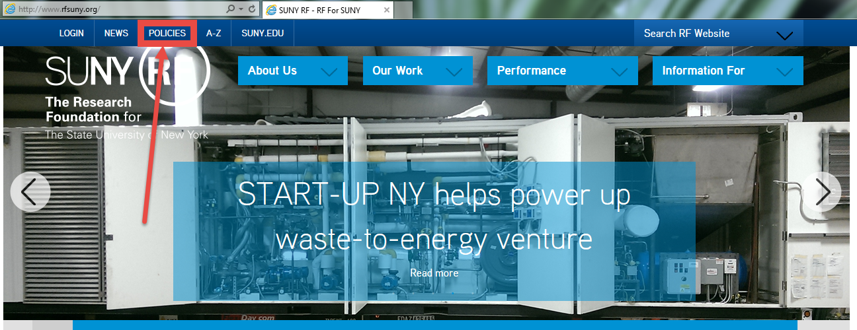
Where to Find RF Policies, Procedures, and Guidelines

Slide 11
Contact Us
Joshua B. Toas, JD, CCEP, CCEP-I, CFE. Chief Compliance Officer. 518-434-7145
Jeneeta Howe, JD, MBA. Compliance Associate. 518-434-7019
Nadia M. Sidarous, CCEP. Senior Administrative Assistant. 518-434-7202

Slide 12


Slide 13
Policies, Procedures, & Guidelines

