Slide 1
What You Should Know About IT Security

Slide 2
What Is At Stake? What Are We Protecting?
Protected Personal Information (PPI)
Access to and disclosure of PPI such as SSN, date of birth, home address, home telephone number, etc., must be strictly limited to individuals with an official need to know.

Slide 3
What Is At Stake? What Are We Protecting?
Protected Health Information (PHI)
PHI includes any information that is created or received by a health care provider, health plan, public health authority, employer, life insurer, school or university, or health care clearinghouse that relates to the physical or mental health or condition of any individual, the provision of health care to an individual, or the payment for the provision of health care to an individual.

Slide 4
What Is At Stake? What Are We Protecting?
Proprietary Intellectual Property
Includes all copyright, patent, trademark, trade secret, author’s rights, industrial design, etc. covered by the Uniform Trade Secrets Act.
Proprietary Business Information
Includes any information our organization wishes to keep confidential – e.g. certain financial data, research results, contracts, customer lists, etc.

Slide 5
Information is the New Gold!

Slide 6
Information is the New Gold!
Social Security Number: $1 - $5
Credit Card (Full Info): $15 - $30
Bank Login Credentials: $190 and up
Patient Health Records: up to $300
Ransomware demands can range from $300 to tens of thousands.
Damage from loss of intellectual property can be devastating to an organization.

Slide 7
How Information is Classified
Public - Information that may be broadly distributed without causing damage to the organization, its employees and stakeholders.
Internal - Information whose unauthorized disclosure, particularly outside the organization, would be inappropriate or inconvenient.
Confidential/Restricted - Highly sensitive or valuable information, both proprietary and personal. Must not be disclosed outside of the organization without the explicit permission of Senior Management.

Slide 8
Information Classification Examples
Names of the RF Board of Directors (public)
Unpublished results from a sponsored research study (confidential)
Reimbursement form submitted for a prescription (confidential)
Completed W9 form (confidential)
Training materials (internal)
Patient discharge form (confidential)

Slide 9
What to do if a Breach Occurs
Recognize that a breach has occurred.
Alert a supervisor and/or someone responsible for information security in your organization.
Document the circumstances surrounding the breach.
Cooperate fully with any investigation.
Follow up to ensure your alert has been received and acted upon.

Slide 10
Scenario 1
Your colleague keeps a spreadsheet of graduate students who participate in a study at your campus, containing the names, addresses, birthdates, and social security numbers of all the participants. You notice the file when you are looking through a commonly shared network folder where everyone has access to it. What should you do?

Slide 11
Delete the file and tell you colleague he shouldn’t keep files like that on the network.
Make a copy of the file and email it to his supervisor.
Report the incident to your supervisor, and ensure it is followed up by someone responsible for information security in your organization.
Do nothing. You didn’t put the file there, so it’s none of your business.

Slide 12
Acceptable Use of Information Technology Resources
The RF or SUNY campus may provide IT systems for official use. This may include computing systems, tablets, cell phones, storage, and other devices.

Slide 13
Acceptable Use of Information Technology Resources
Users are responsible for reviewing, understanding, and complying with policies, procedures and laws related to access, acceptable use, and security of RF Resources and RF Data.

Slide 14
Acceptable Use of Information Technology Resources
There should be no expectation of personal privacy when using RF resources.
Users should also be aware of their campus policies on privacy of communications and technology use.

Slide 15
Best Practices for Data Security
Understand that your User ID + Password combination is your digital identity. You have been granted privileged access to information resources. Keep your digital identity private.

Slide 16
Best Practices for Data Security
Store work-related data to a network drive or some place where it is frequently backed up. Doing otherwise introduces a risk of permanent data loss.

Slide 17
Best Practices for Data Security
Lock your computer screen when you are away from your computer. Do it manually each time you leave your work area, and set the screen saver to lock after a set time of inactivity.

Slide 18
Best Practices for Data Security
Routinely review files, and purge records no longer needed or required to be maintained by applicable record retention laws and/or policies.

Slide 19
Scenario 2
You were assigned a network drive for file storage by your central IT department, but you often store your work-related files on your desktop computer’s hard drive or a portable USB flash drive. Is this a good practice?

Slide 20
Sure, you should be able to store your files wherever you like.
Yes, and you should put your personal files like your MP3 music collection and your vacation photos on the network so they’ll be safe and sound.
No, because your work-related files probably aren’t being backup up on a regular basis.
No, it’s always better to store your files in the cloud.

Slide 21
Your Electronic Identity Is Your Responsibility
Your digital identity is comprised of a Login ID and a password. Password policies differ among individual systems, but in general, maintaining a secure digital identity can be accomplished with the following factors in mind…

Slide 22
Your Electronic Identity Is Your Responsibility
Make passwords unique enough to remember, but difficult to guess.
Longer passwords are harder to crack, so use a “pass phrase” if possible.
Complex passwords are harder to crack, so use numbers, symbols, and mixed case if possible.

Slide 23
Your Electronic Identity Is Your Responsibility
Sample Complex Password
From the phrase “I hope the Buffalo Sabres win the Stanley Cup in 2017!”
Comes the password IhtBSwtSCi2017!

Slide 24
Your Electronic Identity Is Your Responsibility
Utilize two-factor authentication if offered.
Keep a different password for each account/service/website.
Writing down passwords is acceptable if the written password is stored in a secure place away from your computer.

Slide 25
Your Electronic Identity Is Your Responsibility
Social engineering involves manipulating people into giving up confidential information such as passwords or bank information. Cyber criminals might also try to gain access your computer to secretly install malicious software which could give them complete control over your computer and your data.

Slide 26
Your Electronic Identity Is Your Responsibility
Criminals use social engineering tactics because it is usually easier to exploit your natural inclination to trust than it is to discover ways to hack your computer system.

Slide 27
Your Electronic Identity Is Your Responsibility
Social Engineering appears in many forms:
Spam or Phishing Emails (including Spear Phishing)
Free Software Downloads
Unrequested “Help Desk” Calls
Offers of “Free” Merchandise

Slide 28
Phishing
Phishing attempts to fool an individual by masquerading as a trustworthy source in order to acquire sensitive information such as passwords or banking information. It is usually attempted through an email communication.

Slide 29
How to Spot a Phishing Attempt
Email arrives from an unknown or unexpected sender, or it seems to be from someone you know but is out of context from their normal communications.
The email is addressed to a generic recipient.
The sender is asking for immediate action, or denotes a sense of urgency.
It contains an attachment you weren’t expecting to receive.

Slide 30
How to Spot a Phishing Attempt
It seems to come from an official source, but contains spelling or grammar mistakes.
The return address doesn’t match with what you would expect from the sender.
It asks you to click a link and provide your user name and password. Be suspicious of any hyperlinks inside of email messages. Hovering over the link without clicking reveals the true destination.

Slide 32
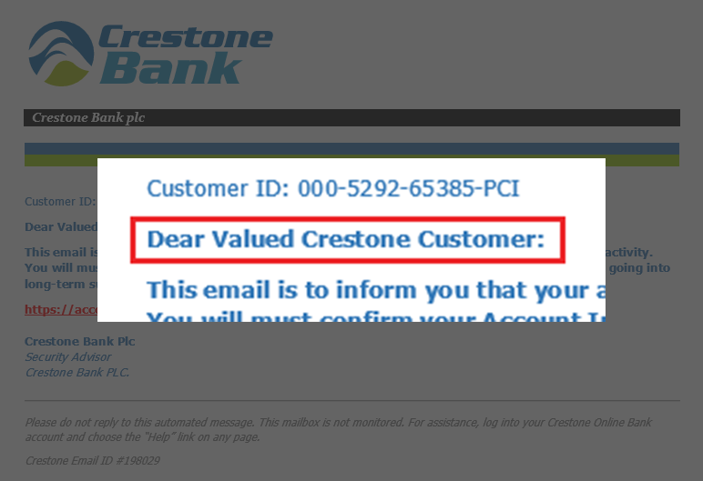

Slide 33
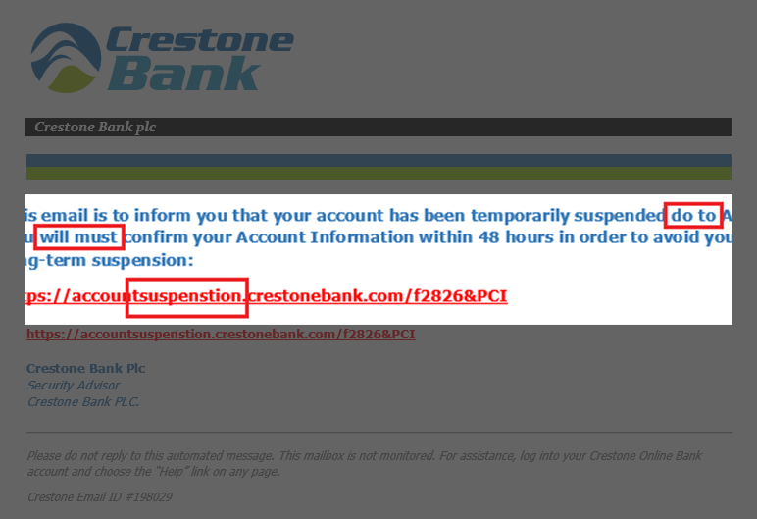

Slide 34
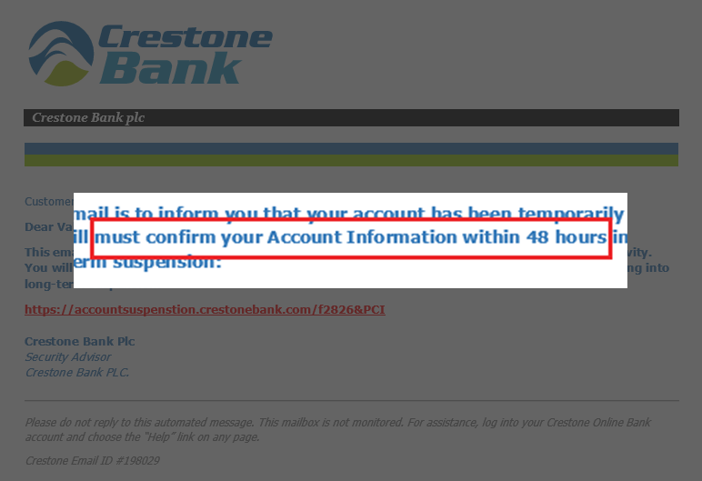

Slide 35
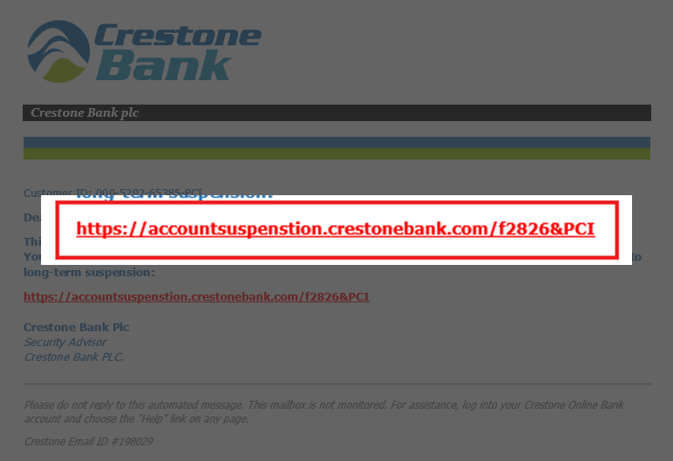

Slide 37
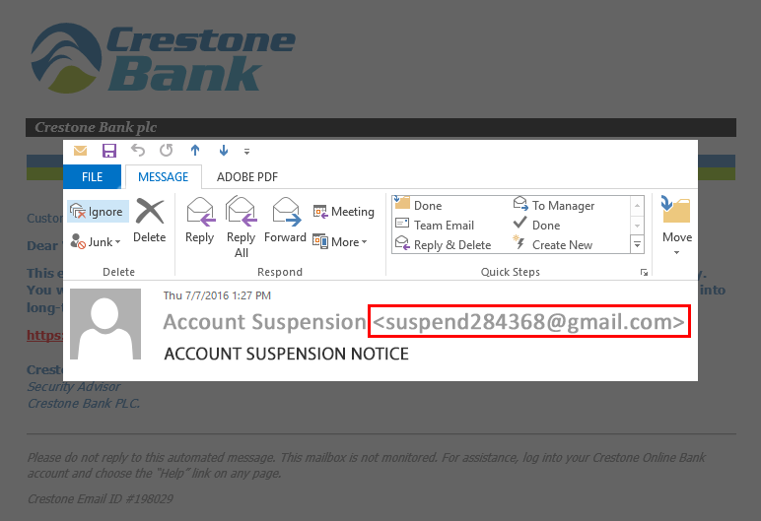

Slide 38
Scenario 3
You will be out on vacation the following week, and your supervisor needs a report run from the RF Business system during that time period. She asks you to write down your login ID and password so that she can log in as you during your absence to run the report. What should you do?

Slide 39
Write down your credential information and give it to her. After all, she is your supervisor. You’re just doing what you were told.
Write down your credential information and place it in a sealed envelope before giving it to her.
Write down the wrong password so she can’t get in using your credentials.
Politely explain that you need to keep your credential information private, and ask her if there is an alternate way to get the report information she needs.

Slide 40
Scenario 4
You are prompted by the RF Business system that your password has expired. You should do the following when choosing a new password:

Slide 41
Choose something long and complex, or choose a pass phrase. Make it unique. Optionally, you can write it down and keep it locked away.
Choose something really easy to remember like your name, your spouse’s name, your phone number, etc. This way you’ll never forget it.
Choose something more difficult to remember, but write it down on a piece of paper and keep it close to your computer so it’s easy to access it if you forget.
Just use the same password as your Facebook account.

Slide 42
Scenario 5
You receive an email from “Administrator” telling you that you all system users need to verify their login and password information. If you don’t do this, your account will be shut down. The helpful administrator provides a link in the email which will direct you to the login page. What should you do?

Slide 43
If it’s from an Administrator, it must be legitimate. Click on the link and enter your login credentials.
Forward the email to all of your colleagues and tell them they also need to do this because the Administrator said so.
Delete the email after you give all of your login credential information, and empty your deleted items.
Do not click on anything, and delete the email.

Slide 44
How to Avoid Viruses and Other Malware
Malware, or “malicious software” is specifically designed to gain access to, or damage a computer without the knowledge of the owner. There are many types of malware including spyware, keyloggers, viruses, worms, ransomware, or any type of malicious code that infiltrates a computer system.

Slide 45
How to Avoid Viruses and Other Malware
Ways malware can infect your computer:
Downloading and installing software from unknown or unreliable sources.
Clicking on email or web links from infected sources.
Sharing files (music, software, etc.) with others.

Slide 46
How to Avoid Viruses and Other Malware
Ways malware can infect your computer:
Sharing removable storage such as USB flash drives and SD cards with others.
Connecting to unsecure public Wi-Fi hotspots.

Slide 47
How to Know if Your Computer is Infected
Your computer may become slow to respond, or crash frequently.
You may see pop-up advertisements.
You may get notifications from friends about email they received from you, but you never sent.
You may notice new toolbars in your web browser, or software that starts automatically.

Slide 48
How to Know if Your Computer is Infected
Your computer’s hard drive may be constantly active, or you may run out of hard drive space.
You may see an unusually high volume of network or Internet traffic.
Your antivirus or security software is disabled.
You may get a ransomware notice demanding payment to unlock your files.

Slide 49
How to Know if Your Computer is Infected
Your computer may never exhibit any symptoms of malware. You may not be aware you are a victim until a crime has been perpetrated against you, such as credit card fraud, bank account money transfer, or intellectual property theft.

Slide 50
How to Prevent Malware Infections
Ensure your systems have anti-malware software installed, and that it is up to date.
Do regular software updates, including operating systems, web browsers, and other software.
Do not log into your desktop PC environment with administrative rights. Establish a user account with limited privileges in order to run day-to-day software and interact with email and your web browser.

Slide 51
How to Prevent Malware Infections
Think before you click. Always be cautious about opening email attachments and web links, and be wary of any emails or phone calls requesting personal information or passwords.
Don’t use open or unsecured Wi-Fi networks.

Slide 52
What to Do if You Suspect Your Computer is Infected
If you suspect your computer is infected with malware, call your computing help desk right away, and follow their instructions.

Slide 53
Scenario 6
You are surfing the web at work when an advertisement pops up offering software that allows you to listen to music on your computer. It promises free unlimited music streaming. All you have to do is download the software and install it on your computer. No ads, no fees, nothing. Should you do it?

Slide 54
Yes. It must be legitimate. Nobody would go through the time and expense of setting up a website and developing the software for this if it wasn’t authentic. If they ask for a credit card for any extra purchases you should give them that too.
No, because it may contravene the acceptable use of technology policy of your organization.
No, because the software may contain malware that could harm your computer and steal your data.
Both B & C.

Slide 55
Scenario 7
You are walking through the parking lot in front of the building you work in, and you see a USB flash drive laying on the ground. Nobody is around that may have dropped it, so you pick it up and bring it inside with you. What should you do with it?

Slide 56
Plug it into your work computer and see what’s on it. If there are files on the drive you should open them up and see what they are. Who knows, you might find something interesting?
Plug it into your work computer and copy the files onto your hard drive to look at them later. Then you can delete the files from the flash drive and use it for yourself.
Tape it to the bulletin board at work with a note saying “Found this in the parking lot. It has some vacation photos on it and a few personal items. Take it if it’s yours.”
Hand in the drive to your office or campus security department. Do not plug it into a computer.

Slide 57
Storing, Transporting, & Transmitting Data Safely
We often only think of security in terms of data residing on computer and network hard drives, but we also need to take special care in protecting data as we transport it (think laptops, tablets, phones, etc.) as well as when we transmit it (email for example, or cloud storage services like DropBox).

Slide 58
Storing, Transporting, & Transmitting Data Safely
Storing Confidential Data:
Backed up to prevent data loss. Since mobile devices are sometimes disconnected from corporate networks, their data may not be backed up as regularly as desktop computers and file servers.
Secured by encryption, which prevents information from being read from a device in the event it is ever lost or stolen.

Slide 59
Storing, Transporting, & Transmitting Data Safely
Special Considerations for Laptops & Mobile Devices:
Hard Drive encryption.
Enable password protection / screen lock, and establish an automatic security timeout after inactivity.
When available, enable the application or feature so that lost or stolen devices can be traced and remotely wiped or cleared.

Slide 60
Storing, Transporting, & Transmitting Data Safely
Special Considerations for Laptops & Mobile Devices:
Make the device available, at the request of the RF, for the purpose of allowing the RF or its designee to review and/or extract work-related information in the event of legal action or investigation. This is also a requirement for personal devices used for RF business purposes.

Slide 61
Storing, Transporting, & Transmitting Data Safely
Transmitting Data:
Sensitive information must be encrypted if transmitted over the public Internet. Email is not encrypted by default, and is therefore not to be used to transmit confidential information. Secure web browsing and file transfer is possible with Secure Socket Layer (SSL). Look for HTTPS and the secure “Lock” icon in web browsers.

Slide 62
Storing, Transporting, & Transmitting Data Safely
Transmitting Data:
Remember, once you transmit sensitive information, you no longer have control of it.

Slide 63
Scenario 8
As part of your job, you use a laptop computer that stores HIPAA information about clinical trial patients. You work in an open office with cubicles which have poor physical security. Which one of the following methods are the most effective in protecting the information stored on your computer?

Slide 64
Lock your computer with a password protected screen saver when you are away from it.
Encrypt the data with a secure password.
Physically secure the laptop when it is not in use.
All of these methods will offer some form of protection for your information.

Slide 65
Scenario 9
You need to send some Protected Personal Information (PII) about a study participant to a colleague in another site location. The information resides in a Microsoft Word document file. Which of the following are acceptable ways of getting that data to your colleague?

Slide 66
Send the file to your colleague via email.
Upload the file to a shared folder on a cloud storage system such as DropBox.
Put the file on a USB flash drive and courier it to your colleague.
Encrypt the file with a strong password, and then use any of the previously mentioned methods.

Slide 67
Reference Material
Federal Trade Commission, Protecting Personal Information: A guide for Business – https://www.ftc.gov/system/files/documents/plain-language/bus69-protecting-personal-information-guide-business_0.pdf
Protected Personal Information (PPI) - 23 CFR 701.115 – https://www.gpo.gov/fdsys/granule/CFR-2012-title32-vol5/CFR-2012-title32-vol5-sec701-115/content-detail.html
Protected Health Information (PHI) - H. REPT. 104-736 – https://www.gpo.gov/fdsys/search/pagedetails.action?granuleId=CRPT-104hrpt736&packageId=CRPT-104hrpt736
Network World – http://www.networkworld.com/article/2995427/malware-cybercrime/how-much-is-your-stolen-personal-data-worth.html
ISO 27001 Information Classification/Handling Matrix
Notes:
Federal Trade Commission
Protecting Personal Information: A guide for Business
https://www.ftc.gov/system/files/documents/plain-language/bus69-protecting-personal-information-guide-business_0.pdf
Protected Personal Information (PPI) - 23 CFR 701.115 - https://www.gpo.gov/fdsys/granule/CFR-2012-title32-vol5/CFR-2012-title32-vol5-sec701-115/content-detail.html
Protected Health Information (PHI) – H. REPT. 104-736 - https://www.gpo.gov/fdsys/search/pagedetails.action?granuleId=CRPT-104hrpt736&packageId=CRPT-104hrpt736
http://www.networkworld.com/article/2995427/malware-cybercrime/how-much-is-your-stolen-personal-data-worth.html
Reference ISO 27001 Information Classification/Handling Matrix

